Slide 1
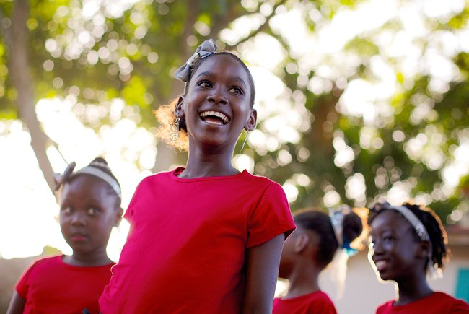
SIX
SHARED
GOALS
Regional GTA Webinars – ESA
Sharing GTA promising practices and strategies that have worked in Mozambique
March 2023

Slide 2
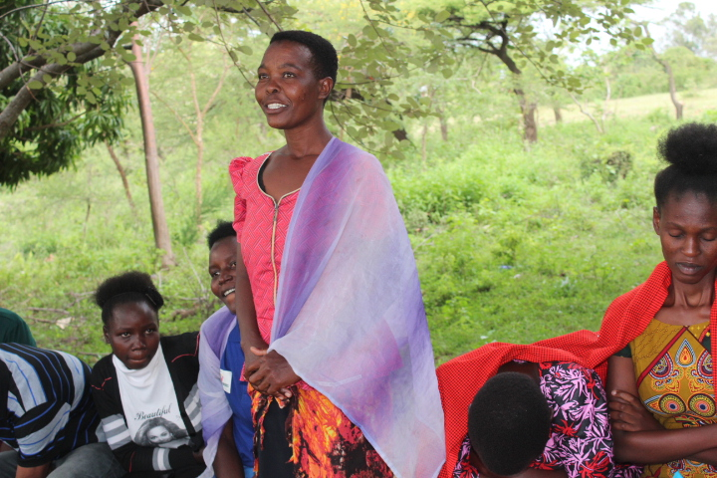
Community members participate in activities as part of a cross-border programme to end child marriage in Kenya and Tanzania
Girls Not Brides/David Owino
East and Southern Africa Gender-transformative collective action to address child marriage – Lessons learned from Mozambique
Notes:
Berta
After welcoming everyone (welcome everyone from all over East and Southern Africa and mention that translation to English is available)
Ask everyone to introduce themselves in the chat (name, name of organisation and country joining from)
Mention the objectives of the webinar.
This webinar will be a space to:
to learn about:
Promotion of Key GNB for GTA
Next steps: reflections from the National Coalition and GNB
Learn – what gender transformative approaches are with examples of best practices.
Learn – with evidence – why gender-transformative collective action is needed to accelerate progress to end child marriage with a particular focus on Mozambique.
Build shared understanding of what ‘gender-transformative’ means, and the core elements needed for gender-transformative programmes and advocacy.
Hear about a gender-transformative journey we’ve taken this year with CECAP in Mozambique together with UNICEF to build gender-transformative skills and practice.
Share with you our learning materials developed during the GTA journey.
Invite you to share your questions and your learning and experience and finally
If you’re a member of a GNB National Partnership or Coalition, we invite you to consider whether you’re ready for a gender-transformative journey to catalyse transformative change at scale as leaders in the national movements in your country.
Welcome Nerida to for welcome remarks.
Call on the government rep for his remarks.
Take over after remarks and mention that after the webinar a recording of the session, key take-aways and resources will be shared by email
Run through agenda and hand over to Eunice.
Summary of Agenda:
A snapshot of progress on CM and girls’ and women’s rights
Making the case for gender-transformative collective action, what this means and what it takes.
The Call to Action for accelerated progress on CM in Africa and an example of the impact of collective gender-transformative action.
Introduction to a gender-transformative journey to strengthen GTA skills, knowledge, and leadership with an opportunity to hear from 3 GTA travellers on that journey.
Time for Q&A (at the end. We will unmute those who indicate that they want to speak, to ask questions using the Q&A button at the bottom of your screen)
Hand over to Eunice
During the presentations, please monitor the chat for questions and note them down so they can be responded to.
After All the panellists finish their session, take over and lead the question and answer session, by asking people to raise their hands and my colleague Noleen can unmute them to ask their questions.
After about 2 or three people ask their questions, next read the questions you have taken from the chat and assign people to respond (me or the Head of Africa for Girls Not Brides), the Gender Advocates or any member of the team if the question is addressed to them.
At the end of the Q&A session
Say the following:
Kindly respond to the feedback Poll that has been shared.
Following the webinar, a recording of the session, key take-aways and resources will be shared by email.
The published Facilitation Guide is linked in the chat.
The published Mozambique GTA Report has been published on Girls Not Brides site.
Thank everyone for coming and bring the webinar to a close.

Slide 3
Interpretation
português - Esta sessão será apresentada em inglês e português. Para aceder aos serviços de interpretação simultânea, clique no ícone do globo na barra inferior do seu ecrã, e seleccione a sua língua preferida (inglês, espanhol, francês, português, ou versão original).
ENGLISH - This session will have presentations in English and Portuguese. To access simultaneous interpretation, please click on the globe icon at the bottom bar of your screen and select your preferred language (English, Spanish, French, Portuguese, or no interpretation).
Notes:
Berta
Please write in the chat box (preferably in Portuguese or English!) if you are having any technical difficulties and a member of our team will be happy to support
Please also use the chat box to post Questions or experience you would like to share. And if you have a question for one of our panellists please do put their name.

Slide 4
What does
“gender-transformative collective action” mean?
Why is it mission critical?
Notes:
What does gender-transformative collective action mean? Why is it mission critical?
So, why is gender-transformative collective action needed to accelerate progress to end child marriage?
What do we mean by ‘GTA’?
What does evidence show is needed, what are the core elements for child marriage programming to transform unequal relationships of power, shift power and resources so that girls in all their diversity can choose if, when and whom to marry?
Sometimes it’s easier to understand why something is important by describing what happens if you don’t do it, so what are some examples of ways of working, programmes or advocacy that are not taking a GTA?

Slide 5
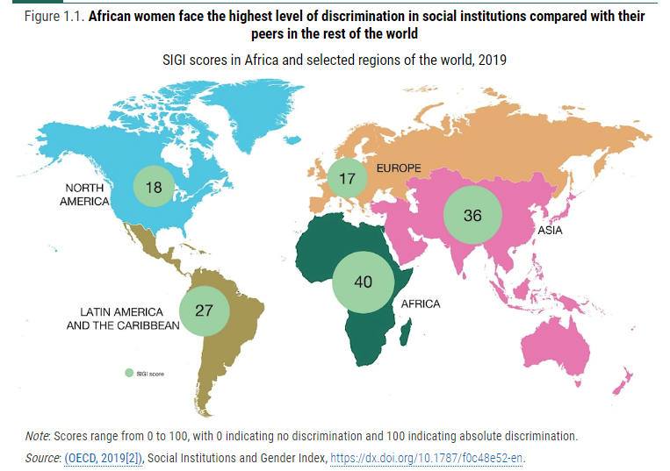
African women face the highest levels of discrimination in the world
Notes:
Eunice
African women face the highest levels of discrimination in the world
The map is a snapshot of SIGI scores for different regions in the world
SIGI is Social Institutions and Gender Index, and measures deeply rooted discrimination and obstacles faced by women and girls in different regions of the world.
The scores aggregate country level data from the Social Institutions and Gender Index which looks at laws, social norms and practices – including child marriage - to measure gender discrimination.
The higher the score the higher the level of discrimination
The highest score of 40 suggests African women experience some of the highest levels of discrimination in the world, including low levels of decision-making power in the family.
Low decision-making power, particularly when compounded by poverty and crisis means few girls can choose if, when and whom to marry.

Slide 6
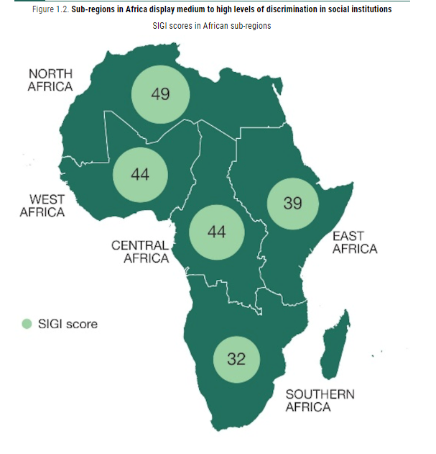
Regional SIGI for Africa
Notes:
Eunice
SIGI in Africa.
Southern Africa fares the best, with a medium level of discrimination and an overall score of 32 compared to the other African sub-regions, and Northern Africa with the worse score. However, this figure is almost double the global average.
East Africa is just one point below the average SIGI score for Africa.

Slide 7
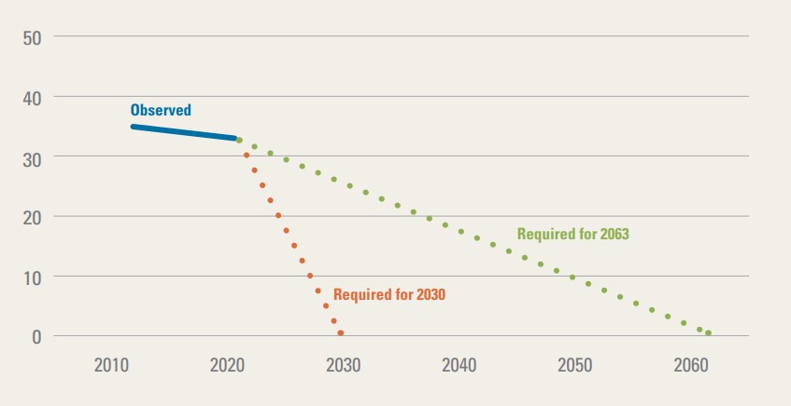
To end child marriage by 2030 Africa needs to accelerate efforts
Child marriage prevalence
SDG 5.3
Africa Union Agenda 2063
Notes:
Eunice
To end child marriage acceleration of effort and change is required.
The blue line shows child marriage prevalence in Africa.
The dotted red and green lines show the rapid acceleration needed to achieve zero child marriage by 2030 and 2063.
The global prevalence of child marriage is 19%. As an aggregated average child marriage prevalence across the ESA is 32%
Unless progress is accelerated, an end to child marriage might not be achieved by 2063 as set out in the Africa Union Agenda 2063. This would mean that girls in Africa would continue to have limited access to rights as shown in the SIGI scores.
To accelerate progress means gender-transformative action at scale and multiple levels.
Graph is from Towards Ending Harmful Practices in Africa: A statistical overview of child marriage and female genital mutilation, UNICEF, New York, 2022.
https://data.unicef.org/resources/harmful-practices-in-africa/

Slide 8
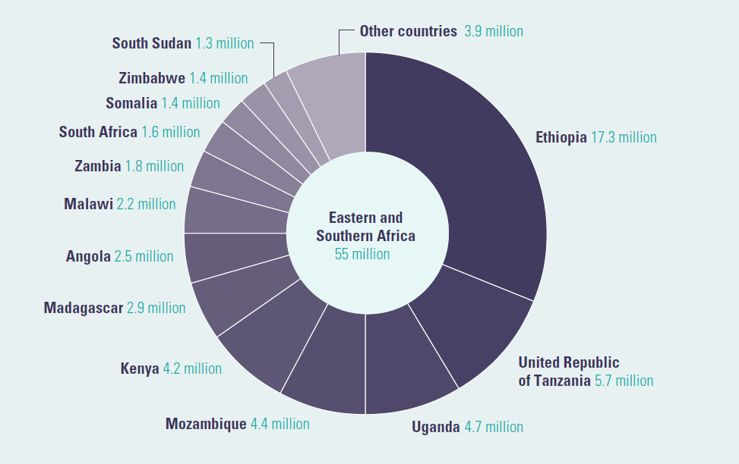
Child Marriage prevalence: East and Southern Africa
Notes:
Eunice
Speaking Notes
East and Southern Africa is home to some 50 million of the over 130 million child brides in Africa, with variations in prevalence as shown in the diagram.
Of this, 4.4 million live in Mozambique. Mozambique also has the highest prevalence of Child Marriage in the region, at 53%.
Two of the countries with the highest prevalence are located in this region (Mozambique and South Sudan)
Child Marriage prevalence in Africa was recorded to have declined in 2015 (when recorded for a 25-year period, 1990-2015) but by just 1/5th. However, like we have seen varied prevalence across countries continues to contribute to this slow reduction and high prevalence.
Overall prevalence is decreasing, but not fast enough; slow declines + steep population growth means the number of child brides in Africa is increasing; and by 2050, there might be more than 1 in 4 child brides.
The map is from the UNICEF publication, ‘Child Marriage in East and Southern Africa: A statistical overview and reflections on ending the practice, June 2022’. https://data.unicef.org/resources/child-marriage-in-eastern-and-southern-africa-a-statistical-overview-and-reflections-on-ending-the-practice/

Slide 9
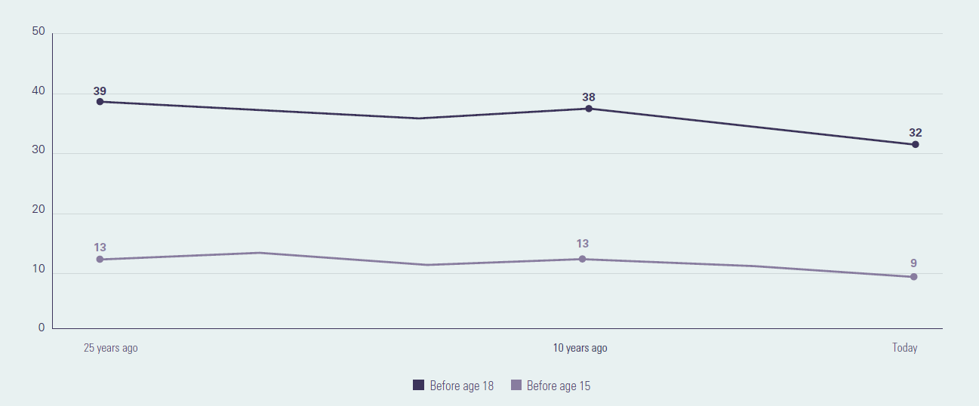
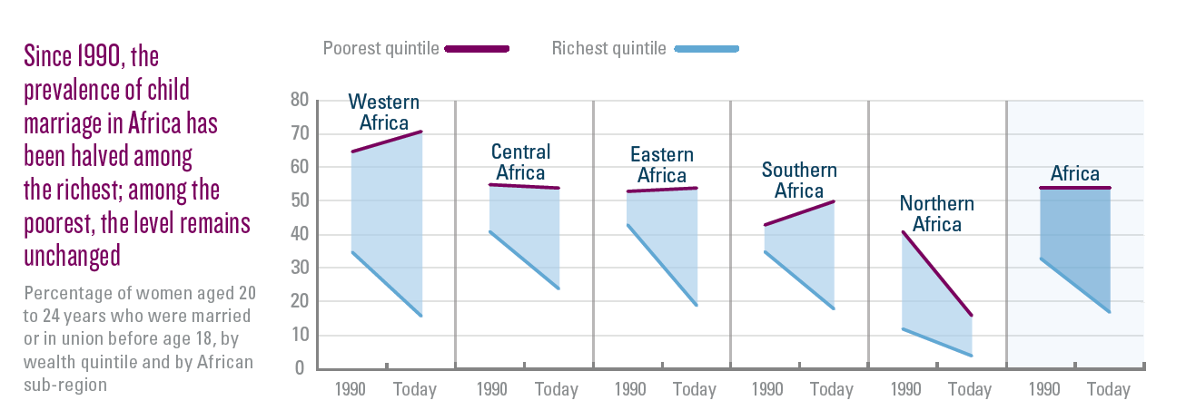
How child Marriage is changing in ESA
Notes:
Eunice
The pace of reduction in prevalence has been slow; for instance over a 25 year period, child marriage in ESA reduced by only 7% for girls before the age of 18; and 4% for girls before the age of 15.
But in Mozambique, prevalence of girls marrying before the age of 18 increased by 2%, from 51% in 1990 to 53% in 2015.
This progress, though, has not been equitable; high levels of child marriage among the poorest have persisted, while declines in the practice have been limited to the richest.
36% of girls in the world’s lowest-income countries and 35% in the world’s most fragile contexts marry before 18, almost double the global average
This trend is also same for education status; where there are twice as much child brides amongst women with no education or primary education than there are among women with secondary education or higher.
The map is from the UNICEF publication, ‘Child Marriage in East and Southern Africa: A statistical overview and reflections on ending the practice, June 2022’. https://data.unicef.org/resources/child-marriage-in-eastern-and-southern-africa-a-statistical-overview-and-reflections-on-ending-the-practice/

Slide 10
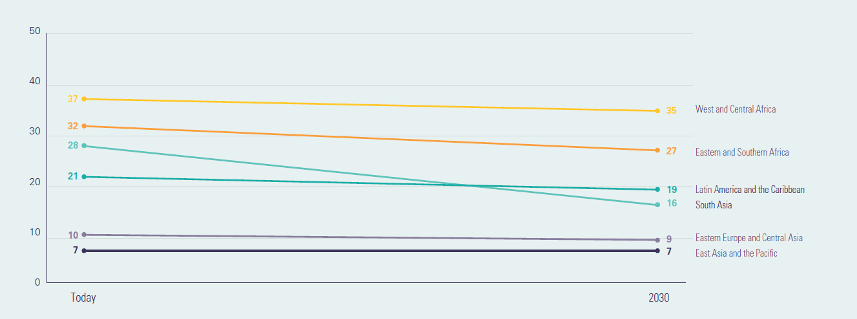
How child Marriage is changing in ESA
Notes:
Eunice
If progress continues at the current pace and is not accelerated, then there will an estimated 20 million more child brides in the ESA region; and prevalence would only have reduced by only 5%, by 2030. This means that the region would not have achieved target 5.3 of SDG 5.
The map is from the UNICEF publication, ‘Child Marriage in East and Southern Africa: A statistical overview and reflections on ending the practice, June 2022’. https://data.unicef.org/resources/child-marriage-in-eastern-and-southern-africa-a-statistical-overview-and-reflections-on-ending-the-practice/

Slide 11

What is a gender-transformative approach?
A transformative approach promotes gender equality by | Fostering critical examination of inequalities and gender roles, norms and dynamics
 | Recognising and strengthening positive norms that support equality and an enabling environment
 | Promoting the relative position of women, girls and marginalised groups
 | Transforming the underlying social structures, policies and broadly held social norms that perpetuate and legitimise gender inequalities
One African member’s definition of a gender- transformative approach:
When you cut a tree from the roots then it will not grow again. When you cut a branch, it will continue.
Notes:
Eunice
What is a gender-transformative approach?
Speaking notes
A gender-transformative approach is one that promotes gender equality by
Fostering critical examination of inequalities, gender roles, norms and power dynamics
Recognising and strengthening norms that support equality and an enabling environment.
Promoting the relative position of women, girls, and marginalised groups
Transforming the underlying social structures, policies and behaviours that perpetuate and legitimise gender inequalities.
One member shared an interesting definition of gender transformative approaches:
“When you cut a tree from the roots then it will not grow again. When you cut a branch, it will continue.”
We can only end child marriage if we address the root causes of gender inequality.
We will not achieve gender equality unless we address child marriage.
We’re committed to both: our vision statement goes beyond a world without child marriage to one where girls and women enjoy equal status with boys and men and can achieve their full potential.

Slide 12
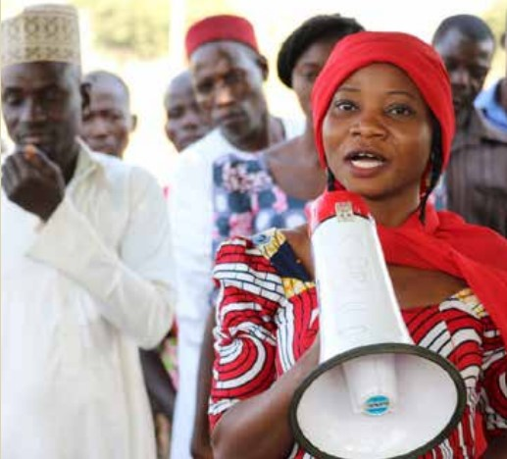
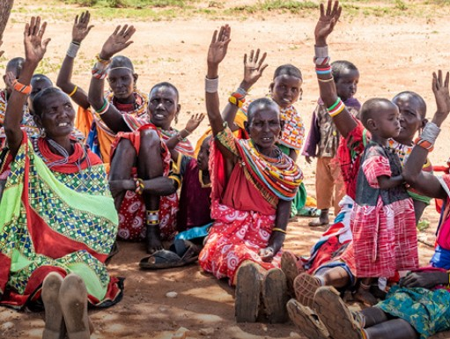

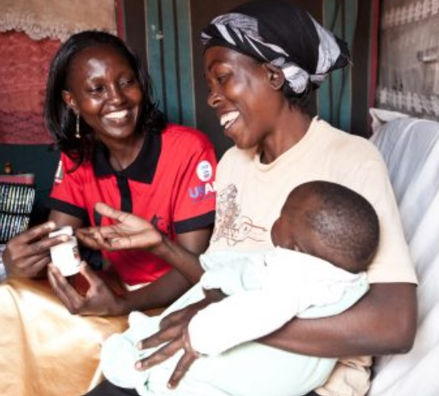

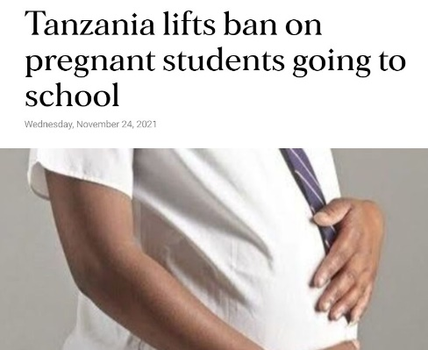
Core elements of a gender-transformative approach
1. Adolescent girls’ skills, agency, and leadership
2. Enabling environment, family and community mobilization
3. Addressing masculinities and engaging men and boys
6. It’s cross-cutting and needs to be integrated across all gender-transformative work - gender norms and inequalities
5. Policy & structural change, and institutional partnerships (incl. laws & policies)
4. Services and multi-sectoral collaboration
Source: Technical Note on GTA in the Global Programme to End Child Marriage, UNFPA, UNICEF and UN Women
Notes:
Eunice
Core elements of a gender-transformative approach?
Speaking Notes
The Global Programme to End Child Marriage Technical Note on Gender-transformative approaches describes 6 core elements of a gender-transformative approach –or if you prefer jargon-free, ways to uproot a tree
These are from left to right and top to bottom
Core element 1: Adolescent Girls’ Skills, Agency and Leadership
Core element 2: Enabling Environment, Family and Community Mobilization
Core element 3: Addressing Masculinities and Engaging Men and Boys
Core element 4: Services and multi-sectoral collaboration
Core element 5: Policy and Structural Change and Institutional Partnerships , including laws and policies
Core Element 6 is cross cutting and needs to be integrated cross all gender-transformative work, namely Gender Norms and Inequalities
Child marriage is a complex issue which needs a complex solution – this means collaborating with a constellation of actors to catalyse change in individuals, institutions and multiple sectors.
Six words beginning with the letter ‘p’ help me to cut through the complexity. They are:
Power and Privilege – in our engagement, how are we catalysing progressive norms to rebalance power and privilege?
Political and Personal – how does our collective action advance accountability for quality gender- equitable services, policies, laws, markets, and budgets to create alternatives to child marriage? And how am I working on my own privilege and prejudice to be the best I can for girls’ and women’s rights.
Potential and People – how do we centre the voice and priorities of girls and young people, respect and value their diversity, and promote their decision-making power.

Slide 13
The consequence of not taking a gender-transformative approach
Some members have been able to rescue girls from forced marriages and these girls are now dependent on us. This is a major problem for us and for our respective institutions. What is the point of rescuing girls from marriage if we are not able to support them afterwards – to return to school or learn a skill?
Girls are unable to fulfil their potential
Gains made are concessions rather than entitlements
Alternatives are not created
Educated girls are higher value brides
Increased risk of backlash
Drive the practice underground increasing girls’ vulnerability
Notes:
Eunice
The consequences of not taking a gender-transformative approach
Speaking notes
To strengthen the case for gender-transformative action here are some consequences of NOT using gender transformative approaches.
The quote on the left is from a Girls Not Brides member, to summarise:
Some members have been able to rescue girls from forced marriages but what is the point if we can’t support them afterwards?
Without systems and services in place what is the future for girls who courageously go against the wishes of family and social norms? And what are the alternatives to child marriage?
This was the same for a girl who I heard said, given her time again she would choose the cut – FGM, in preference to the isolation, poverty and indignity of her daily life since being forced to leave family and home following her refusal to have her genitals mutilated in line with the norm.
Raising the legal minimum age of marriage in isolation can drive the practice underground, replace formal marriage with informal unions (where girls might have fewer rights), delay the age of marriage, possibly, but with little change to the empowerment (economic and life skills such as decision-making power), status and safety of girls and adolescents.
And we know that those challenging the status quo are put at risk without the enabling environment and support needed for activism and advocacy.

Slide 14
Experience Sharing
Eunice, Please respond to this question
What was your role during the GTA IW, the strategies you used, as a member of the facilitation team to strengthen GTA capacities of members, overview of the tools and resources we used?
Notes:
Eunice

Slide 15
Taking a gender-transformative journey
Strengthening gender-transformative skills, knowledge and leadership
Notes:
Estrela
Taking a gender-transformative journey: Strengthening gender-transformative skills, knowledge and leadership
The starting part for this journey was alignment between the mission and vision of the UNFPA-UNICEF Global Programme to End Child Marriage, the UN/EU Spotlight Initiative to eliminate all forms of VAWG and the Girls Not Brides global partnership commitment to build civil society action to end child marriage.
Key participants on this gender-transformative journey include members of GNB’s National Partnership in Mozambique – CECAP – with a key role played by NP member AMODEFA as CSO Lead.
UNICEF HQ, WACA and ESA Regional and Country offices, plus government representatives
And a special mention to the role played by the 3 Gender Advocates who functioned as lead facilitators of the workshops, and continue to support application or promotion of the learning supporting CSO members, including the Road Map Action plan sessions.
The GNB gender-transformative journey is an adaptation and extension of UNICEF’s Gender-Transformative Accelerator Tool which they piloted in African and Asian global programme countries with GP staff from UNFPA and UNICEF.
The change desired through investment in this and future stages of the gender-transformative journey is to recognise the power of collective action and the unique role civil society can play in building the critical mass and consciousness needed from individual to institutional level to enable girls to fulfil their potential and exercise voice and choice.

Slide 16
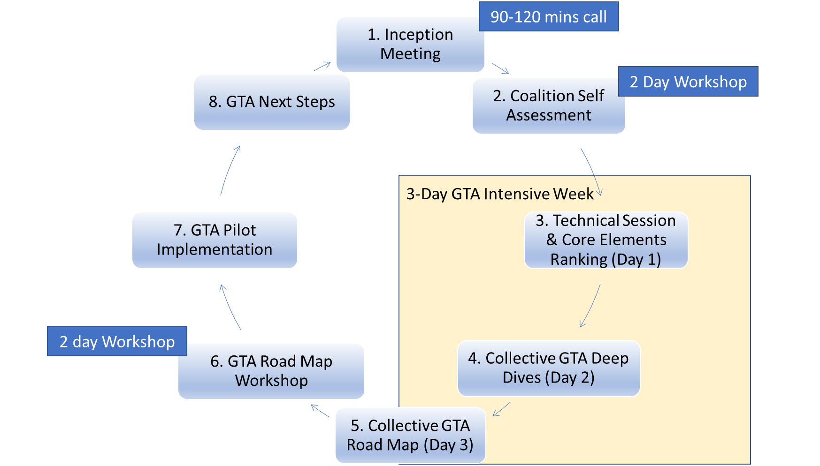
Stepping-stones in a gender-transformative journey
Notes:
Estrela
Stepping stones in a gender-transformative journey
Just to say again the tools, slides, resources, agendas, examples and steps will be made available in the CSO Facilitation Guide to be published and promoted on the GNB website, in English and Portuguese.
The Facilitation Guide supports workshop-based critical reflection and action planning to end child marriage as a CSO collective that is informed by external evidence and the experience and perspectives of CSO members and those most affected by child marriage
In the slide we see the 7 stepping stones that mark the gender-transformative journey over a period of 12-14 months
In brief:
Step 1: Inception Meeting, setting the compass, agreeing who does what
Step 2: Organisational self-assessment, a 1 or 2 day workshop
Steps 3,4 and 5 – The 3 days of the GTA Intensive Week of workshops with all members
Steps 6 – Finalising the GTA Road Map and GTA pilots, can be a 2 day workshop.
Step 7 – Implementation of actions and activities set out in the GTA Road Map.
Step 8 - Planning next steps in the GTA Journey, as capacity assessment/learning needs will have emerged along the way and building gender-transformative skills and leadership is a long-term process that requires long-term investment.

Slide 17
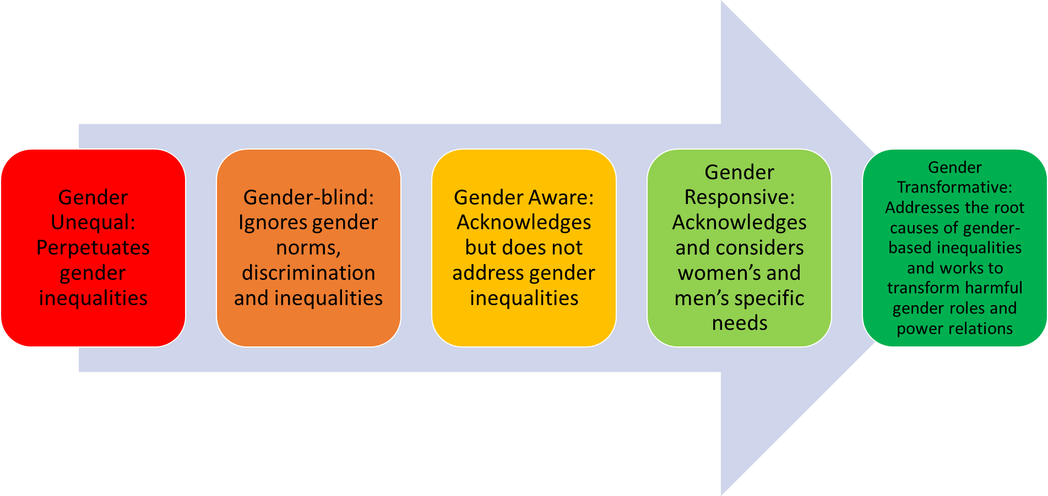
Moving across the Gender Integration Continuum to accelerate progress to end child marriage
Accelerated progress on child marriage
Notes:
Estrela
Moving across the Gender Integration Continuum to accelerate progress to end child marriage
Underpinning the gender-transformative journey is the Gender Integration – sometimes called Equity – Continuum.
This is familiar I’m sure to many of you
The process of gender integration means critically reflecting on the impact of gender norms, roles and dynamics, including unequal relationships of power, and identifying how to transform and overcome them for women, girls and gender minorities to exercise their equal rights and power, including if, when and whom to marry.
At one end (left) of the Continuum gender is not addressed, or gender norms and roles are exploited, which perpetuates gender inequality and worse can be harmful. Moving along the Continuum to the right passing through Gender-aware and Gender-responsive toward Gender-transformative shows active commitment to addressing the root causes of gender inequality which will in turn it is believed lead to change in the lives of girls.
Progress – sometimes called moving the needle – along the gender integration continuum is the only pathway to accelerate progress to end child marriage at scale, safely and sustainably

Slide 18
Summary Scores of the Girls Not Brides Self Assessment Scorecard
Notes:
Estrela
This slide refers to Step 2 on the GTA cycle. It shows the key headline of the Girls Not Brides’ Self-Assessment Scorecard (an organisational self-assessment tool). This step is not part of the original UNICEF GTA Accelerator but was included knowing that gender-transformative action requires gender-transformative organisational practice. Or in other words, it requires organisations to ‘walk the talk’.​
In the slide we see an example of the aggregated scores of members of one collective, 1 being the least and 3 the highest.

Slide 19
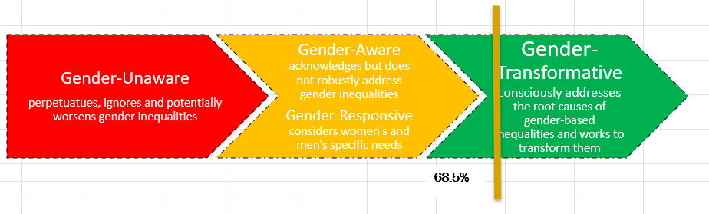
Gender Transformative Elements of the Self Assessment Scorecard.
6 Scorecard Principles that are essential for GT organisational practice
1 Parceria diversificada e inclusiva
2 Liderança por e para mulheres, jovens e pessoas das comunidades mais afetadas pelo Casamento prematuro
3 Engajamento activo com coletivos de mulheres, redes de jovens, grupos de direitos das minorias
4 Abordagens que abordam as causas profundas do casamento prematuro para promover os direitos e a agência das meninas
5 Advocacia para abordar os impulsionadores estruturais do casamento prematuro informados por análise de género e poder.
6 Casamento prematuro efetivamente enquadrado como uma prioridade de direitos de meninas e mulheres
Notes:
Estrela
In this slide we can see the 6 principles of the Scorecard that were pre-selected for their importance to gender-transformative organisational practice.
The result in the line chart above is the result of aggregated scores for the 6 principles.
A recurring theme is that the scores are not what matters, as this is not intended to highlight high scoring or low scoring Coalitions; but rather to stimulate reflection and discussion​s on each of the themes.

Slide 20
Key Takeaways
Estrela, Please include key takeaways/learning points from the GTA Intensive Week.
Notes:
Estrela
Observed changes

Slide 21
Experience Sharing
What were the expectation of members, experiences of GTA before the IW?
What were some of the exciting reactions to the ‘new’ information on GTA?
What have you seen changing in the member you work with and CECAP as a whole? What can you share as evidence to these changes?
Notes:
Estrela

Slide 22
Gender transformative promising practice in ESA/Mozambique
Notes:
Mercy
Speaking Notes
There are a few slides from the Mozambique evidence review that follow.

Slide 23
Experience Sharing
The Journey: What was CECAP’s position (on the gender integration continuum) at the start of the GTA Journey and where is it now?
Please put together a set of slides with pictures to show how CECAP activities have been shifting power and resources for girls, building girls’ agency and leadership, putting into practice Gender Transformative Approaches
What will/is CECAP doing differently to strengthen it Gender Transformative Approaches.
What are some of the changes in GTA skills and knowledge of colleagues and member staff and changes in organisational culture of CECAP?
What are some priorities and approaches for collective action in terms of gender transformative approaches
Notes:
Mwema

Slide 24

Mwema Uaciquete
Gender Advocate Mozambique and Behaviour Change Advisor with Pathfinder Int’l.
Notes:
Berta

Slide 25
Q & A
Notes:
Berta

Slide 26
Links to key resources
Technical Note on Gender-Transformative Approaches (2020) UNFPA/UNICEF and UN Women
Here
Gender-Transformative Accelerator (2021) UNFPA/UNICEF
Here
Gender-transformative education. Reimagining education for a more just and inclusive world (2021) Plan International
Here
Ending child, early and forced marriage is crucial to gender equality (2020) Girls Not Brides
Here
Tackling the Taboo: sexuality and gender-transformative programmes to end child, early and forced marriage and unions (2019) The Child, Early & Forced Marriage & Unions and Sexuality Working Group
Here
Transcending Norms: Gender-Transformative Approaches in Women and Girls’ Safe Spaces in Humanitarian Settings (2021) UNFPA
Here
Enhancing Social Norms Programs: An Invitation to Rethink “Scaling Up” From a Feminist Perspective (2021) CUSP
Here
Gender-Transformative Budgeting: A Guide for Pan-African Parliamentarians (2019) FEMNET
Here
Notes:
Lara

Slide 27
THANK YOU!

