Slide 1

The Child Marriage Research to Action Network (The CRANK)
This session will have presentations in English. To access simultaneous interpretation, please click on the globe icon at the bottom bar of your screen and select your preferred language (English, Spanish, French, Hindi, Bangla or no interpretation).
Esta sesión tendrá presentaciones en inglés. Para acceder a los servicios de interpretación simultanea, por favor haga clic en el icono del globo que encontrará en la barra inferior de su pantalla, y seleccione su idioma de preferencia (inglés, español, francés, hindi, bangla o version original).
Cette session comprendra des présentations en anglais. Pour accéder aux services d'interprétation simultanée, veuillez cliquer sur l'icône globe que vous trouverez dans la barre inférieure de votre écran, et sélectionnez votre langue préférée (anglais, espagnol, français, hindi, bangla, ou version originale).
यह सत्र अंग्रेज़ी में प्रस्तुत किया जाएगा। अपनी सुविधा अनुसार अनुवाद सुनने के लिए, कृपया अपनी स्क्रीन के नीचे दिए गए ग्लोब आइकन पर क्लिक करें और अपनी पसंदीदा भाषा चुनें — अंग्रेज़ी, स्पेनिश, फ़्रेंच, हिंदी, बांग्ला या विकल्प "कोई अनुवाद नहीं"।
এই সেশনটি ইংরেজিতে পরিচালিত হবে। আপনি যদি নিজের সুবিধামতো অনুবাদ শুনতে চান, তাহলে স্ক্রিনের নিচে থাকা গ্লোব আইকনে ক্লিক করুন এবং আপনার পছন্দের ভাষা নির্বাচন করুন — ইংরেজি, স্প্যানিশ, ফরাসি, হিন্দি, বাংলা অথবা “কোনও অনুবাদ নয়”।
Notes:
Translations are available in English, French and Spanish – please chose the channel of your choice clicking on the globe icon at the bottom of the screen.
This session will be recorded and recordings will be shared along with key notes from the session in the follow up resources communication

Slide 2
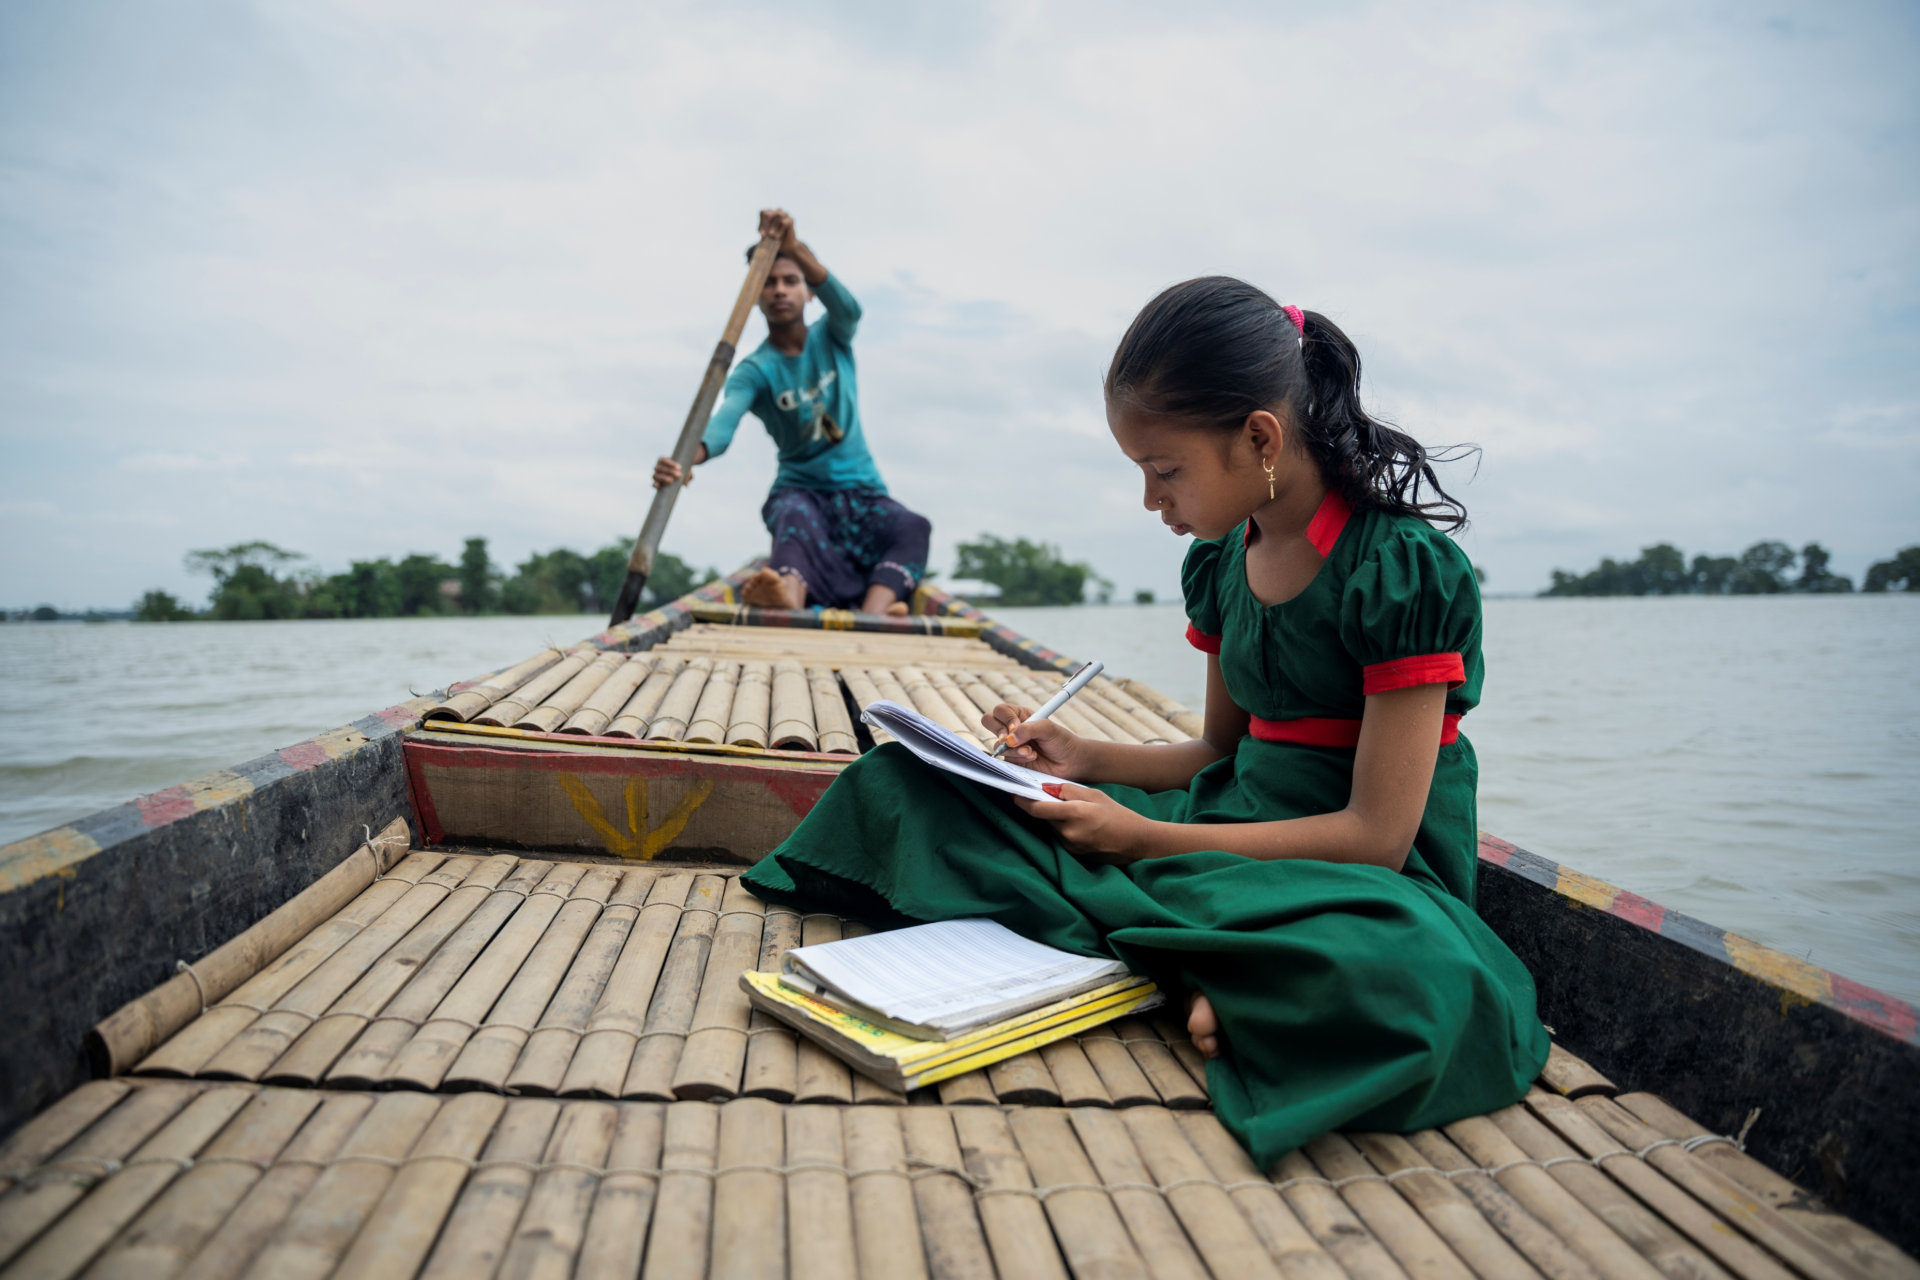
The interlinkages between climate change and child marriage – Learning from emerging evidence and practice
The Child Marriage Research to Action Network (The CRANK)
© UNICEFUNI565846Das
Photo: © UNICEF/UNI636920/Himu
10 April 2025

Slide 3
Agenda
Time (UK) | Discussion
14:00 - 14:05 | Welcome Opening welcome: Dr. Faith Mwangi-Powell, CEO Girls Not Brides: The Global Partnership to End Child Marriage
14:05 - 14:12 | Setting the scene: Mohinder Watson
14:12 – 14:55 | Learning from the latest evidence – implications for research, practice and policy: Chiagozie Udeh, Global Scoping Review on Environmental Crisis and Child Marriage Sajeda Amin, Proximal, Distal, and Life-course Effects of Climate Change on Child Marriage: Evidence from Bangladesh Loretta Adowaa Asare, The social consequences of climate change: a qualitative analysis of early girl child marriage as an informal adaptation strategy among rural communities in Northern Ghana Alissa Koski, The effect of extreme weather events on the frequency of child marriage
14:55 - 15:10 | Discussion – Mohinder Watson
15:10 – 15:20 | Learning from promising strategies Ramatoulaye Dieye, Regional Gender Advisor, World Food Programme Reetika Revathy Subramanian, Creator Climate Brides
15:20 - 15:35 | Discussion – Mohinder Watson
15:35- 15:40 | Bringing it all together – Mohinder Watson
15:40 – 15:45 | Close – José-Roberto Luna Manzanero, UNFPA

Slide 4
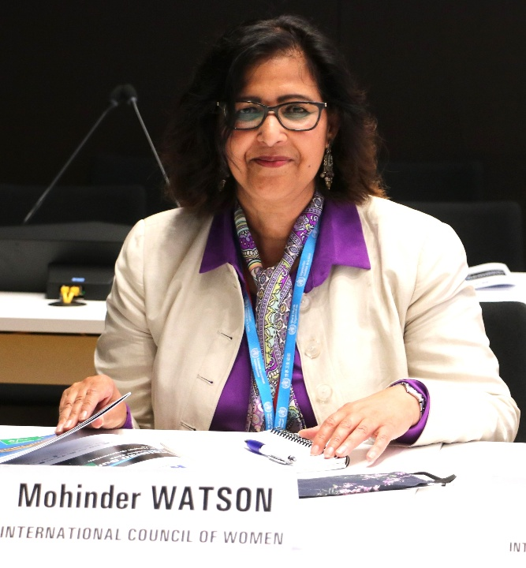
Moderator
Dr. Mohinder Watson is a researcher, writer and activist who has been advocating against child marriage for over a decade and serves as the Main UN Geneva representative for the International Council of Women.
In March 2022 she convened the first ever global Expert Group Meeting on the evidence for the nexus between climate change and child marriage. She has continued with this work and in February 2024 gave a briefing to the UN CEDAW committee in Geneva on the evidence for the links between climate change and child marriage.

Slide 5

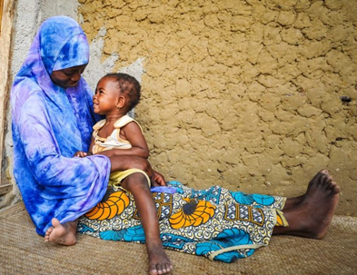
Learnings from Expert Group Meeting on Evidence for the Nexus between Climate Change and Child Marriage, March 2022
© Mohinder Watson, PhD MPH
Email:mohinderw@bluewin.ch
Researcher on child marriage and VAWG
UN Representative Geneva, International Council of Women

Slide 6
Background to March 2022 Expert Group Meeting to explore evidence for the nexus between climate change and child marriage
In late 2021 when writing a brief on the links between climate change and child marriage, found little literature and existing data was fragmented
Why? Possibly because link is not immediately obvious, as it is indirect and not direct and our tendency is to work in silos (SDG 13 and SDG5).
The technological/scientific framing of climate change downplays impact on peoples’ lives/livelihoods - especially women/girls who are disproportionately affected
Identified a research gap, need to understand the inter-linkages, increase awareness
Held virtual Expert Group Meeting – I thank all our wonderful participants – academics, journalists, UNICEF, CARE Mozambique, World Vision, climate change activists, Stanford Univ, NGOs and more. Links to Expert Group and CEDAW reports are in the chat.
Findings were presented to the UN CEDAW committee in a briefing in February 2024
In October 2024 when invited to speak on climate change and child marriage in Geneva, I briefly reviewed evidence since 2022. I mentioned one study from Ghana and two systematic reviews by Docherty et al 2023 and Palmer et al 2024. Although no conclusive evidence of link yet, it has been reported in over 20 countries.

Slide 7
Unpacking pathways to child marriage in the context of climate change
Vulnerable families maybe pushed deeper into poverty – eg if crops fail, resort to child marriage as maladaptive coping strategy- reduce family size - one less mouth to feed.
Families may be displaced, which increases security concerns eg fear of sexual violence. Misguided beliefs that CM can mitigate such risks and protect family honour.
Girls married early for safety reasons - eg families living in flood plains may arrange early marriages to enable girls to move to safer locations away from climate risks
Disruption to girls’ education eg if schools are closed due to damage/destruction or if schools are used as temporary shelters, this can increase child marriage. Schooling is a protective factor against CM, so very important.
Gender discrimination becomes intensified with increasing poverty - boys’ education is prioritized, and girls often taken out of school and married early. In the absence of social protection, boys are often expected to take care of parents in their old age and so are prioritised, whereas girls are expected to move away to their marital homes.
Marriage transactions such as bride price and dowry can incentivise CM- Bride price can generate income for girls’ families. Dowry payments made to the groom’s family may be reduced or removed altogether in exchange for the early marriage of girls.
Note: often a combination of many factors rather than any single factor drives CM.

Slide 8
Recommendations
1. Implement and enforce laws/policies - 18 minimum age of marriage
2. Build climate resilient education systems, prioritize girls' education even during crises
3. Promote gender-responsive climate adaptation/mitigation strategies - empower women/girls to become leaders/decision makers, address GBV and integrate child protection policies in all programming from the start, not as an after-thought.
4. Invest in climate resilient communities: eg early warning systems, infrastructure, water/resource management, crop diversification, alternative livelihoods and social protection systems as a safety net to prevent families resorting to child marriage,
5. Address social norms – “Localise SDGs” – work in communities, engage men and boys, religious leaders, village chiefs/elders, teachers, health care workers etc.
6. Adopt and integrate children’s rights and human rights-based approaches: promote/protect rights of women and girls in all their diversity
7. Looking ahead –We need more research to build a robust body of independent and impartial evidence to inform policy making and programming. We need statistics on how many girls are affected and where. We need to localise the SDGs and work with communities to co-create sustainable solutions which also advance local development.

Slide 9
Thank you
Please download our Expert Group Meeting and CEDAW Briefings from the chat.
The work we started in 2021 is ongoing. We will hold a second Expert Group Meeting when we have much more data to advance this topic.
Mohinder Watson, PhD MPH
mohinderw@bluewin.ch

Slide 10
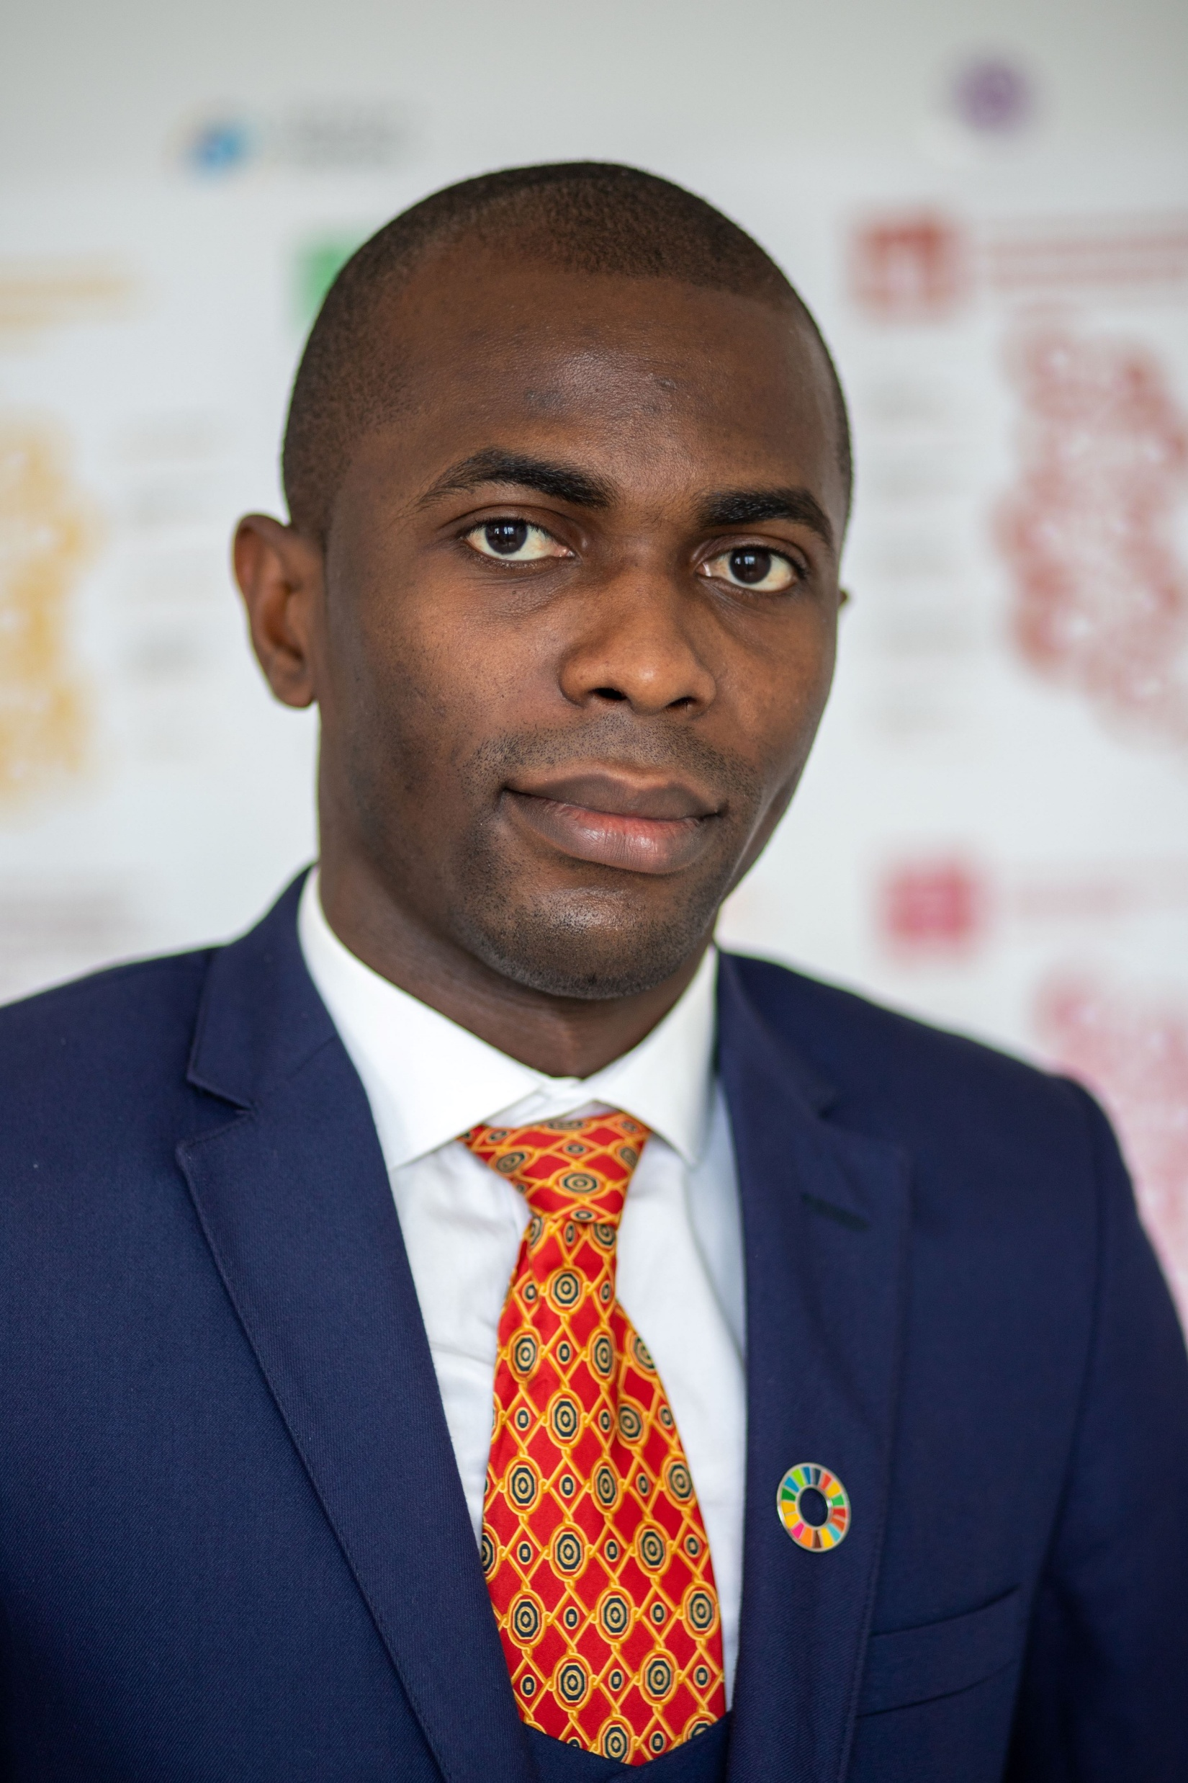
Speakers
Chiagozie Udeh works on climate adaptation programming, and climate change policy and advocacy in the UNFPA East and Southern Africa Regional Office. Using gender-transformative adaptation approaches, he supports the integration of SRHR and gender in national climate policies.
He also coordinates the Joint Youth Working Group on SRHR and Climate Change and has served as the Global South Focal Point of YOUNGO, the Youth Constituency to the UNFCCC.

Slide 11
Climate Change and Child Marriage: Global Evidence
10 April 2025; Chiagozie Udeh

Slide 12

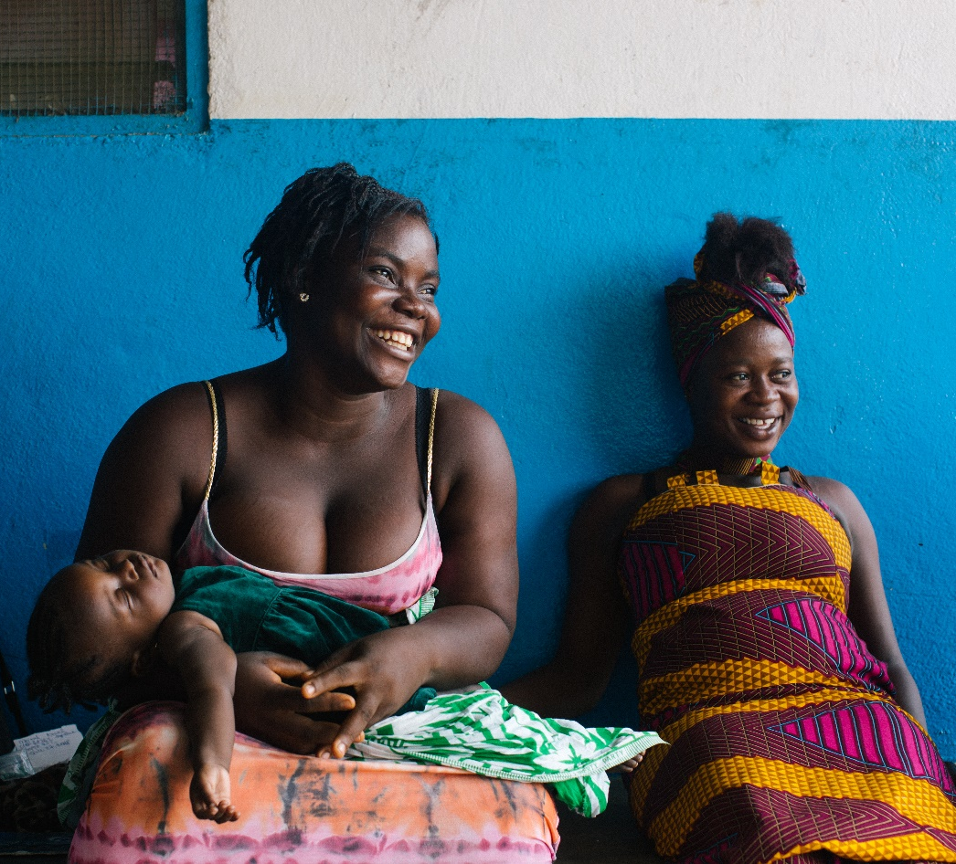
UNFPA and Queen Mary University London: Scoping Review of the Impact of Environmental Crisis and Child Marriage
Lead authors: Daniel Pope & Heather McMullen,
Co-authors: Angela Baschieri, Anandita Philipose, Chiagozie Udeh, Julie Diallo, & David McCoy
Reviewed academic and ‘grey’ literature on the link between environmental crises and child marriage.
Conducted a search of Google Scholar, Scopus and MedLine for both peer-reviewed academic literature and 'grey' literature.
Total of 24 relevant articles
Both quantitative and qualitative work.

Slide 13
^{Summary} of the evidence from the scoping review
Local socio-cultural contexts such as bride price or dowry practices further shape how these factors affect child marriage.
1
The review shows environmental crises worsen known drivers of child marriage
2

Slide 14
1. Environmental crises worsen known drivers of child marriage

Slide 15
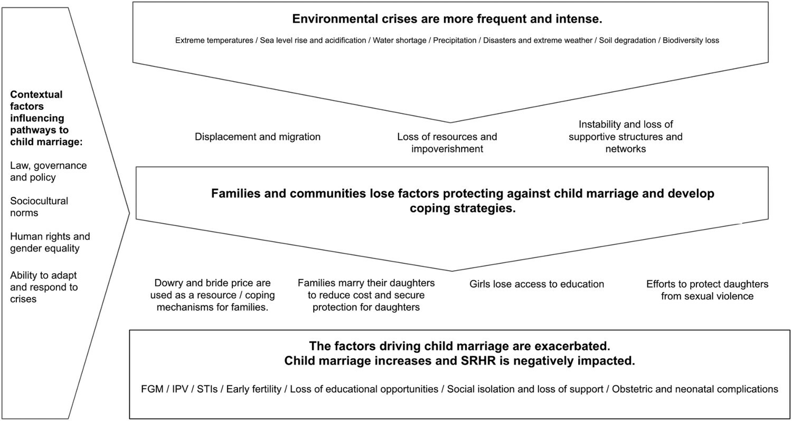
A conceptual framework showing intersection of CC & CM
Notes:
This is a conceptual FW

Slide 16
“The floods took all our harvest… I tried to negotiate to tell my parents […] that I didn’t want to get married, but they told me that I had to because that would mean one less mouth at the table.”
Chamberlain et al., 2017) MALAWI

Slide 17
Key pathways through which environmental crisis drives child marriage
Loss of Livelihoods
Coping strategy in response to the loss of assets & income after droughts, floods etc
Sexual violence and FGM
CC can lead to rise in sexual violence with CM perceived as a means to protect children and the family’s reputation from sexual violence.
Risk of more girls undergoing FGM to get married for better bride price.
Education disruption
Disrupt education directly (e.g. destruction of school infrastructure) and indirectly (e.g. worsening poverty
Displacement
CM has been seen to increase among displaced populations and also in anticipation of environmental disaster to move daughters away from high risk.
Dowry and bride price
Prevalence of dowry or bride price practices appears to contribute to how economic shocks from environmental crises can affect decisions around child marriage
Notes:
What is the pathway from and to – drivers?

Slide 18
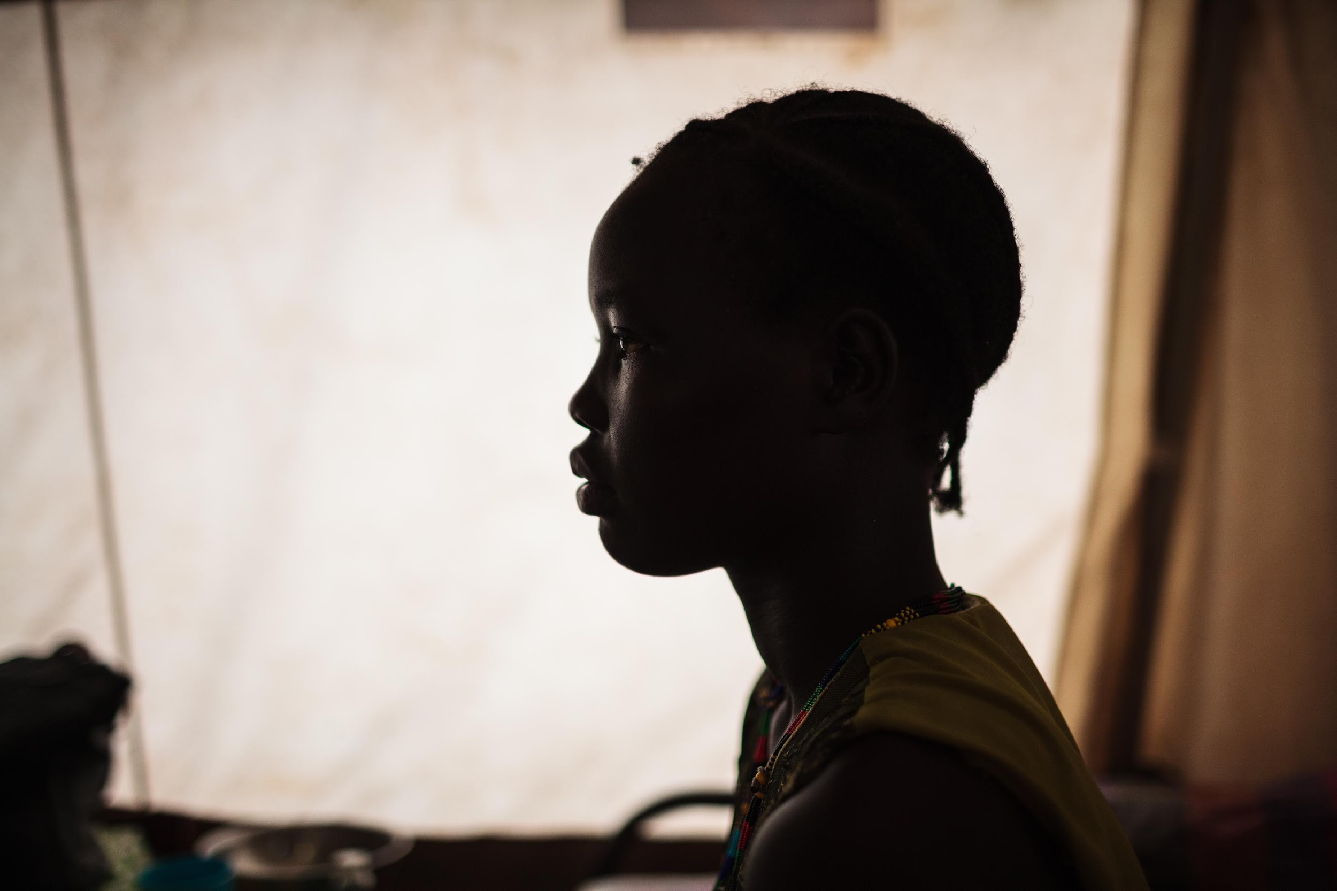
By 2025, climate change will cause at least 12.5 million girls in 30 low and lower-middle income countries to abruptly stop attending school annually (Malala Fund, 2021).
22 of those countries are in Africa.

Slide 19
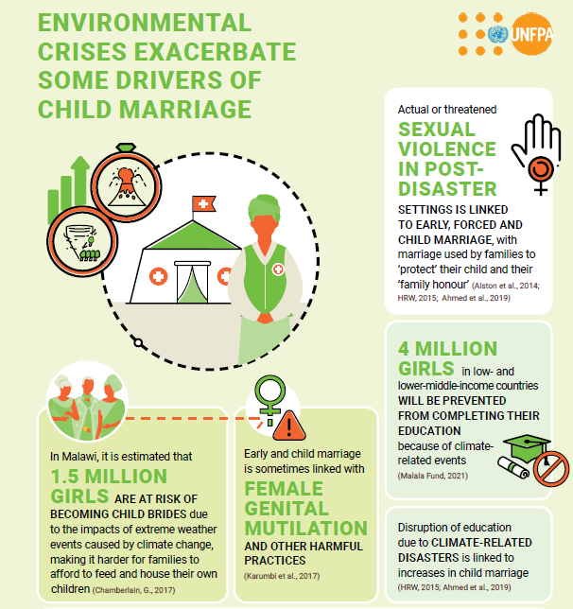
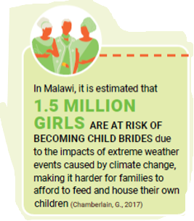

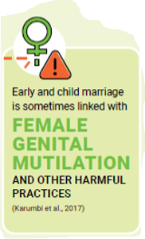
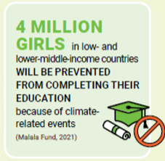
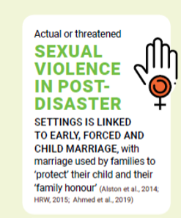
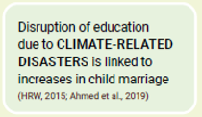
Environmental crises worsen some drivers of child marriage: Examples from around the world
Notes:
ESA has the second highest child marriage percentage. Climate driven and other humanitarian crisis make the situation worse.

Slide 20
2. Local socio-cultural contexts like bride price/dowry shape how these factors affect child marriage
South Asia
Sub Saharan Africa
East & Southern Africa
Dowry predominant
Increase in CM
Dowry practices linked to reductions in CM after environmental crises
Drought linked to 4 % decrease of CM in India
Bride price predominant
Increase in CM and FGM
Eritrea an exception
Smaller dowries or command higher bride prices for younger girls
Drought is associated with a 3% increase in CM
Bride price and dowry at play
Increase in CM and FGM following climate disaster
Interrupted SRH services and high teenage pregnancy
Role of climate-induced infectious diseases (eg. Cholera)
Climate policy and data gap
Cultural sensitivity

Slide 21
^{Key limitations of the study}
Evidence is mostly correlational, not causal
Many studies use a single meteorological variable (e.g. rainfall) as a proxy for local climate complexity
Several studies used cohorts married decades ago raising concerns about recall bias
Significant proportion (13/24) of evidence is from grey literature lacking formal peer review
Majority of evidence is from South Asia, especially Bangladesh; limits generalisability to other cultural contexts.

Slide 22



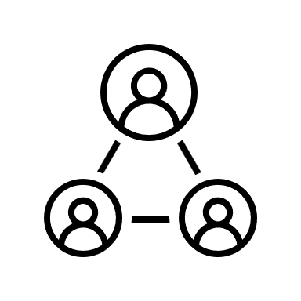
3. Recommendations
National climate policy solutions
Strengthen research and data
Strengthen protection systems
Programming and project interventions
Close gap on limited research especially at national level
Vulnerability assessment on CC/CM
Locally-led research
Future work should investigate a wider variety of ecological and environmental changes beyond drought, heatwaves, and flooding.
Integration in NDCs, NAPs and ccGAP;
Captured on impact, vulnerability, intervention and budget
Indicators for measurement
Early warning systems found to be protective against child marriage post-disasters in Indonesia; merits further exploration.
Ensure programme is gender-transformative i.e., accounts for impact of environmental crisis on SRHR & harmful practices including CM

Slide 23
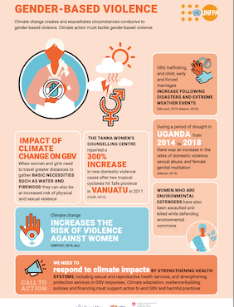
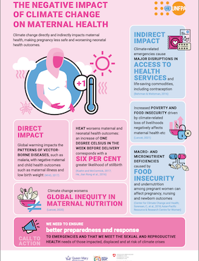
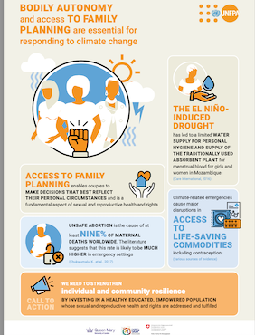
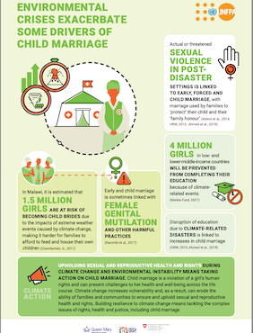
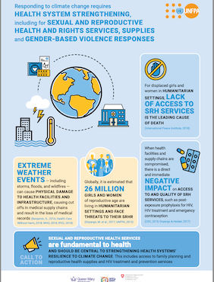

4. Resources: Infographics, Q&A, advocacy, recommendations

Slide 24
Thank you!
www.unfpa.org

Slide 25
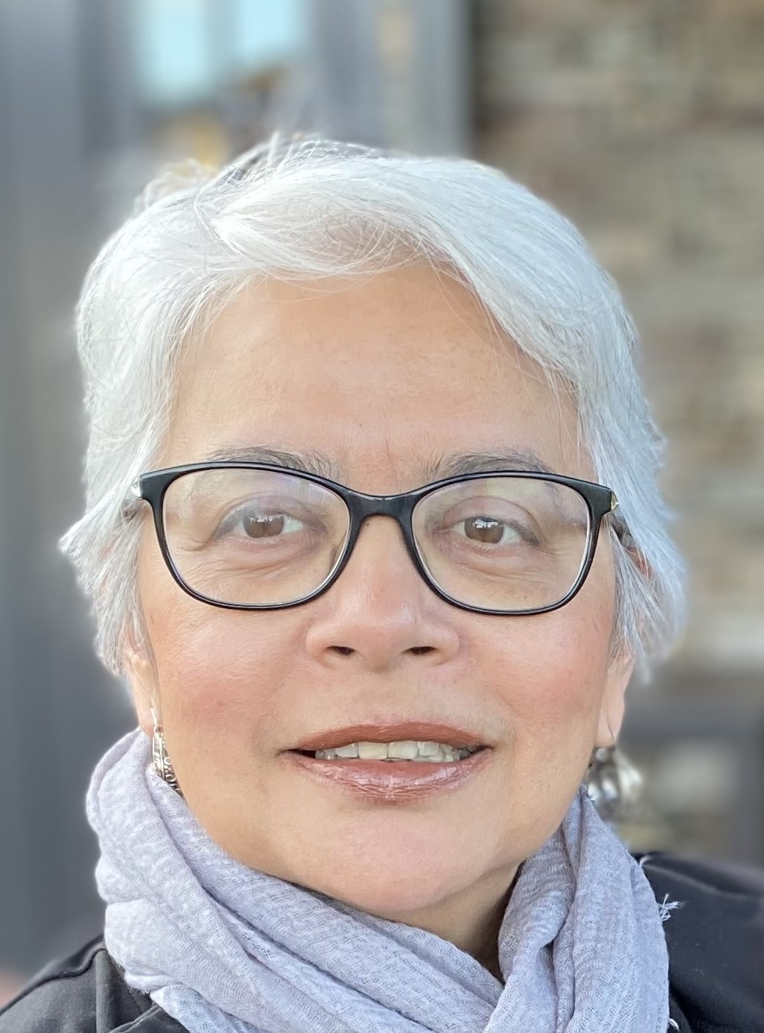
Speakers
Sajeda Amin is Senior Research Advisor at Sajida Foundation and an independent consultant. As Senior Associate at Population Council, she led multi-country initiatives on child marriage prevention and girls’ empowerment. She has a PhD in Demography and Sociology and a Master’s in Public Policy.

Slide 26
PROXIMATE, DISTAL AND LIFECOURSE EFFECTS ON CLIMATE CHANGE ON CHILD MARRIAGE
SAJEDA AMIN
Independent Consultant
Senior Research Advisor, Sajida Foundation
April 10, 2025
CRANK Webinar

Slide 27
Scoping Review on Climate Change and Child Marriage in Bangladesh
Regional variation in Climate Change—
  Coastal communities vulnerable to anthropocene climate change-- sea level rise, waterlogging, salinity, cyclones
  Northern and central districts are affected by flooding, river erosion, and drought
Regional variation in Child Marriage
  high overall child marriage rates; about 50% of women (20-24) are married by the age of 18.
  Higher rates in western region and coastal belt
  * Study commissioned by the UNICEF-UNFPA Global Program to End Child Marriage and UNFPA Dhaka

Slide 28
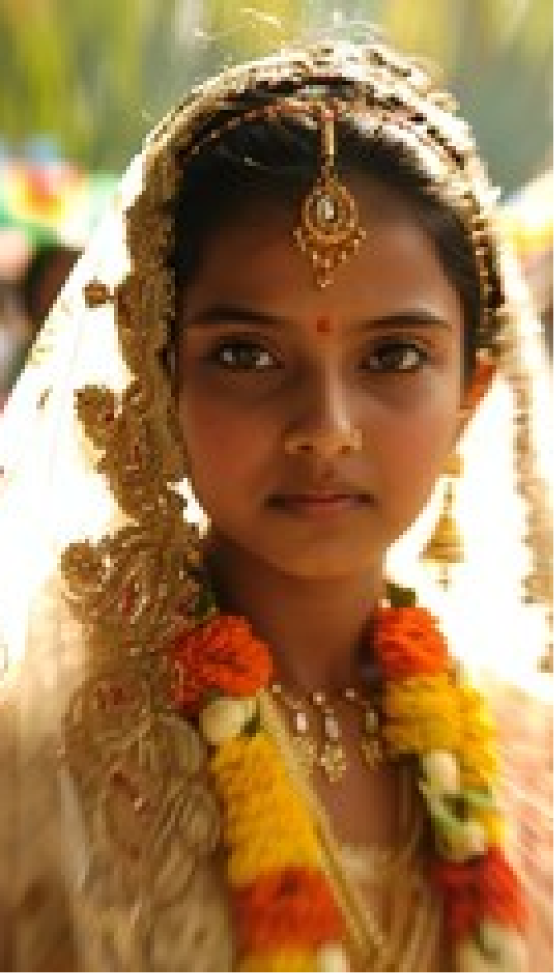
Review of 15 relevant articles
Climate Change
Child Marriage
Published 2014 and 2024
Original primary or secondary analysis
Published
Quantitative and qualitative evidence

Slide 29
Climate Concepts Covered
Extreme rainfall
Drought
Extreme heat waves and dry spells.
Salinity
Waterlogging, surface and ground water salinity, prolong dry season
Cyclones/storm surge/tidal water, salinity intrusion, heat.
Floods and cyclones.
Cyclones, floods, waterlogging/salinity.
Increased heat and precipitation
Seasonal or flash floods, drought, rive- bank erosion.
Natural disasters including climate change
Cyclones, tidal surges, floods, droughts, riverbank erosion, water logging, soil salinity, landslides.

Slide 30
Summary of Scoping Review: Impact of Climate Change on Child Marriage
Most qualitative studies assert climate change exacerbates the impact of factors that increase child marriage: diminished livelihoods options, increased insecurity and reduced marriageability
Attempts to quantify the impact of climate change on child marriage offers mixed results-- only about half the quantitative studies estimate statistically significant impact of proximal effects of rainfall, heat, floods ie weather shocks
Strongest impacts are observed in areas and studies that explore medium and longer term (distal) and cumulative effects of coastal erosion, drought and salinity.
Quantitative and qualitative studies identify other distal impacts with pathways of displacement and livelihood

Slide 31
Summary of WHO Review on what works for child marriage
Strongest evidence on skill-building programs for livelihoods and education on preventing early, child and forced marriages
Relatively little and mixed effects of legal or norm change approaches
Mixed evidence on standalone approaches to promote voice and agency

Slide 32
Gaps
Need a comprehensive framework and theory of change specifying what about climate change matters
  Where is it the most consequential?
  How does it affect child marriage?
  When does it have the most impact?
Qualitative studies
  Can suggest pathways mediated by livelihoods, migration and poverty. Needs clear articulation theory of change pathways of change
Quantitative exploration
  Comparative spatial analysis can highlight relative importance of identified pathways
  Temporal impacts
  Lifecycle effects

Slide 33
Takeaways
  Future directions to address evidence gap
    Promote secondary analyses linking MICS/DHS with climate data
    More mixed methods analysis: in situ as well as broader context
    Look for associations near and far
    Lifecycle approaches to understanding implications of child marriage
    Do not be limited by child marriage research on “what works”
  Explore pathways of policy relevance and intersectionality (who suffers the most)
    Greater attention to sequelae of climate change such as migration and urbanization
    Explore proximate as well as DISTAL effects:
      Longer term impact of climate change
      Later life implications of child marriage eg NCD effects,

Slide 34
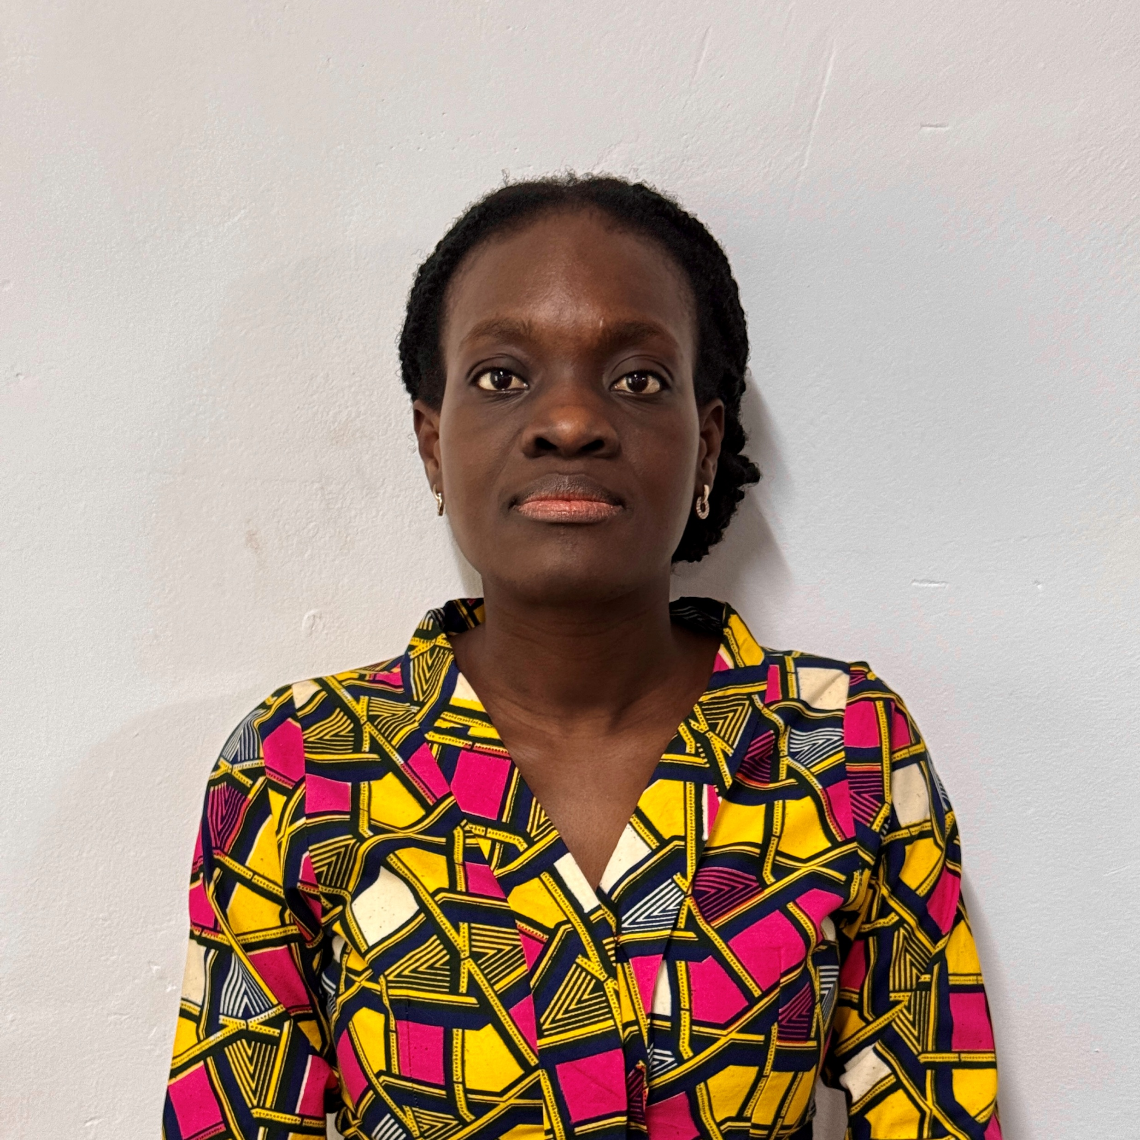
Speakers
Loretta Adowaa Asare is a social policy analyst, with a Master’s degree in Social Protection Systems working on gender equality, social protection, and climate change. Her work focuses on the social consequences of climate change on marginalized groups in Northern Ghana, contributing to policy discussions on child marriage.

Slide 35
The Social Consequences of Climate Change:
A Qualitative Analysis of Early Girl Child Marriage As An Informal Adaptation Strategy
Among Rural Communities In Northern Ghana
By:
Loretta Adowaa Asare
Bonn –Rhein- Sieg University of Applied Science
&
John Boulard Forkuor
Kwame Nkrumah University of Science and Technology

Slide 36
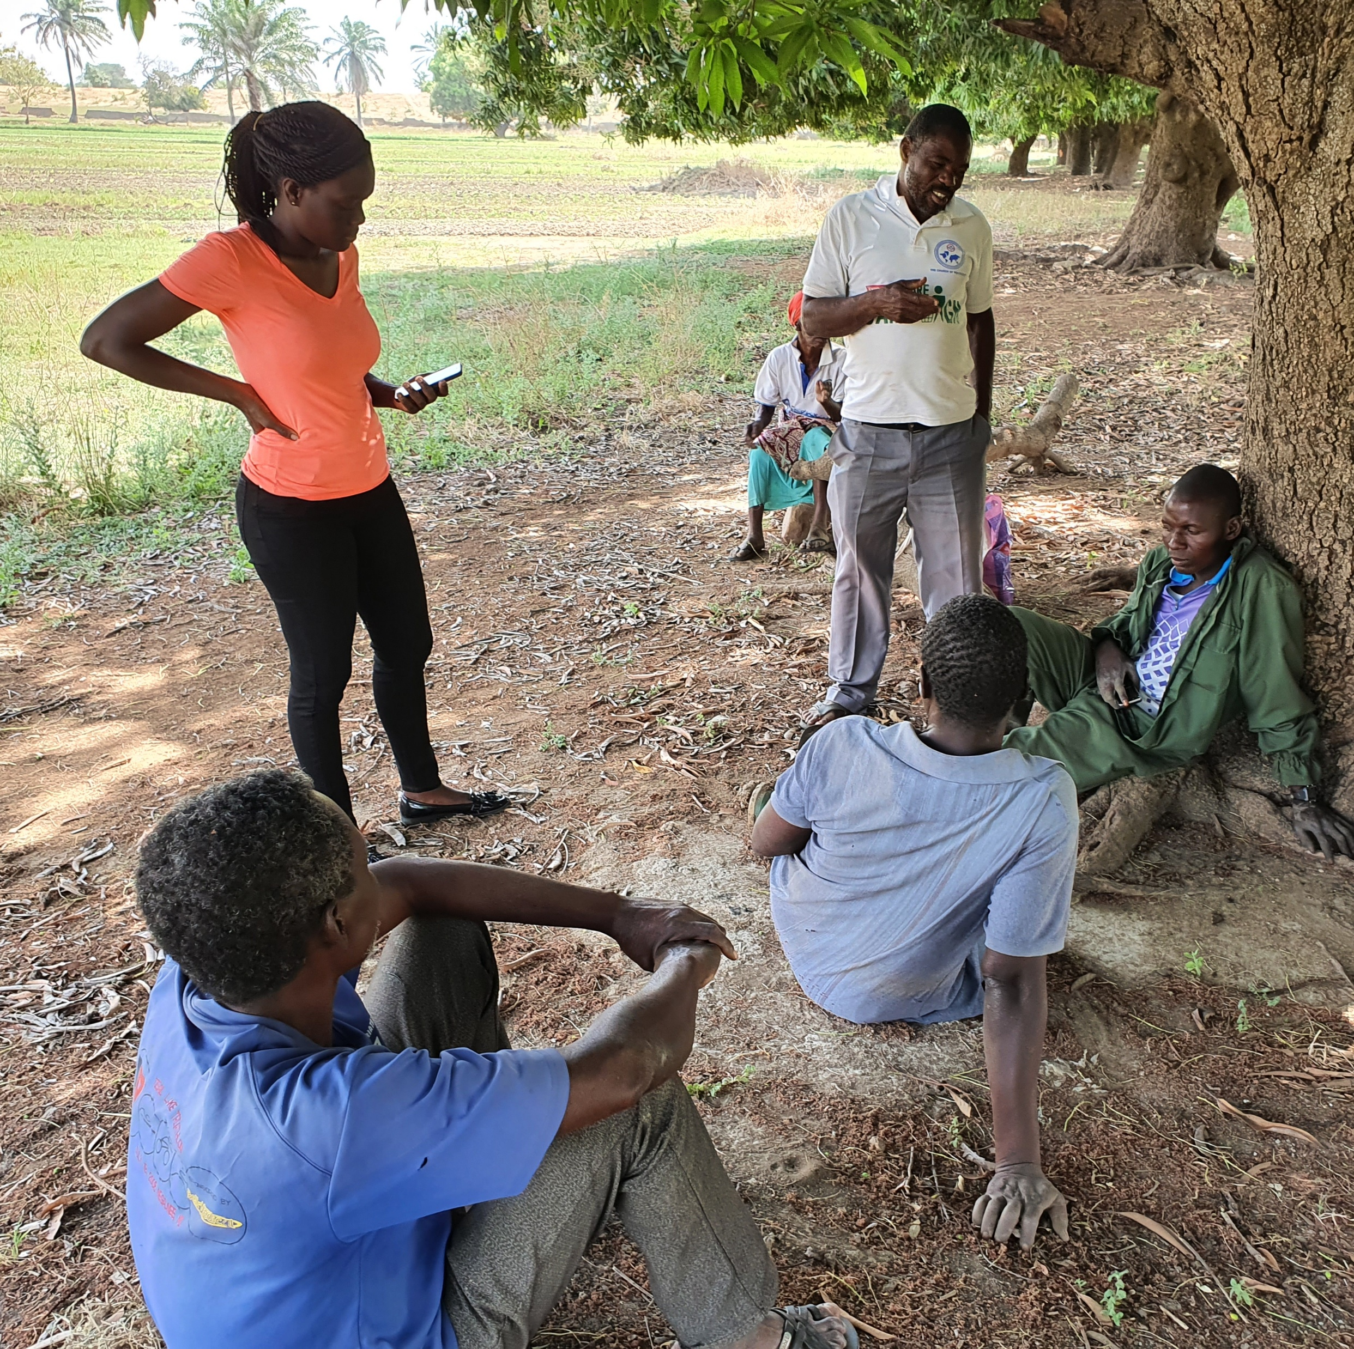
Presentation outline
Setting the scene
Objective, scope & methodology
Findings
Conclusion and recommendations

Slide 37
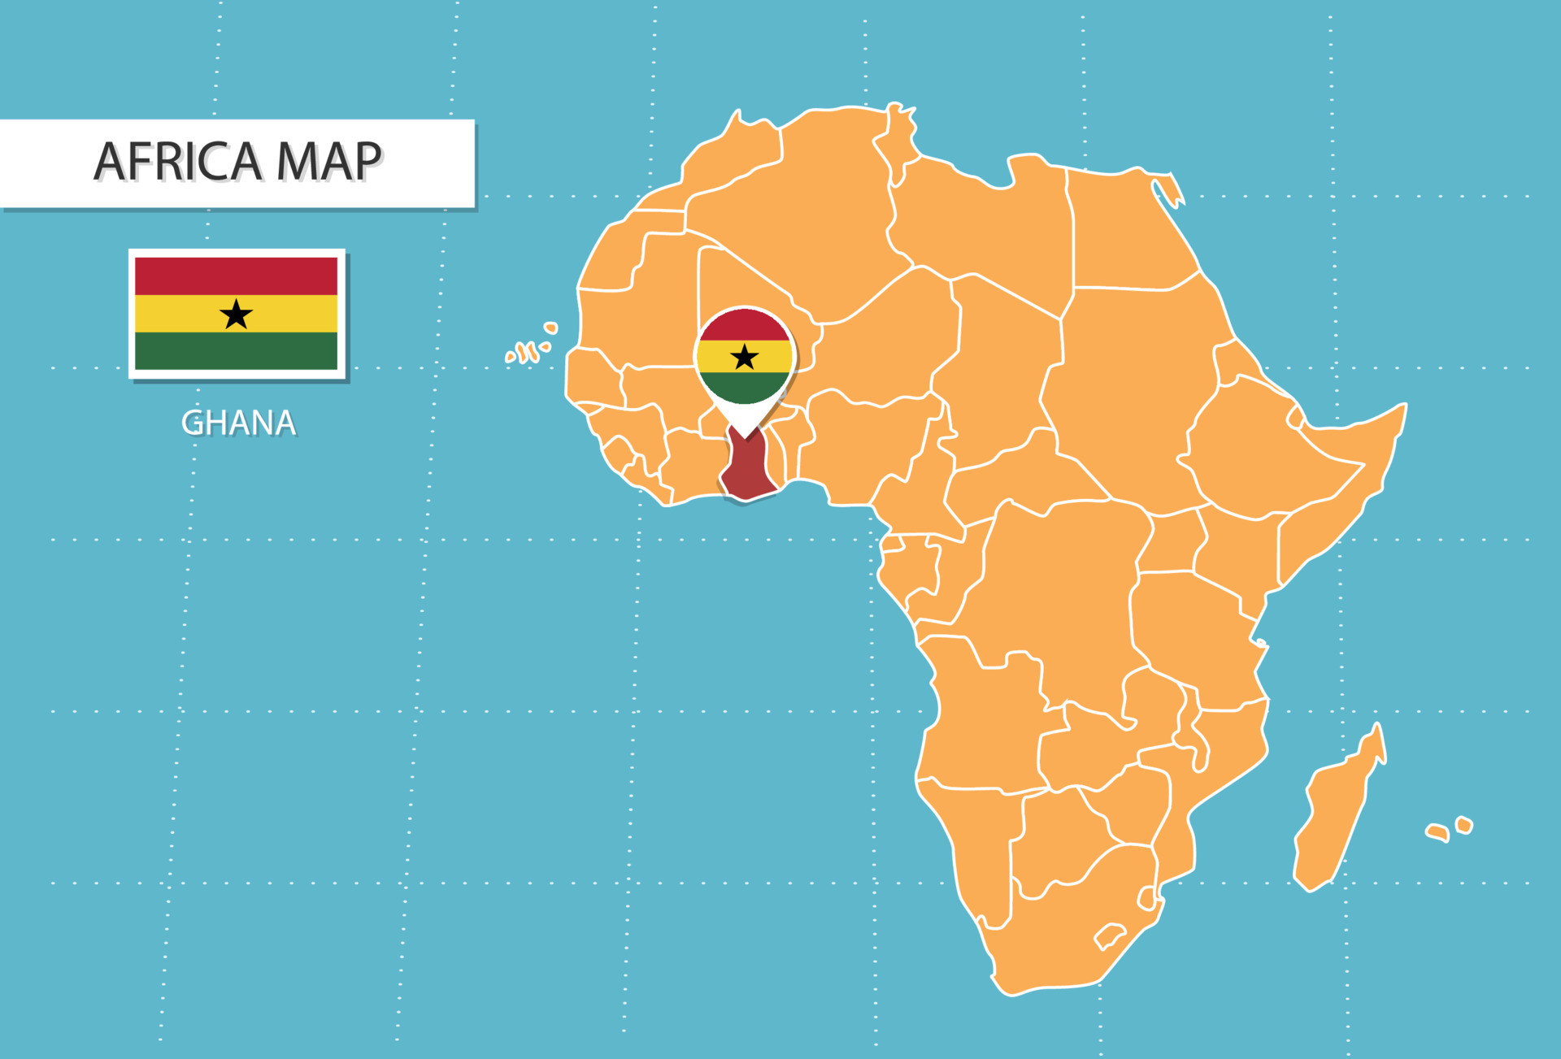
Statistics and setting the scene
Location: Ghana is in West Africa, and borders Togo, Ivory Coast, and Burkina Faso.
Occupation: Agriculture plays a crucial role in the economy.
Almost 40% of the population engage in agriculture (Assan et.al 2018)
Climate change: Vivid impact, affecting the annual rate of food production.
Map: iStock

Slide 38
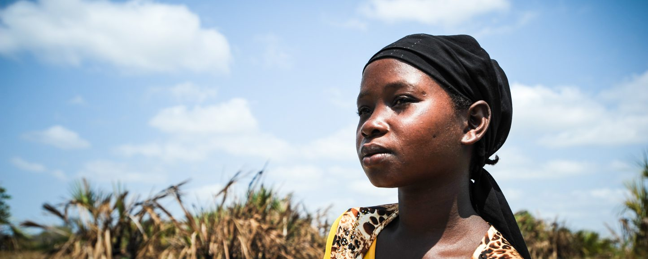
Situation in Northern Ghana: Bongo District
Photo: Shutterstock
Agriculture is dominant, with
72.2%
consisting of crop, livestock & fishing
Climate-related events impact livelihood and food security (Mashizha et al. 2017).
Farmers marry daughters early to offset climate-related financial burdens.
Highest child marriage rate in the country.
Most food insecure district in the upper east region.
Little state presence/formal social protection, early girl-child marriage as a way to safeguard the future of the girl in the event of climate disaster (McLeod et al., 2019; McCarthy 2020).
39.2%
women aged 20-49 married before age 18
20%
of households are food insecure

Slide 39
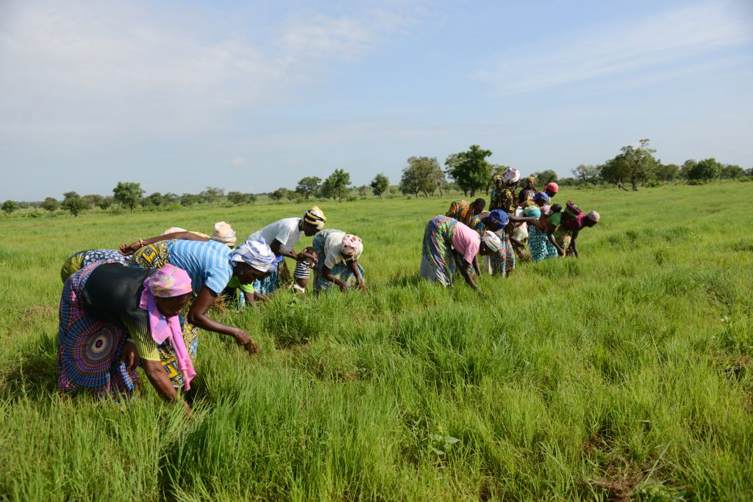
What this study looked at
Objective & scope
To investigate the impacts of climate change on early girl-child marriage in the Bongo district, Ghana.
Research question
What is the linkage between climate change effect and early girl-child marriage as an adaptative social protection mechanism?
Methodology
Qualitative data: interviews, purposive sampling, focus group discussions, observation.
4 communities: Kunkua, Adaboya, Bongo, Borigo
Photo: Getty Images

Slide 40
Findings
1
Early girl-child marriage is seen as a way to keep boys in school.
“And again, if you have boys and girls who have completed JSS and there is no money to continue, you can give the girl to marry and take the cows and the things and sell them and use the money to take care of the boys in school…” (Farmer 1)
2
Bride price is used to establish an alternative livelihood to support the family in the event of climate disaster.
“[…] bride price becomes a very efficient capital that enables a family to venture into a small new business to help sustain the family and escape poverty […]” (Farmer 2)
Notes:
Early marriages as a safe avenue for the girlchild and family

Slide 41
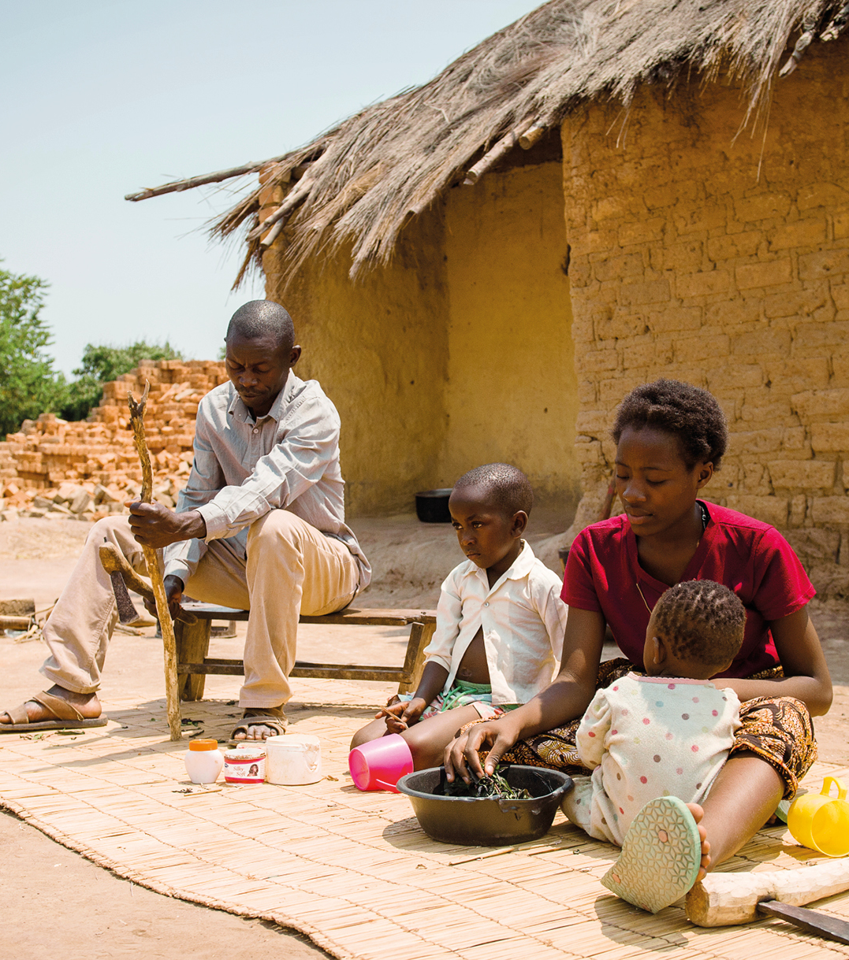
Findings (continued)
Source. Camfed –Ghana website
3
Child marriage is seen as a protection mechanism with group – not individual – consequences.
The girl child is seen as a liability or burden until married.
Early marriage is seen as a way to protect the girl child from poverty and pregnancy.
4
5
“[We] believe that marrying our daughters off will help them since their husbands will now take full responsibility and help them through school even after childbirth” (Farmer 10).
Notes:
To explain point 3: Families marry their daughters to affluent men, who then cover the basic needs of the family.

Slide 42
Conclusion & recommendations
Ministry of Gender & Social Protection – need to implement preventive measures with social workers at local level.
Social workers – advocate and work with Ministry of Agriculture on innovative and sustainable practices that:
  Support girls to be seen as contributing, and so avoid marriage.
  Reduce the climate-related economic drivers of child marriage.
Data collection – Most studies measure household wealth after girls marry – need to look at poverty as a driver of child marriage.
Notes:
To explain second point: Adapting innovative and smart agricultural practices could support girls to be seen as productive (not a burden) and avoid marriage.

Slide 43
REFERENCES
Assan, Elsie, Murari Suvedi, Laura Schmitt Olabisi, and Andrea Allen. 2018. ‘Coping with and Adapting to Climate Change: A Gender Perspective from Smallholder Farming in Ghana’. Environments 5(8):86.
Atitsogbey, P., M. Steiner-Asiedu, C. Nti, and R. Ansong. 2018. ‘The Impact of Climate Change on Household Food Security in the Bongo District of the Upper East Region of Ghana’. Ghana Journal of Agricultural Science, 52, 145–53.
Mashizha, Tinashe Mitchell, Cornelias Ncube, Munyaradzi Admire Dzvimbo, and Monica Monga. 2017. ‘Examining the Impact of Climate Change on Rural Livelihoods and Food Security: Evidence from Sanyati District in Mashonaland West, Zimbabwe’. Journal of Asian and African Social Science and Humanities 3(2):56–68.
McCarthy, Joe. 2020. ‘Why Climate Change Disproportionately Affects Women’. Global Citizen. Retrieved 3 October 2020 (https://www.globalcitizen.org/en/content/how-climate-change-affects-women/).
McLeod, Christie, Heather Barr, and Katharina Rall. 2019. ‘Does Climate Change Increase the Risk of Child Marriage: A Look at What We Know-And What We Don’t-With Lessons from Bangladesh and Mozambique’. Colum. J. Gender & L. 38:96.
Raj, Anita, Marissa Salazar, Emma C. Jackson, Natalie Wyss, Katherine A. McClendon, Aarushi Khanna, Yemeserach Belayneh, and Lotus McDougal. 2019. ‘Students and Brides: A Qualitative Analysis of the Relationship between Girls’ Education and Early Marriage in Ethiopia and India’. BMC Public Health 19(1):1–20.
Sarfo, Elizabeth Anokyewaa, Joana Salifu Yendork, and Anthony Vernon Naidoo. 2022. ‘Understanding Child Marriage in Ghana: The Constructions of Gender and Sexuality and Implications for Married Girls’. Child Care in Practice 28(2):228–41.
Schaffnit, Susan B., and David W. Lawson. 2021. ‘Married Too Young? The Behavioral Ecology of “Child Marriage”’. Social Sciences 10(5):161.
Svanemyr, Joar, Venkatraman Chandra-Mouli, Charlotte Sigurdson Christiansen, and Michael Mbizvo. 2012. ‘Preventing Child Marriages: First International Day of the Girl Child &quot;My Life, My Right, End Child Marriage&quot’; Reproductive Health 9(1).

Slide 44
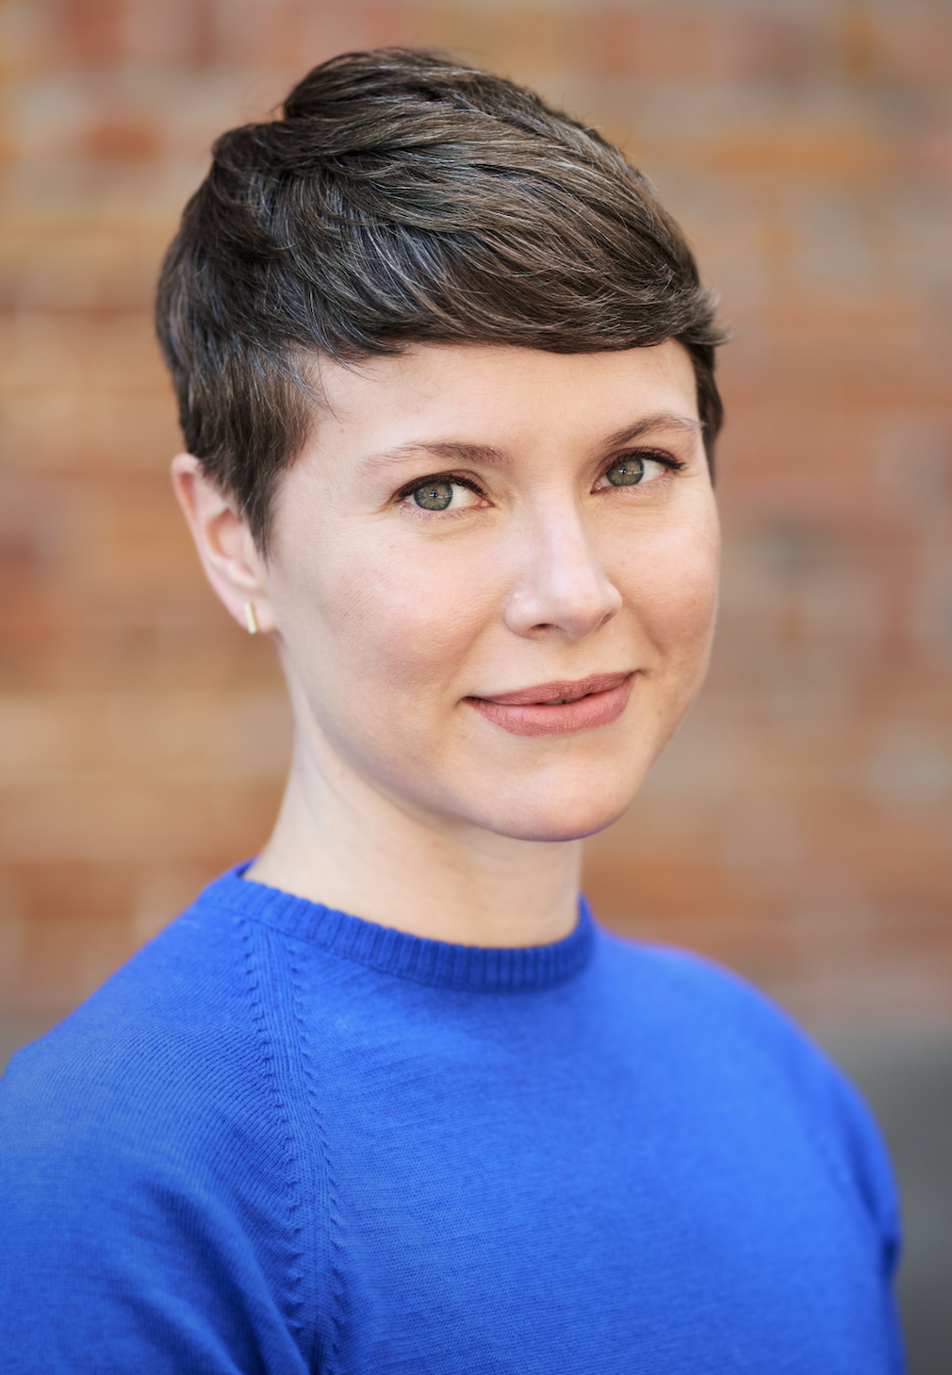
Speakers
Alissa Koski is a social epidemiologist and Associate Professor at McGill University in Montreal. She studies the drivers and consequences of child marriage, with a recent focus on North American child marriage practices.

Slide 45
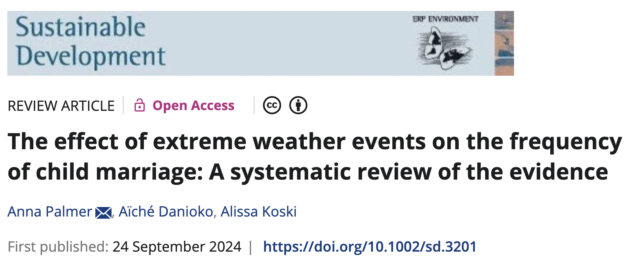

Slide 46
WHAT WE DID
Our review built upon the earlier review by Pope et al. in several ways:
Included more recent work published between 2021 and 2023
Evaluated how well existing quantitative research demonstrates that these weather events cause changes in the probability to marrying as a child. In other words, how sure can we be that the results of these studies reflect causal relationships, and not (non-causal) correlations?
1
2

Slide 47
WHAT WE LEARNT
Most research has been conducted in a small number of countries.
  Since the drivers of child marriage differ across societies, it will be important to consider a broader range of settings going forward.
Prior quantitative studies are at high risk of bias.
  Stronger research designs are needed.
1
2
Our research team has already been acting on these recommendations.

Slide 48
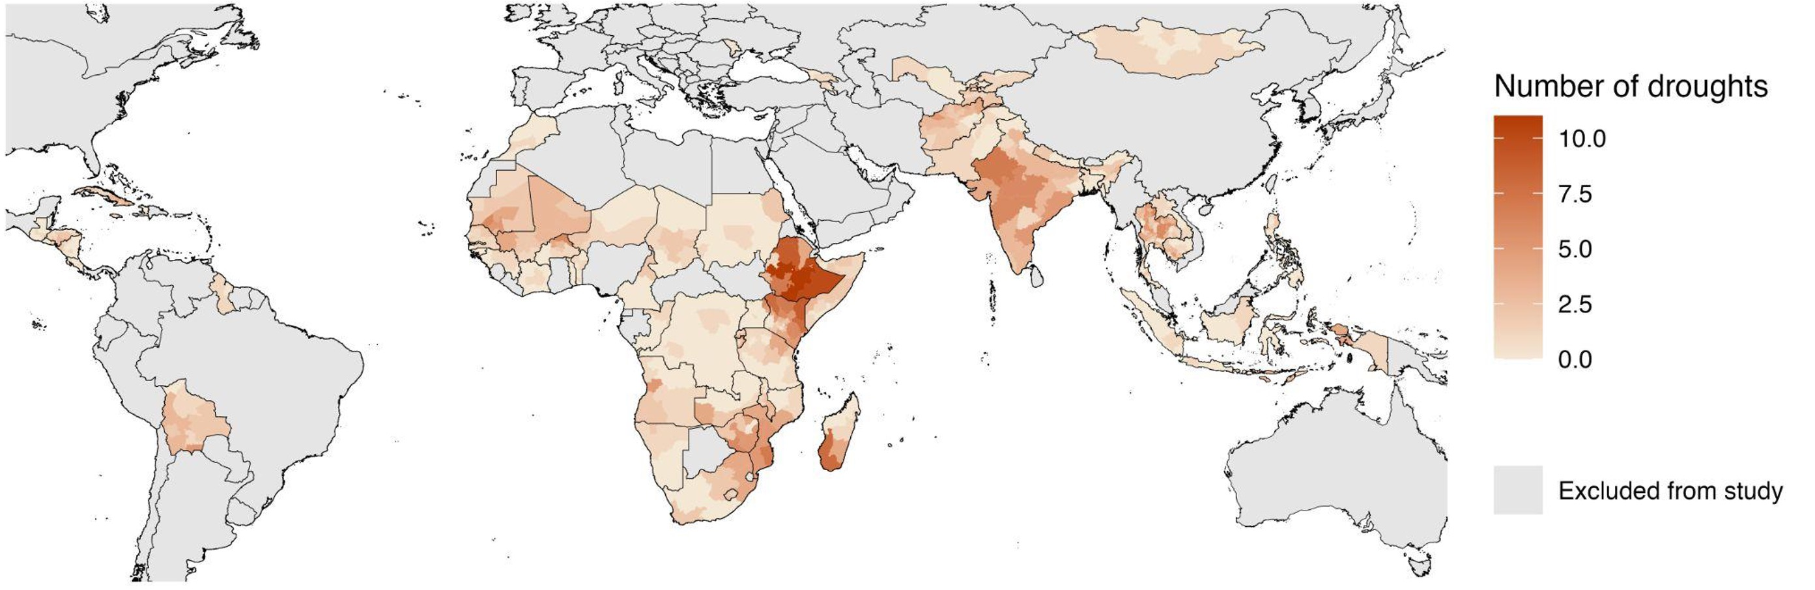
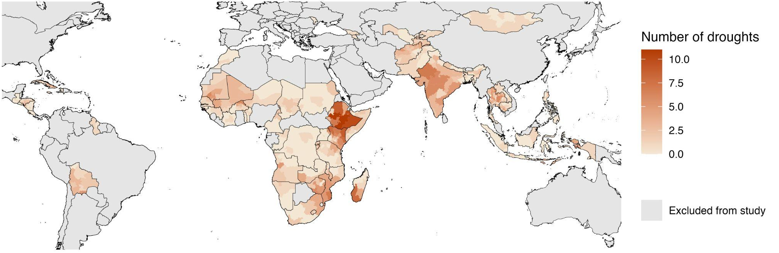
WHAT EFFECT DO DROUGHTS HAVE ON NATIONAL RATES OF CHILD MARRIAGE IN 61 COUNTRIES?
Droughts did not change national rates of child marriage in most countries.
There were a few exceptions: in a handful of countries child marriage rates increased, but rates decreased in others.

Slide 49
IMPLICATIONS FOR RESEARCH AND POLICY
It is not clear that extreme weather events necessarily lead to increases in child marriage on a large scale.
  National strategies may not need to change – at least not yet.
That does not mean that these weather events do not affect child marriage patterns among smaller groups.
  Studying whether smaller groups within countries are more affected may warrant targeted practice approaches.
  We need to consider the relative weight of economic and social forces in decision-making about child marriage.
1
2

Slide 50
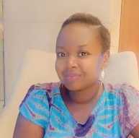
Speakers
Ramatoulaye Dieye is the Regional Gender Advisor for the United Nations World Food Programme (WFP) in the Dakar Regional Bureau. She promotes women’s economic empowerment and decision-making mechanisms through gender-transformative food system programmes.
She previously worked at Girls Not Brides, supporting advocacy and policy efforts to end child marriage in West and Central Africa. She has also written a book on food insecurity, a major theme in the Sahel context.

Slide 51
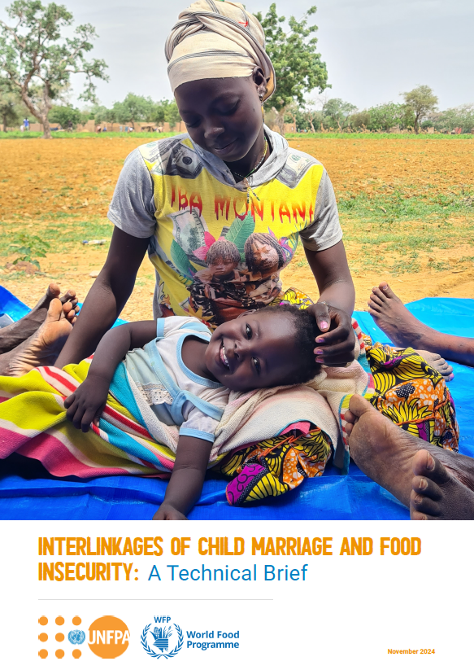
Interlinkages of Child Marriage and Food Insecurity : Technical Brief
insights from literature review on the correlation between food insecurity and child marriage
  Profound implications of CM on well-being and development
  particularly affects girls, families, and communities in low-income settings
West and Central Africa Context
  High levels of food insecurity and child marriage
  Region prone to polycrisis
Existing joint programmes for adolescent girls
  Advancing rights-based programming
  Gender-transformative approaches
Notes:
Generated by Copilot
Child marriage and food insecurity are deeply interconnected issues in West and Central Africa. Understanding these linkages is crucial for developing effective interventions. Child marriage often exacerbates food insecurity, as young brides may lack access to education and economic opportunities, leading to cycles of poverty. Conversely, food insecurity can push families to marry off daughters early as a survival strategy. Addressing these challenges requires a holistic approach that considers the socio-economic factors at play. By tackling both issues simultaneously, we can create sustainable solutions that empower girls and improve food security in the region.
______
Through this brief, UNFPA and WFP are joining efforts and building on knowledge generated to understand the correlation between food insecurity and child marriage, particularly in West and Central Africa and also highlights the need for more research to inform policies and improve responses. meant to address the interlinkages between food security and child marriage especially in a polycrisis context.

Slide 52
Integrated programming : example from the Breaking Barriers to Girls’ Education (BBGE) Programme in Chad and Niger (WFP/UNICEF/UNFPA)
Girl child
Education
Take-home ration and scholarship
SRHR
WASH
Food support and livelihood
Increased enrolment of girls
Delay in child marriage
Increased livelihood opportunities for women
Increased participation of women in decision making
…
In Chad, the country commited to increase school canteen coverage by 15 per cent in provinces that are highly vulnerable to food and nutrition insecurity and have low attendance rates and school results.
Notes:
Generated by Copilot
The Breaking Barriers to Girls’ Education Programme exemplifies integrated programming in Chad and Niger. This initiative combines education with essential support services like food rations and scholarships, which are critical for increasing girls' school enrollment. The program has shown promising results, including delayed child marriage and enhanced livelihood opportunities for women. Notably, Chad's commitment to boost school canteen coverage by 15% in vulnerable provinces highlights the importance of addressing food and nutrition insecurity to improve educational outcomes. This multifaceted approach not only supports girls' education but also fosters community resilience.
______
This slide outlines a comprehensive strategy to address child marriage within the context of multiple crises. It emphasizes the need for multisectoral approaches and coordinated interventions that incorporate humanitarian efforts. A comprehensive policy framework is essential to tackle the underlying drivers of food insecurity while integrating gender considerations into climate change policies. The research agenda calls for further exploration of the connections between food security, climate change, and child marriage. Additionally, enhancing data and monitoring systems to include variables related to child marriage will help us understand its correlation with food security and health outcomes.

Slide 53

Call to action
Multisectoral Approaches
01
02
Comprehensive Policy Frameworks
Coordinated interventions with a humanitarian approach
.
Address underlying drivers of food insecurity
Integrate gender considerations in climate change policies
Addressing CM in polycrisis
Data and Monitoring
Research Agenda
Further explore interlinkages between Food Security, Climate Change and Child Marriage
Integrate variables related to child marriage in Food Security Data and Understand the correlation with factors like food security, health, and demographics
03
04
Notes:
Generated by Copilot
This slide outlines a comprehensive strategy to address child marriage within the context of multiple crises. It emphasizes the need for multisectoral approaches and coordinated interventions that incorporate humanitarian efforts. A comprehensive policy framework is essential to tackle the underlying drivers of food insecurity while integrating gender considerations into climate change policies. The research agenda calls for further exploration of the connections between food security, climate change, and child marriage. Additionally, enhancing data and monitoring systems to include variables related to child marriage will help us understand its correlation with food security and health outcomes.
______

Slide 54
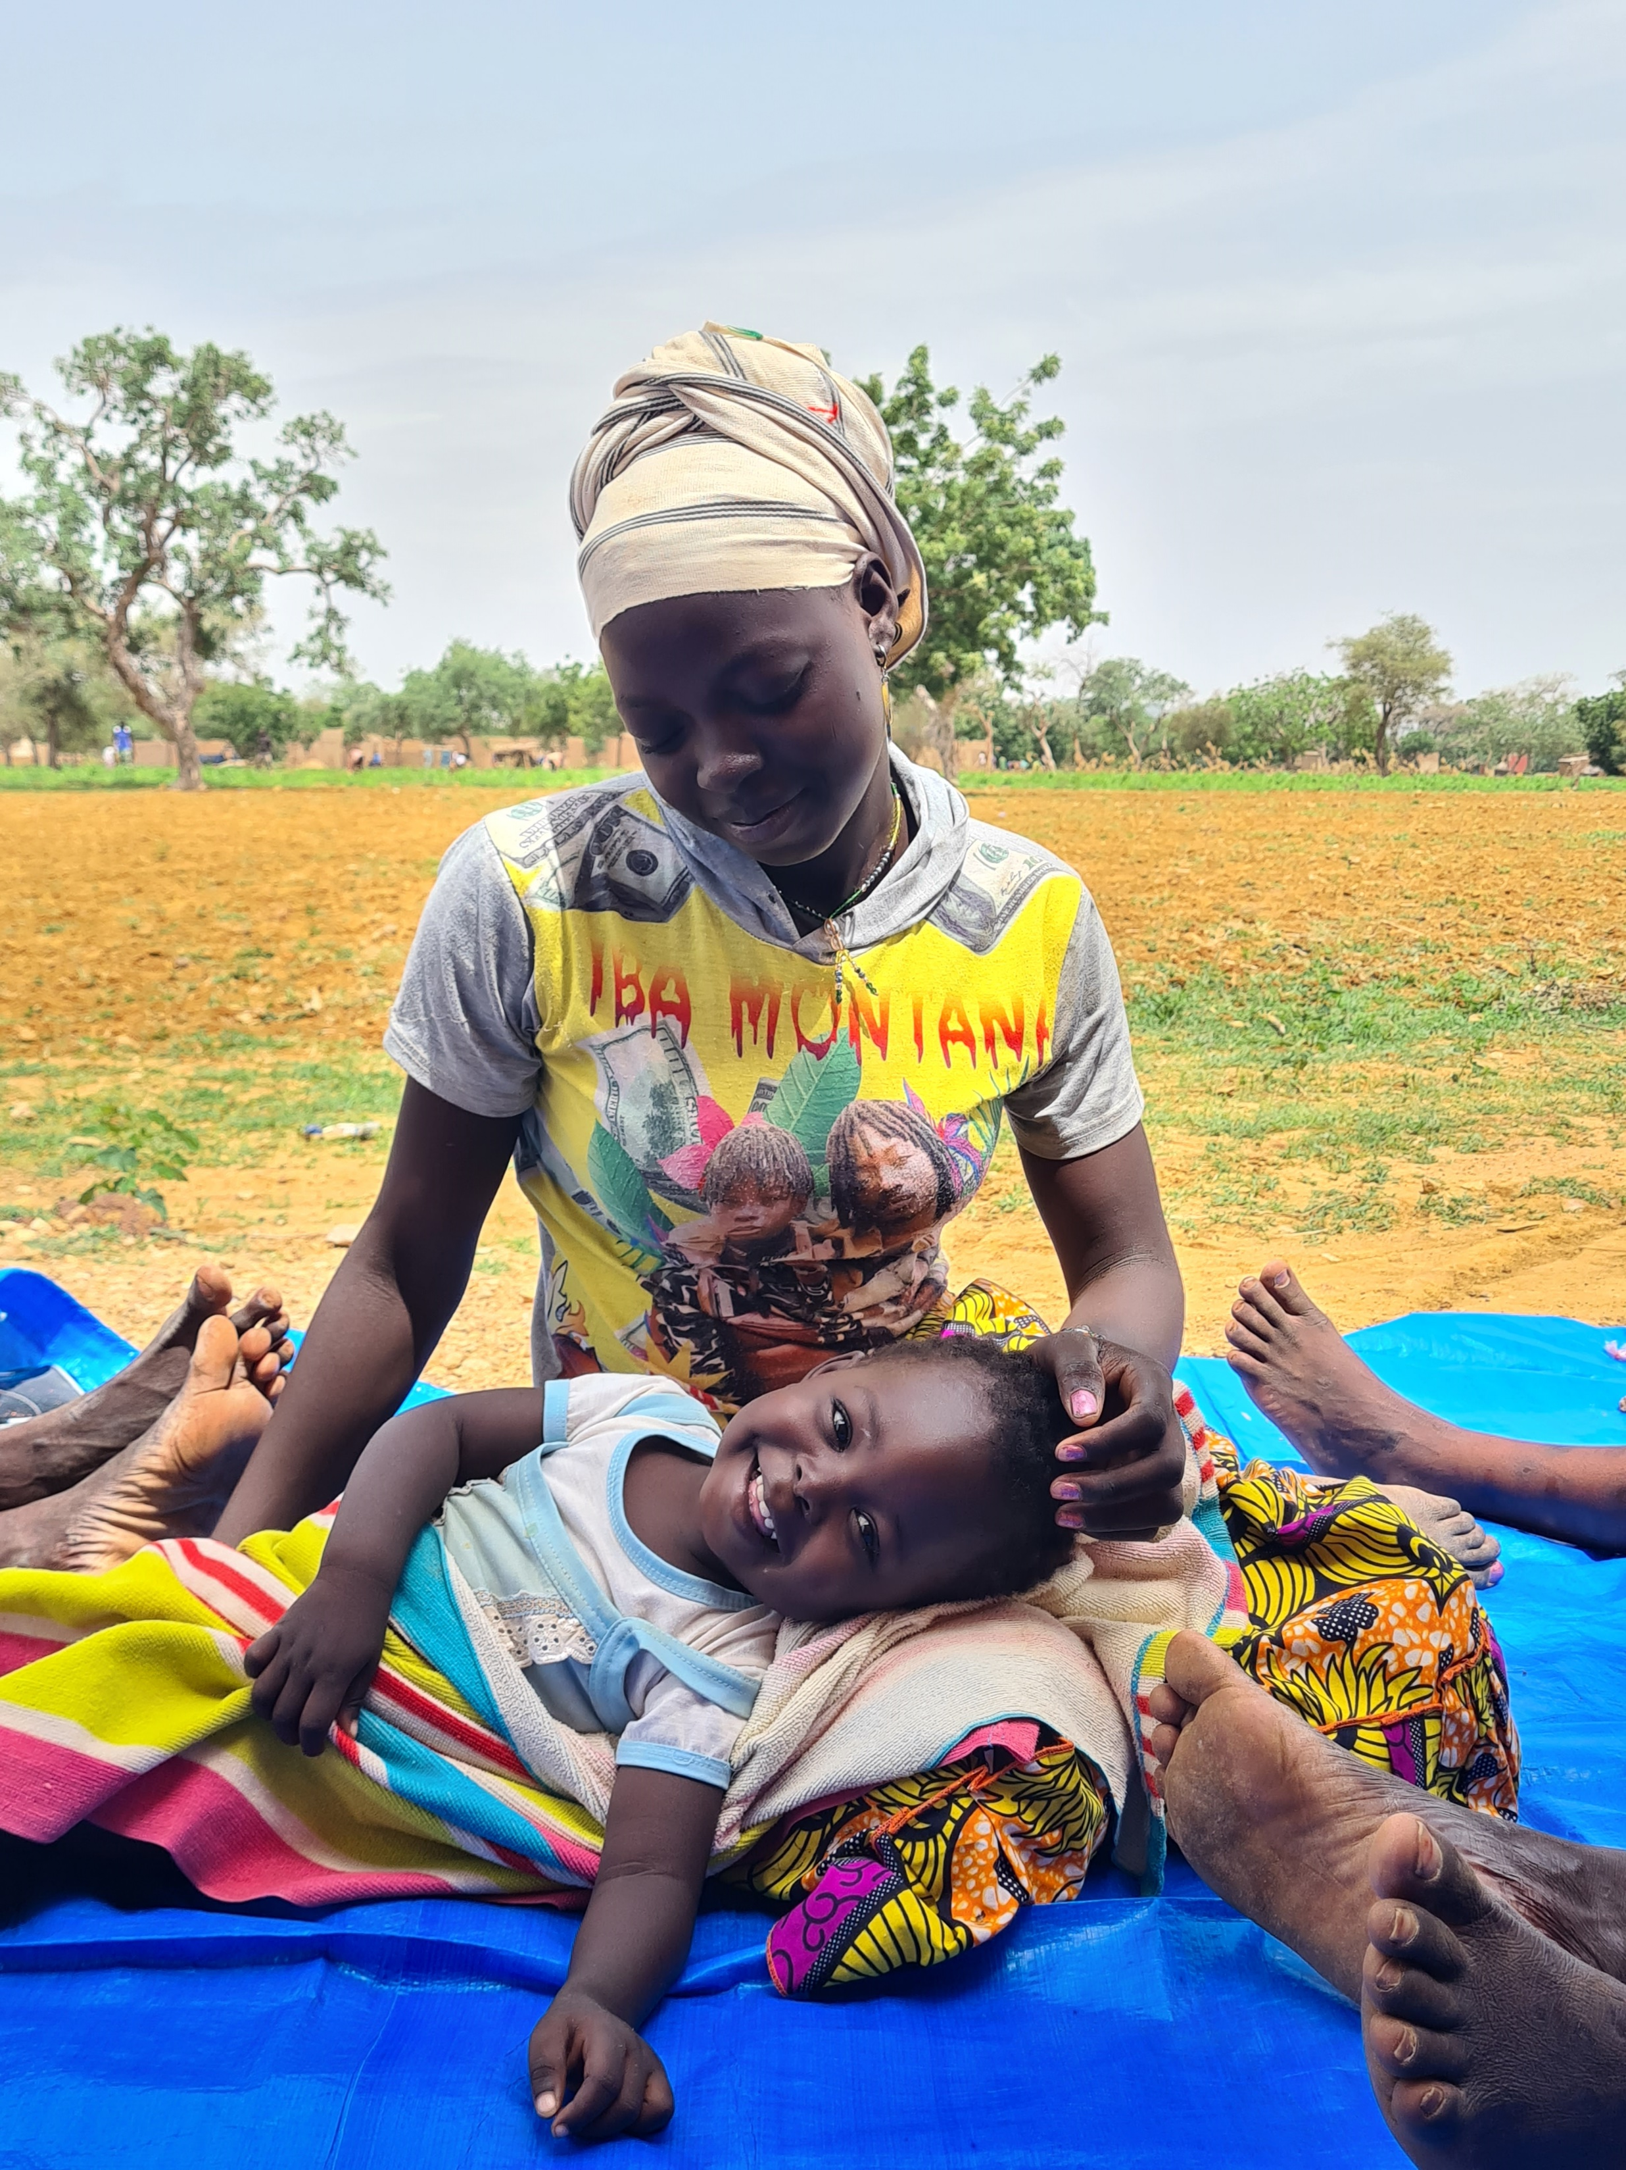


Thank you for your attention

Slide 55
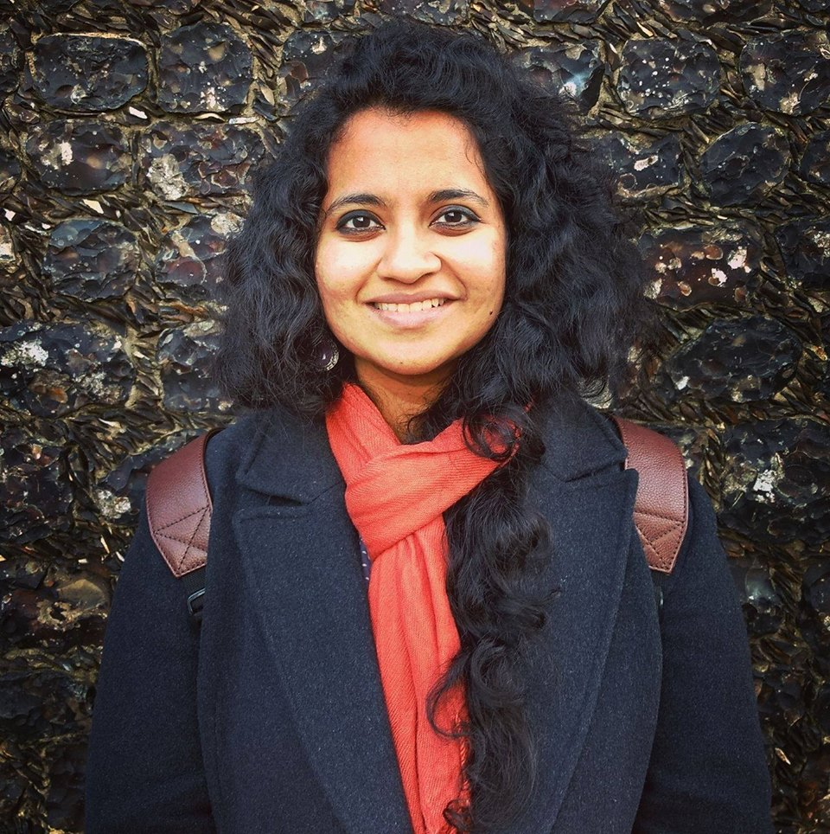
Speakers
Dr. Reetika Revathy Subramanian is a Senior Research Associate at the University of East Anglia. She created Climate Brides, an open-access multimedia platform that unpacks how climate change intensifies the drivers of child marriage in South Asia.
She holds a PhD in Multidisciplinary Gender Studies and has over a decade of experience as a journalist and researcher working at the intersections of gender, labour migration and climate adaptation in South Asia.

Slide 56
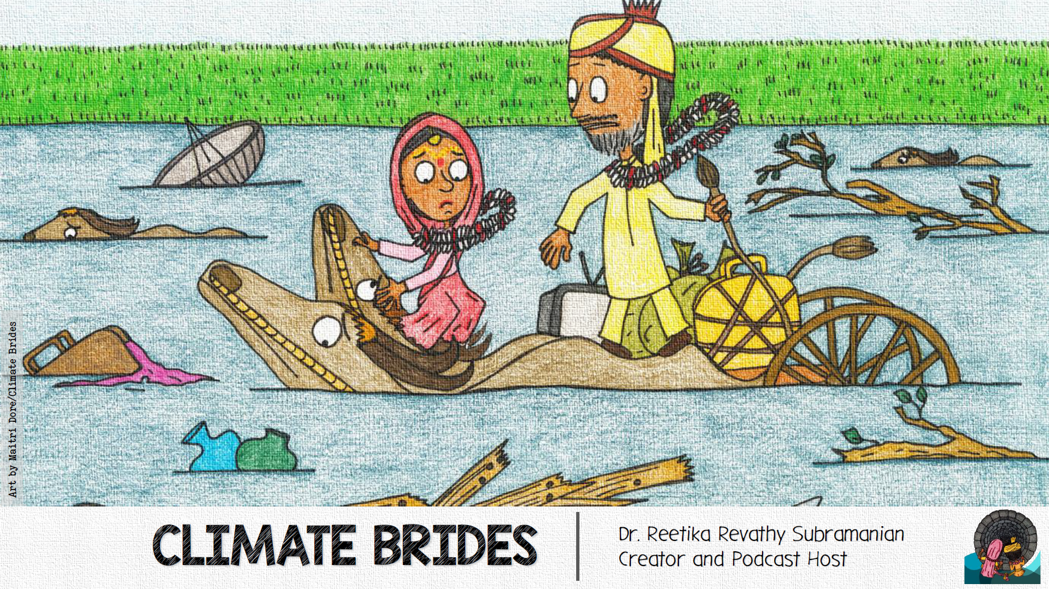

Slide 57
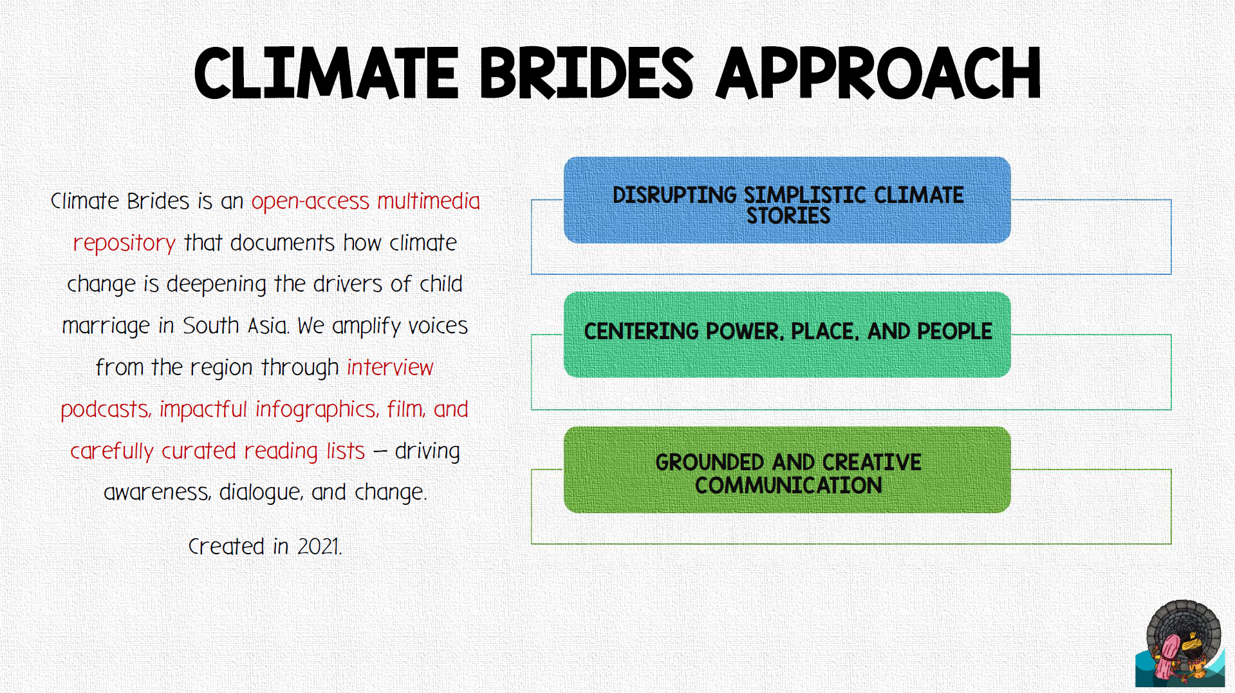

Slide 58
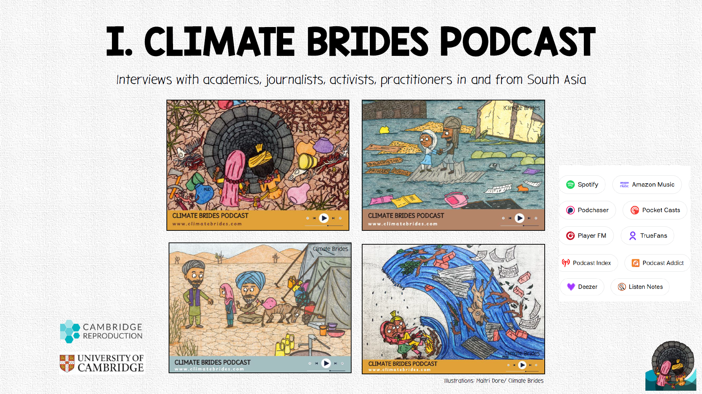

Slide 59
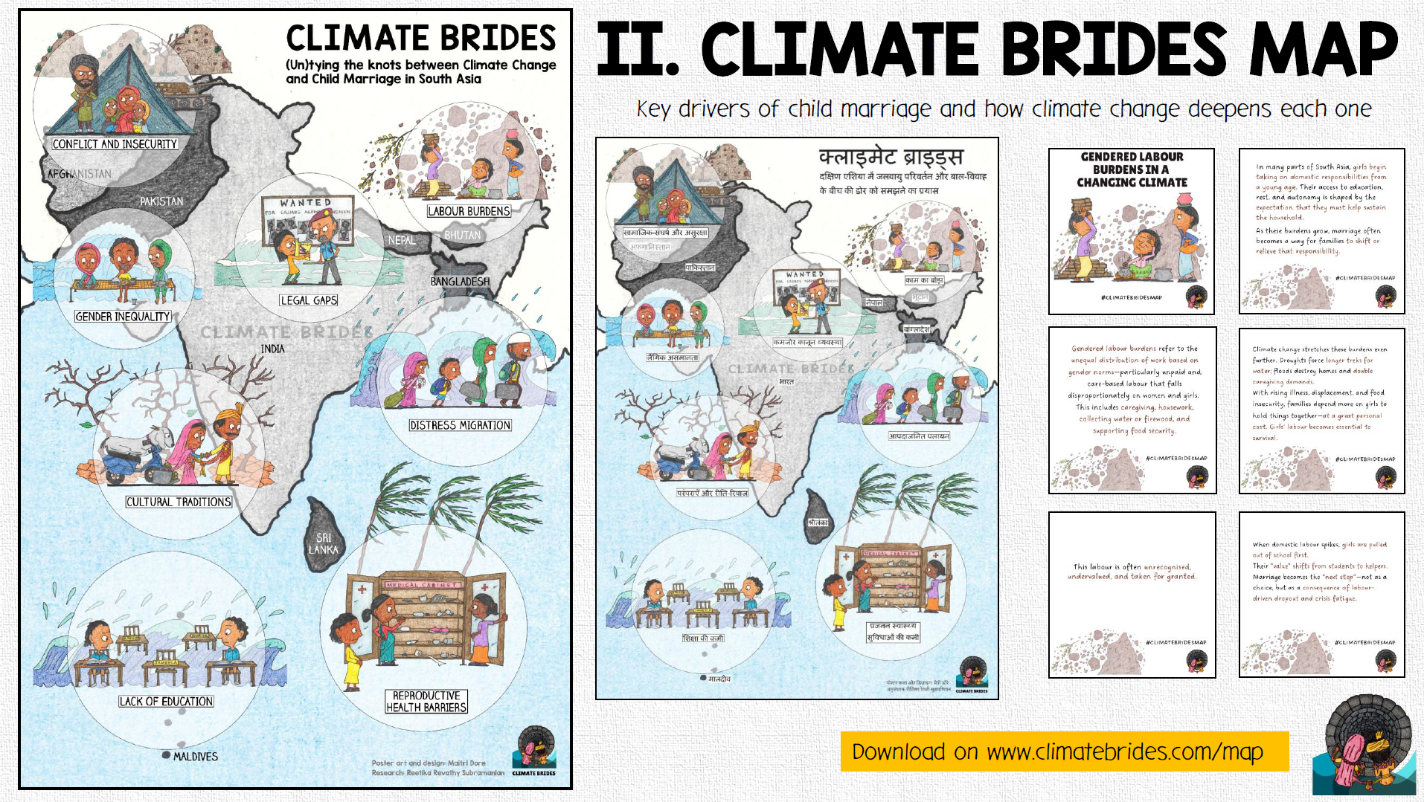

Slide 60
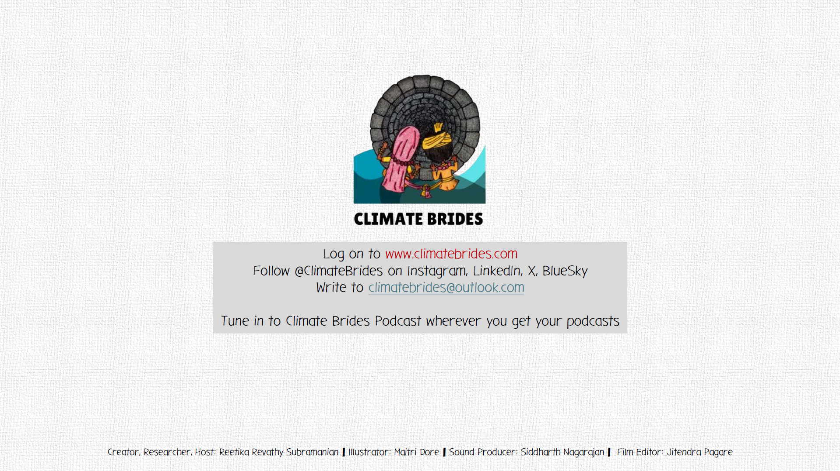

Slide 61
Thank you for joining the CRANK today.
Before you leave, please remember to complete a very quick feedback poll
© UNICEFUNI565846Das

