Slide 1

The Child Marriage Research to Action Network (The CRANK)
This session will have presentations in English. To access simultaneous interpretation, please click on the globe icon at the bottom bar of your screen and select your preferred language (English, Spanish, French, or no interpretation).
Esta sesión tendrá presentaciones en inglés. Para acceder a los servicios de interpretación simultanea, por favor haga clic en el icono del globo que encontrará en la barra inferior de su pantalla, y seleccione su idioma de preferencia (inglés, español, francés o version original).
Cette session comprendra des présentations en anglais. Pour accéder aux services d'interprétation simultanée, veuillez cliquer sur l'icône globe que vous trouverez dans la barre inférieure de votre écran, et sélectionnez votre langue préférée (anglais, espagnol, français ou version originale).
Notes:
Translations are available in English, French and Spanish – please chose the channel of your choice clicking on the globe icon at the bottom of the screen.
This session will be recorded and recordings will be shared along with key notes from the session in the follow up resources communication

Slide 2
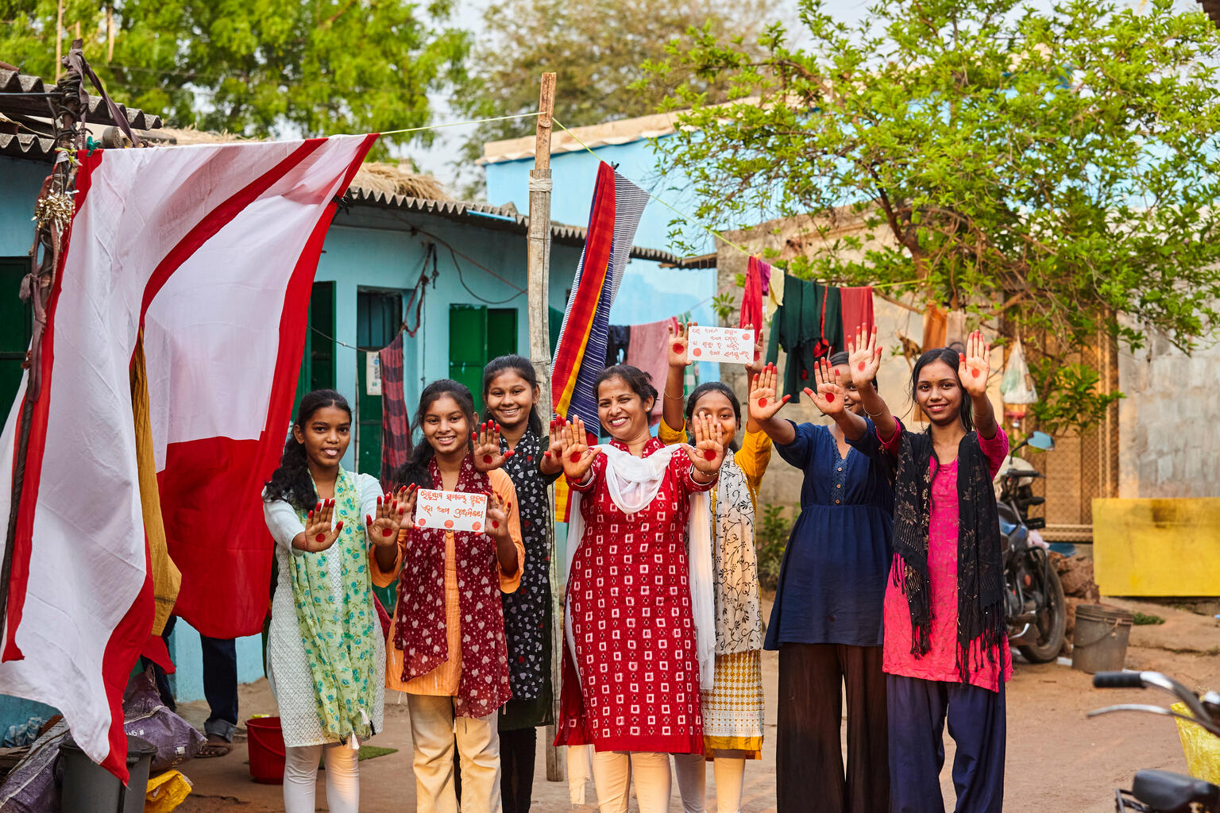
The intersections of child marriage: Strengthening holistic and cross-sectoral solutions.
The Child Marriage Research to Action Network (The CRANK)
© UNICEFUNI565846Das
27 November 2024

Slide 3
Agenda
Time (UK) | Discussion
13:00 - 13:05 | Welcome Opening welcome: Vero Kamanga-Njikho, Global Coordinator (UNICEF)-Prevention of Harmful practices (PHP) Moderator: Annabel Erulkar
13:05 - 13:10 | Setting the scene: Annabel Erulkar
13:10 – 13:55 | Learning from the latest evidence – implications for research, practice and policy: Masturah Baba, Child marriage & sexual & reproductive health & rights Sushmita Mukherjee, Social norms, pathways to education and scale LynnMarie Sardinha, Intimate partner violence against adolescent girls
13:55 - 14:20 | Discussion – Annabel Erulkar
14:20 – 14:35 | Research updates – Jean Casey, Girls Not Brides: The Global Partnership to End Child Marriage: Ramya Subrahmanian, Accelerating evidence-based action to end child marriage, envisioning a way forward LynneMarie Sardinha, WHO Guidelines: preventing child marriage & improving access to contraception for adolescents
14:35- 14:40 | Bringing it all together – Annabel Erulkar
14:40 – 14:45 | Close – José-Roberto Luna Manzanero, Ending Child Marriage Global Lead on Adolescent Girls, Gender, Human Rights & Inclusion Branch, UNFPA

Slide 4
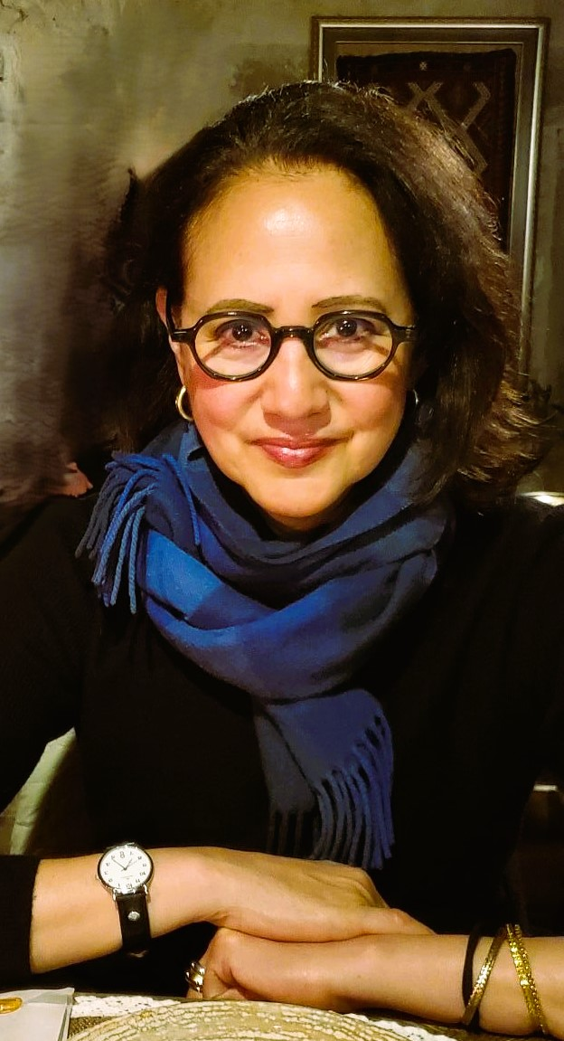
Moderator
Dr. Annabel Erulkar is Senior Associate in the International Programs Division of the Population Council, based in New York. Dr. Annabel is a globally recognized expert in marginalized girls and young women, focusing on girls at risk of child marriage, child domestic workers and migrant/trafficked girls and young women. Over the last nearly 30 years, she has worked in four of the Population Council’s Country Offices in Africa and established two of them: in Nigeria and Ethiopia. Prior to her current global role, she was Country Director for the Population Council’s Ethiopia Country office for 17 years

Slide 5

Speakers
Masturah Baba is the Technical Advisor for Adolescent Sexual Reproductive Health working on the MOMENTUM Country and Global Leadership – Violence against women and girls project in Nigeria. She has a decade of experience working in programmes that seek to improve outcomes for SRH, early adoption of Family planning, prevention and response to violence against women and girls - with focus on Child Early and Forced Marriages.

Slide 6
Exploring the intersection of child marriage with “Sexual and reproductive health and rights, and violence against women and girls” - focusing on Ebonyi and Sokoto States, Nigeria
Presenter: Masturah Baba
Advisor – Adolescent Sexual and Reproductive Health
USAID’s MOMENTUM Country and Global Leadership Project, Save the Children
CRANK Research Meeting – 27th November 2024

Slide 7




Project Overview
Goal: Prevent and mitigate consequences of violence against women and girls and address possible drivers of child early and forced marriage (CEFM) and promote early adoption of family planning (FP)
Objective 1
Objective 2
Objective 3
Objective 4
Build capacity of host-country institutions, local organizations, and providers to deliver evidence-based, quality GBV, CEFM and voluntary FP services
Increase access to and use of evidence-based, quality IPV, SV, CEFM and FP/RH information, services
Adaptive learning and use of evidence in GBV and CEFM programming
Facilitate cross-sectoral collaboration and innovative partnerships among state and non-state IPV, SV and CEFM organizations/institutions
Implementation Sites
Consortium Members
Ebonyi and Sokoto States in Nigeria, supporting 9 communities and 237 health facilities
Local Implementing Partners
Period of Implementation
Sokoto: (NANA, HHSGF, RUWOYD)
Ebonyi: (DOVENET, ECEWS, EHNRD)
October 2020 – September 2024
Notes:
Ebonyi State
Essential Health Network for Rural Dwellers (EHNRD)
Daughters of Virtue and Empowerment Initiative (DOVENET)
Excellence Community Education Welfare Scheme Ltd (ECEWS)
Sokoto State
Nana Girls and Women Empowerment Initiative (NANA)
Helping Hands and Grassroots Foundation (HHGF)
Rural Women and Youth Development (RUWOYD)

Slide 8
Technical Approaches
Formative Assessment Phase
Intervention Phase
Co-creation with stakeholders using findings of the formative assessments.
Design/adapt effective and promising evidence-based interventions to prevent GBV, CEFM, early adoption of FP.
Facilitate the coordination of local actors to respond to GBV with a multisectoral approach.
  Adjust implementation when needed using Collaborating, Learning, and Adapting (CLA) events to accelerate learnings. Implementation and monitoring led by the local partners.
  The Social Norms Exploration Tool (SNET)
  Behaviorally Focused- Applied Political Economy Analysis (BF-APEA)
  Integrated Technical Organizational Capacity Assessment (ITOCA) tool
GBV Services Provider Mapping
Notes:
Briefly highlight and move on in the interest of time – however the slides would be shared in a follow up communication from the CRANK.

Slide 9
Formative Assessment (using SNET and The 5 Why’s) Findings: Key social norms that influence CEFM and early adoption of FP in Ebonyi and Sokoto states
Key social norms influencing CEFM in Ebonyi
Girls should get married early to protect their chastity Girls should get married at onset of menstruation; they are considered as being ready for marriage Girls should agree to the marriage decisions taken by their parents Girls marry early because they have less economic value than boys.
Key social norms influencing CEFM in Sokoto
Girls are expected to be obedient to their parents’ choice and decisions to marry them off Girls should get married early to protect their chastity In some families, girls get married before the onset of menstruation Families marry their daughters off in early marriages to strengthen family ties (Auren zumunci) with relatives.
Key social norms impeding early adoption of FP in Ebonyi
Desire/preference for male child(ren) Fertility decisions are determined by husbands Desire for many children Young women will be labeled as promiscuous if they use FP
Key social norms impeding early adoption of FP in Sokoto
Fertility decisions are determined by husbands. Women are expected to seek permission from their husband before accessing FP Couples are expected to abide by traditional and religious beliefs of having many children Women are expected to begin childbearing early.
Notes:
Highlight common elements across the states – and one norm that differs.

Slide 10
Intervention Approaches
 | Approaches | Target population | Expected outcomes
Capacity development of local institutions | ITOCA/OPI Change Action Plans (CAP) | Local implementing organizations Ministries of Women Affairs Ministry of Health | Strengthen organizational performance Technical capacity to lead GBV programs Resource Mobilization and Business Sustainability
Multi-sectoral response and collaboration | Multi-sectoral task force (MSTF) teams at state and local government areas | Representatives of health, legal aid, courts, social support services, law enforcement, economic empowerment, and civil society organizations | Strengthen the multisectoral team or GBV taskforce to ensure a coordinated and multisectoral response to GBV prevention and response.
Community Interventions | Choices, Voices, Promises | Very young adolescents (VYA) (10-14 years) Parents and caregivers of VYAs Community members | Gender equitable attitudes and behaviors among VYAs, parents and caregivers and community norms
 | ASRH intervention | Married and unmarried older adolescent girls and boys 15-19 years | Improved SRH among adolescent girls and boys, and husbands of married adolescent girls
 | SASA Together | Men and women community members Young people | Understanding of men’s power over women as the root cause of violence against women Balance power in relationships
 | Uto Ezi Na Ulo/ and Ma’aurata Abun Koyi (Bandebehero) | Newly married couples less than 5 yrs in relationship | Improving couple's communication and relationship
 | Women Savings and Loans Clubs | Community women | Reduce women’s experiences of IPV particularly as it relates to socio-economic violence and increase women economic and financial empowerment,
Health Facility Intervention | GBV Screening, case identification and post GBV clinical care and PPFP counselling | Health facility users (OPD, ANC and FP clinics) | Improved GBV Screening and case management Improved health outcomes among GBV survivors Improved use of family planning
Notes:
Talk about the critical element, how the interventions complimented each other, the different targets and how it contributed to the success. Highlight briefly the ongoing CD for local partners.

Slide 11
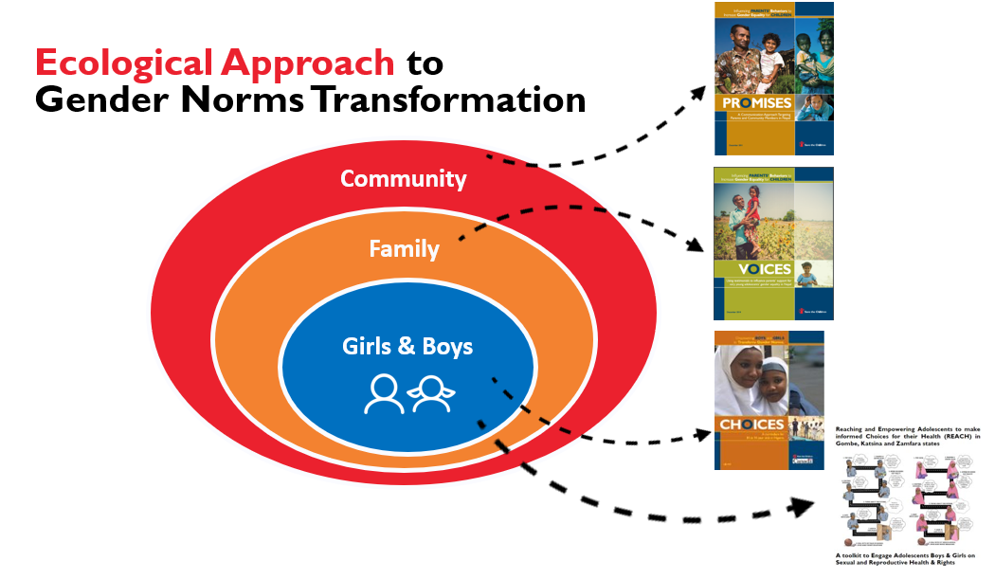
Why Choices, Voices, Promises and Adolescent Sexual and Reproductive Health Interventions?
Very young adolescence (ages 10-14) is an ideal opportunity to strengthen positive, gender equitable, and healthy attitudes before more harmful ones take root.
Older adolescents (ages 15 – 19) go through puberty and transition to adulthood, they increasingly experience the constraints and expectations of gender inequality.
Choices, Voices, and Promises, and the ASRH intervention provided adolescents with:
Safe spaces to reflect on gender norms and their hopes and dreams, promotion of agency and practice critical life skills.
A supportive family and community environment that equally supports adolescents and provides positive role models.
Notes:
Choices and ASRH - Critical reflection and discussions on gender equity, hopes and dreams, and for older adolescents, SRH and life skills
Voices: Promoting gender equitable division of household tasks, Supporting girls and boys to respect and value each other by not displaying anger in harmful ways
Promises: Allowing girls to attend school until age 18 and committing to delaying their daughter’s marriage, Bringing hope equally to VYA daughters and sons

Slide 12
Intervention Details
Details | Sokoto | Ebonyi
7 mixed facilitated sessions and 3 sex segregated
Interactive small group conversations, experiential learning, games, songs, role plays drawings/illustrations, take how exercises
7 mixed facilitated sessions and 3 sex segregated
Interactive small group conversations, experiential learning, games, songs, role plays drawings/illustrations, take how exercises
Choices – using a curriculum
Sex segregated facilitated sessions for parents of VYA
Dialogue forum and experiential learning
Mixed sex facilitated sessions for parents of VYA
Dialogue forum and experiential learning
Voices – using video testimonials
Mixed facilitated sessions with mothers and fathers led by a community leader
Activism
Community celebration and public pledges
Mixed facilitated sessions with mothers and fathers led by a community leader
Activism
Community celebration and public pledges
Promises – using posters
Sex segregated sessions for Married adolescent girls and their husbands
Interactive small group conversations, experiential learning, one-on-one engagement, role plays group activity and take how exercises
Sex segregated sessions for unmarried adolescent girls and boys
Interactive small group conversations, experiential learning, one-on-one engagement, role plays group activity and take how exercises
ASRH - using curriculum
Notes:
Just highlight
Participants were retained through out the intervention – enablers included the interactive methodologies, aligning session days/time to the participants schedules, and the provision of refreshements.

Slide 13
Results
Notes:
Throughout the implementation period, MOMENTUM supported the local partners to utilize qualitative adaptive management methods to reflect on implementation experiences, document learnings, and adjust intervention activities using programmatic results.

Slide 14
Total Reach: Choices Voices, Promises and Adolescent Sexual and Reproductive Health Interventions
Cumulatively 2,814 people were reached
15 (8 girls and 7 boys) mainstreamed back to school in Sokoto
281 parents pledged to ensure their daughters stay in school and at least complete secondary school education
Ongoing arrangement for CEFM stopped 8 girls in Sokoto and Ebonyi
Notes:
Talk briefly on the effectiveness, what contributed to the success and what didn’t work well.

Slide 15
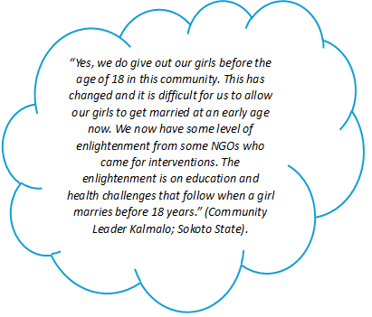
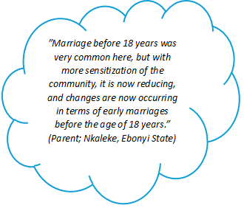
Changed Perceptions on CEFM in Ebonyi and Sokoto
Ebonyi
Varying feedback received with respect to not getting married before 18 years old – with majority in support of delaying child marriage, however, some resistance persists. Parents of adolescent girls, religious leaders, community leaders and members support girls to delay marriage until they reach 18 years.
Sokoto
Respondents shared that prior to the interventions, many believed that it was against their religion for a girl to reach 18 years and not be married, however, things are changing now. Families now support their daughters to complete their education before getting married.

Slide 16
Adolescents and Youth Counseled on Postpartum Family Planning @RMNCH Service Points
Strategies
Trainings
Outreach
Norms Shifting Sessions
Counselling
Linkage to Service Provision
Cumulative no. of Y/A counseled: 25,815
Notes:
Highlight the intervention focused on bridging knowledge gap and provided linkages for uptake of services for SRH and FP. However, the lack of availability of commodities didn’t lead to much uptake by adolescents and young people.
Norm shifting session focused mainly on adolescent & young people, leaving out parents/community members out of the conversation

Slide 17
Changed Perceptions on Early Adoption of FP Amongst Adolescents in Ebonyi and Sokoto
Increased knowledge around sexual and reproductive health, and information on modern FP methods. The project achieved 31% (against the target of 40%) of our target participants who perceive positive norms (able to speak up and discuss) related to the use of FP/RH services. A few male ASRH participants in Ebonyi still are not supportive of FP use. “I thought family planning was harmful but now my knowledge has increased. I am now aware that family planning is of great benefit to the health of the mother.” – ASRH participant
Notes:
This cuts across diverse groups of adolescents – married together with their husbands, unmarried, in-school and out-of-school in Ebonyi and Sokoto.
largely due to their religious beliefs as they believe it’s God that gives children and should not be stopped halfway.

Slide 18
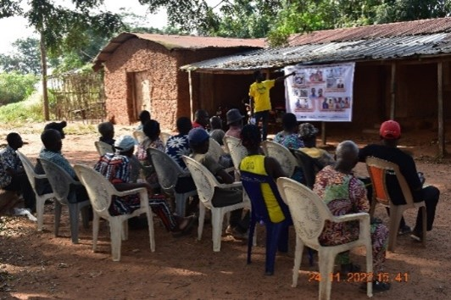
What Worked
Community-based facilitators were crucial: Having prior experience in community education and familiarity with the context led to greater success and enhanced sustainability.
Continues capacity strengthening and linkages to pathways (multi-sectoral response team, referrals, educational institutes, etc.)
Utilizing life stage and age-appropriate toolkits and safe spaces promoted deeper reflection and discussion among adolescent participants.
Advocacy message centered on the potential of the girl child and principles of safeguarding as an entry point eased community acceptance – this opened avenues to address CEFM and ASRH
Working with local actors/implementing partners with standing relationship with key stakeholders and target communities.

Slide 19
Challenges
Resistance to change – deep rooted norms take time to shift and therefore the need to consider adequate resources for implementation and sustainability
Working in hard to reach and insecure locations affected programming
Context mapping – Integrating SRH to programming required skilled facilitator. Some communities we worked with in Sokoto lacked healthcare workers to facilitate the sessions, this required extra ongoing support and supervision beyond what was initially planned, limiting uptake of services for adolescents.

Slide 20
Future considerations
CVP and ASRH can be integrated into other programmes, likewise individual components can be implemented alone or paired (e.g., Choices and Promises, or Choices and ASRH, as the case may be.
Form partnerships, especially educational institutions and response taskforce (safety planning) right from the planning phase, especially as girls start to experiment and voice out their rights.
Be flexible and open to adapting as you implement – the curriculum, the approach, while still ensuring fidelity.
Adopting a multi-sectoral approach yield greater benefits and outcomes
Notes:
Adopting a multi-sectoral approach to yield greater benefits and outcomes - A positive, unintended outcome of the interventions was increased school enrolment and retention of in school and out of school adolescent girls and boys. The local partner organizations and community based facilitators worked with schoolteachers and relevant governmental education entities to facilitate the return of out-of-school adolescents into formal education. This required several consultations and coordination between the local partner organizations and government officials. Working with the education sector to integrate content from the Choices intervention into the formal curriculum and in-school club activities can lead to addressing harmful gendered behaviors and attitudes before they are ingrained and expand reach. In addition, collaborating with other sectors including health and youth development to deliver more integrated programming to strengthen linkages with quality SRH information and FP services as well as livelihood opportunities could yield better outcomes and opportunities for scale-up through government investment and support.

Slide 21
THANK YOU
This presentation is made possible by the generous support of the American people through the U.S. Agency for International Development (USAID) under the terms of the Cooperative Agreement #7200AA20CA00002, led by Jhpiego and partners. The contents are the responsibility of MOMENTUM Country and Global Leadership and do not necessarily reflect the views of USAID or the United States Government.

Slide 22
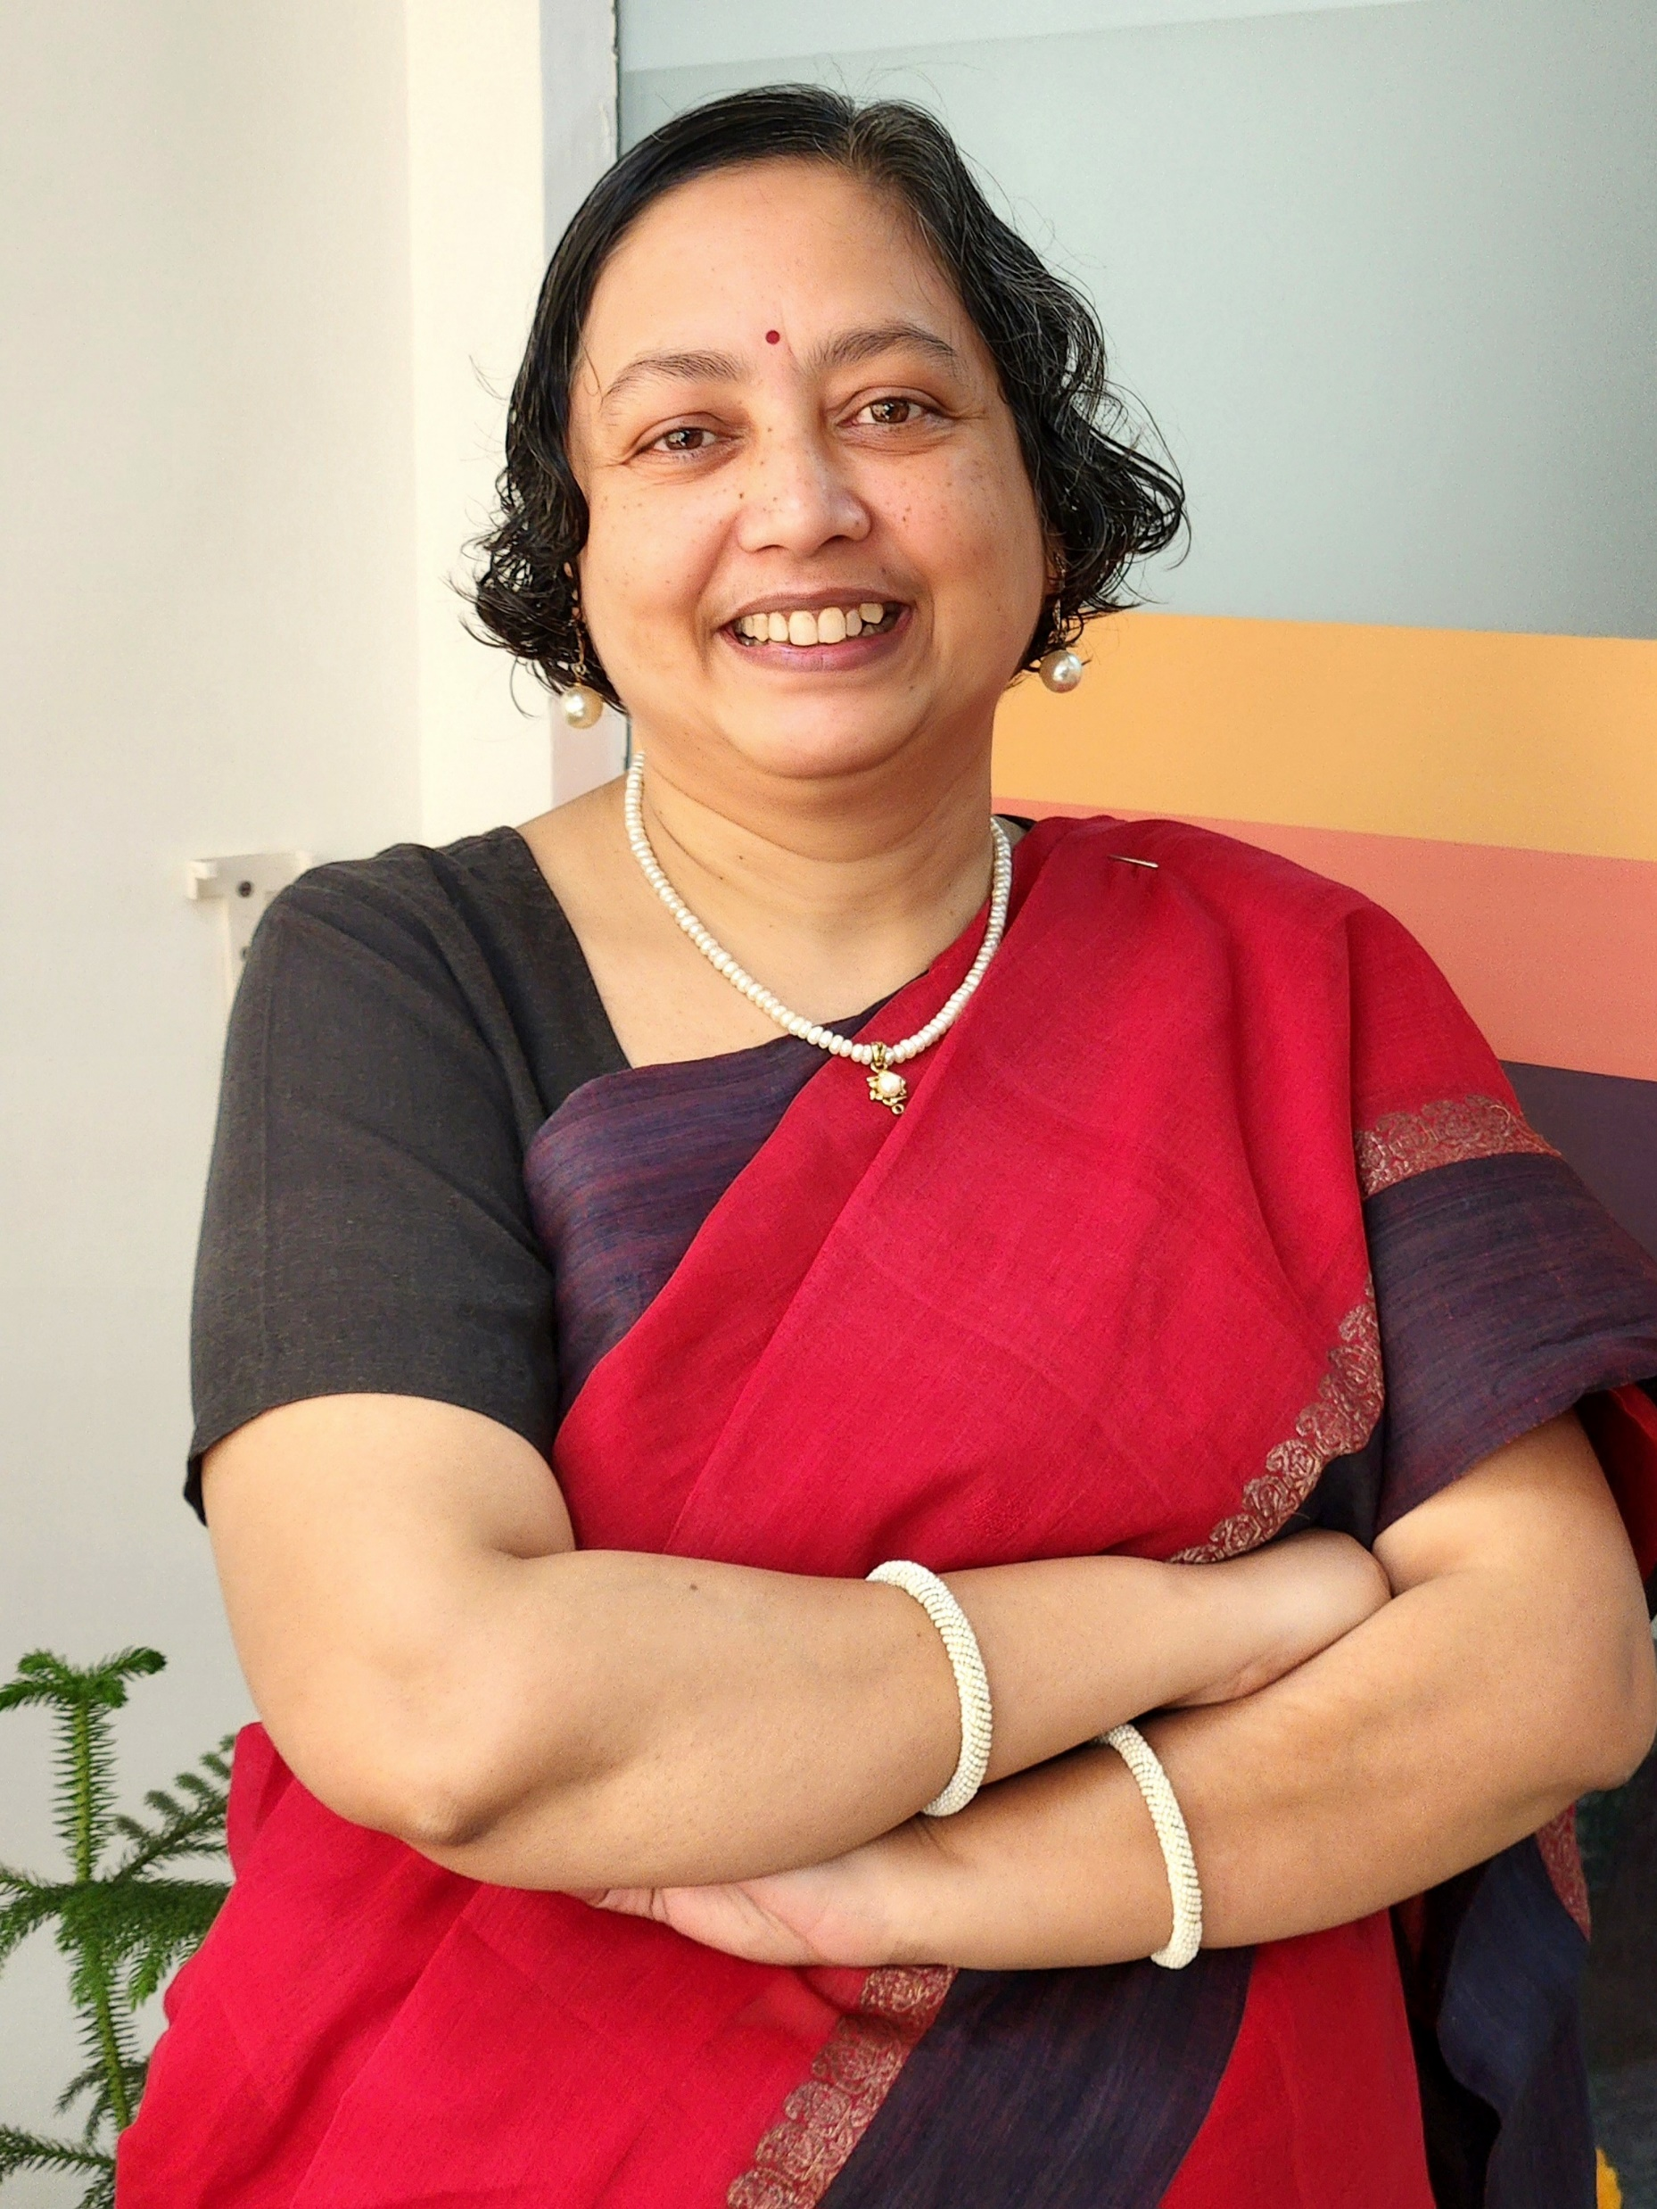
Speakers
Sushmita Mukherjee is a gender and development expert working across different women and girls’ empowerment issues for over 25 years. She has led multiple research and implementation initiatives across Asia and Africa contributing towards identifying solutions for women, girls and youth empowerment. Currently, she leads the Gender DEI and Social Norms work with PCI in India. She also leads the Social Norms and Agency Learning Collaborative – a south Asian platform to learn and share about shifting regressive norms for gender equality and equity.

Slide 23
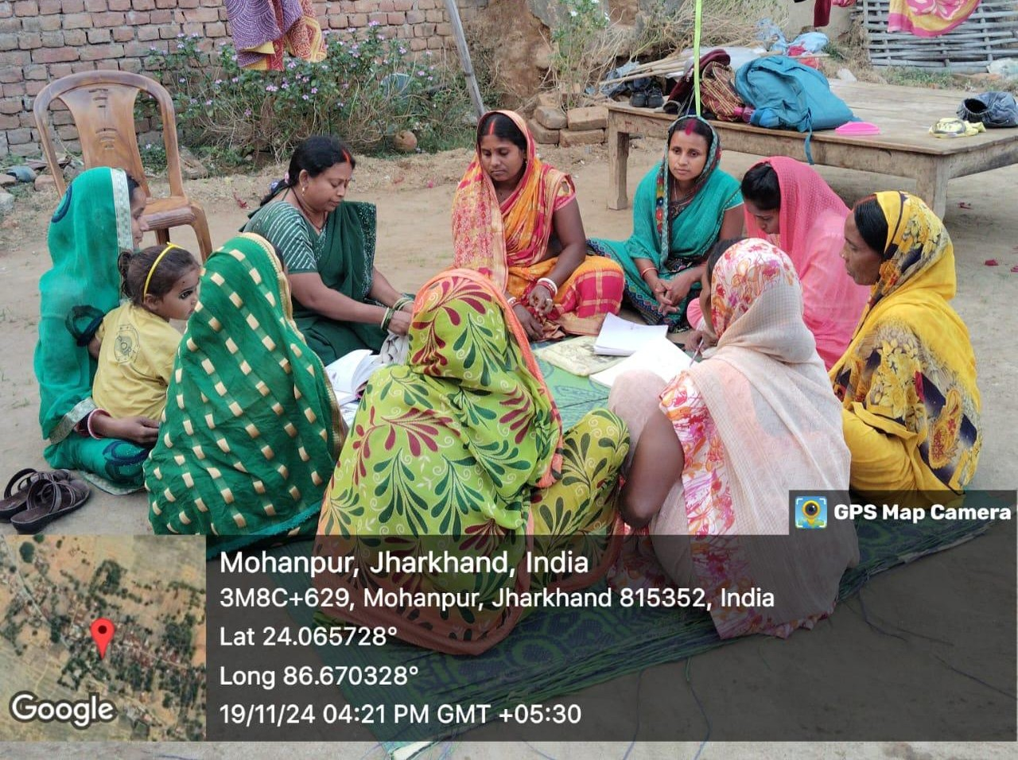

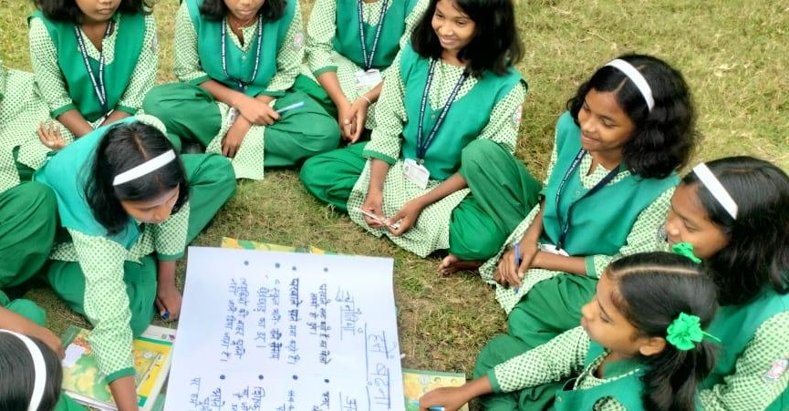
The intersections of child marriage: Strengthening holistic and cross-sectoral solutions
Social norms, pathways to education and scale
Focusing on rural India
By: Sushmita Mukherjee
PCI India
1

Slide 24
Project Umang Background
Normative challenges for mothers and collective groups
Women are less expected to be part of marriage related decision-making
Women are expected to agree to the marriage related suggestions of other family members/relatives
Women are expected to agree to any match proposed
to their daughters (pressure of dowry)
Women are pressured to not raise issues which can cause conflict with men at community or household level
Mothers are expected to teach daughters household chores and be ready for marriage
Mothers expected to get daughters educated only
enough to read, write and support in any family work
Women are expected to care, obey and bear all violence to maintain marriage and family
Social stigma and social penalties (for girls and parents) of stopping any marriage
Social stigma against interfering in cultural practices
of different castes
Early marriage seen as helping to safeguard family honour (protecting girls from harassment and elopement)
Lack of awareness of child marriage / child protection laws
Lack of awareness of legal or systemic processes to
stop CEFM

Slide 25
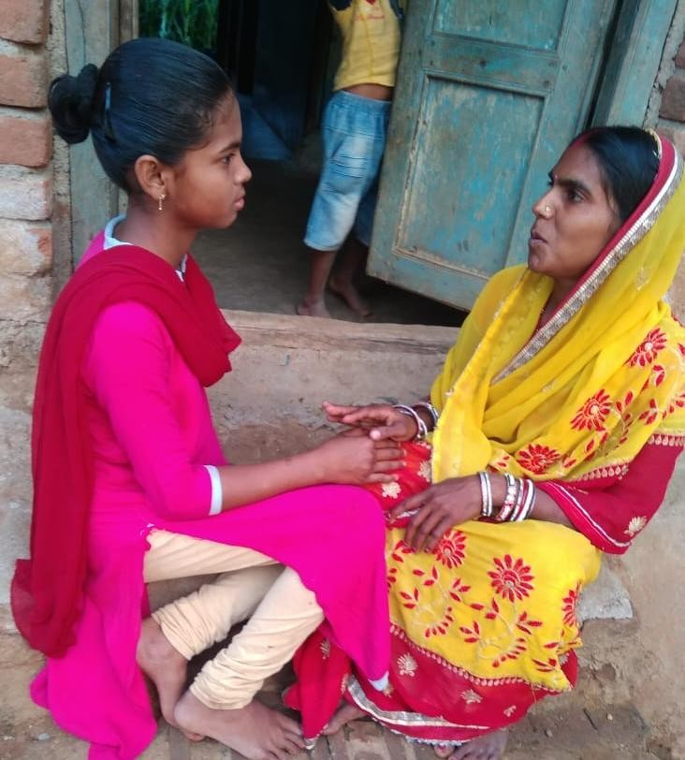
Formative Research
Harnessing the Mother-Daughter Relationship
Mothers are the closest to their adolescent daughters among all family members.
Daughters consider mothers as their first guide s
friend inside families.
Most women (current mothers of adolescent girls) are survivors of child/early marriage themselves.
Joint decision-making at household level needs to be leveraged to expand women’s participation in the process with strengthened agency, voice and skills

Slide 26
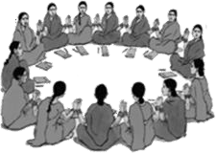
Formative Research
Women’s Collectives and Self-Help Group Structure
Potential to support inter-generational transmission of empowerment
from mothers to daughters through existing structures
CLFs
5-40 VOs
Village Organisations (VOs) 5-20 SHGs
Self Help Groups (SHGs) 10-20 Women
Capacitating Women’s Collectives (most members also happen to be mothers of adolescent girls)
Government of India
3-tiered Institutional Structure of SHGs

Slide 27
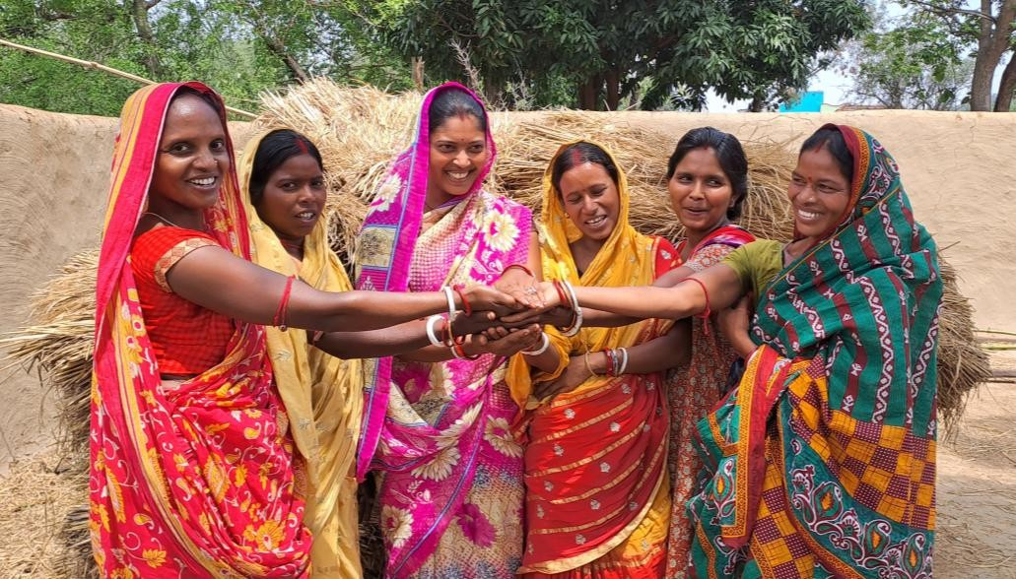
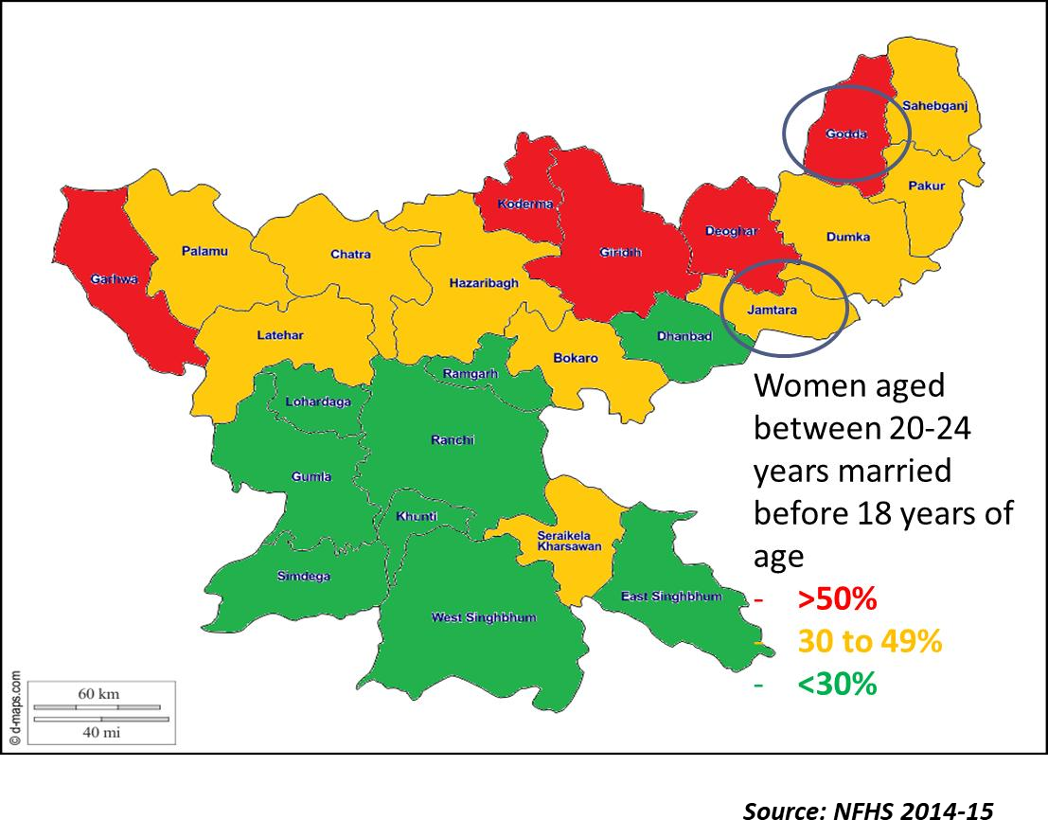
Project Umang Objectives and Design
Objectives
Capacitate women collectives to create a supporting environment s encourage adolescent girls to expand and achieve their educational aspirations
Establish a scalable s sustainable model for addressing child/early marriage through SHG platform
Partnership
Developed by PCI India and Global Communities
Implemented in partnership with the Government of
Jharkhand State Livelihoods Promotion Society (JSLPS)
Phases
Pilot: Oct 2016 – Mar 2023
One block in each of Godda & Jamtara Districts
District Saturation: Jan 2022 - June 2024
Six blocks in Godda & five in Jamtara

Slide 28
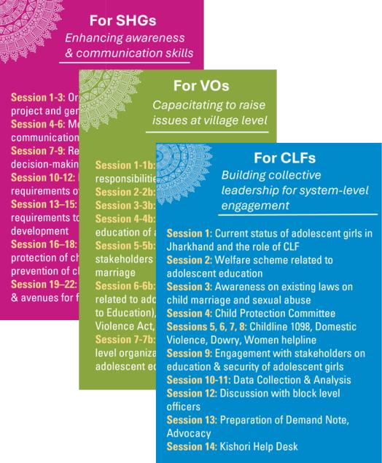
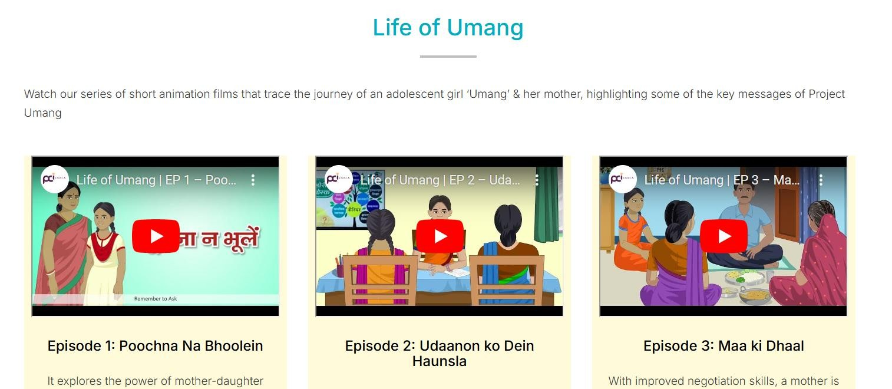
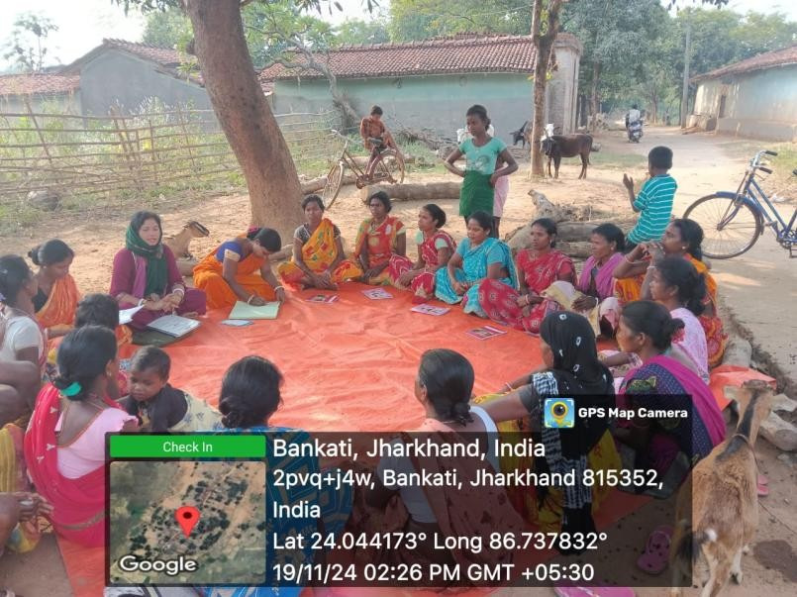
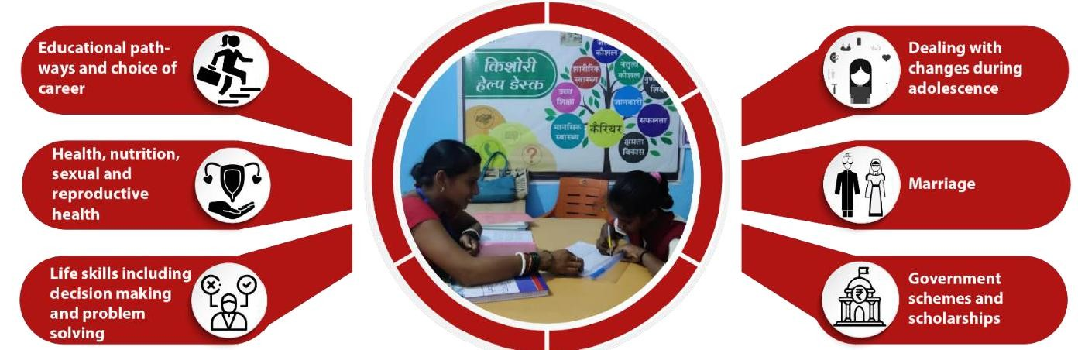
Umang Intervention Design
Edutainment sessions with SHG members
Leadership sessions with women leaders
Career Counseling for Adolescent
Girls and their parents
Weekly SHG sessions

Slide 29

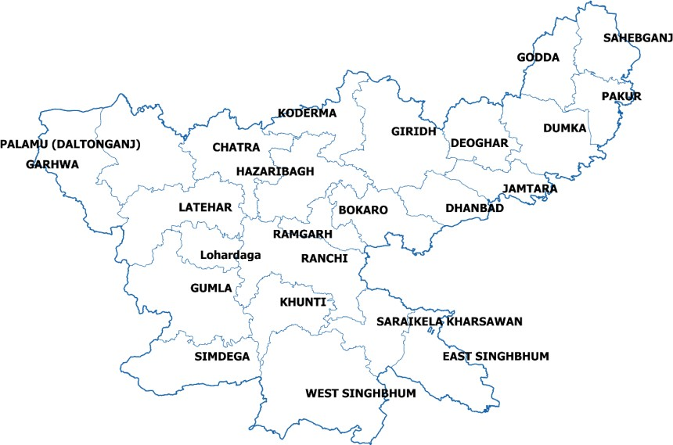

Evaluation Design and Methodology
Study Area (for baseline and endline)
Study Geography (for baseline and endline)
Quantitative Survey carried out in 100
randomly selected villages in each round
Jharkhand Map
Godda district
Godda Sadar block
Jamtara district
Nala block
64 villages in Godda Sadar block
36 villages in Nala block
Four eligible pairs of mothers and daughters selected from each sampled village
Methodology
Data Collection Duration
Representative cross- sectional survey
Pre-Post design
Dyad approach
Quantitative Survey:
Baseline: 395 pairs of
mothers & daughters
Endline: 400 pairs
Baseline - Feb to Mar 2021 Endline – Feb to Mar 2023

Slide 30
Results:
Knowledge and Attitudes to Marriage
Attitudes towards Child Marriage: Average Score
13.5
13.2
12.8
12.6
Mothers*
Daughters
* p<0.05
Baseline Endline
17 indictors were included for both mothers and daughters
Score ranges from 0-17. Higher score indicates more egalitarian view
N - Baseline 395, Endline 400 Mothers
N – Baseline 264, Endline 313 Daughters

Slide 31
Results:
Daughters’ Agency to Resist Child/Early Marriage
Aspirations for getting married after 18 years of age: Desired vs. Real Expectation
GG.2%
100.0%
G4.G%
N=258
N=244
N=276
77.0%
N=296
* p<0.05
Desired Expectation
Real Expectation*
Baseline
Endline
The rising aspirations and conviction seem to stem either from increased awareness, agency and self-efficacy among girls or increased support from their mothers, who are the direct beneficiaries of PCI Umang project.

Slide 32
Educational Aspirations among Daughters
Desired vs Real Expectations
25% increase in number of girls expressing confidence that they will be able to fulfil this aspiration
11.5% increase in girls who aspire to
study at least up to 12th standard.
Educational aspirations among girls to study at least up to 12th grade and/or above
87%
78%
75%
60%
* p<0.05
Desired Expectation*
Baseline Endline
Real Expectation*
Barriers to educational aspirations: Expenses - 34% in endline (41% in baseline); Marriage pressure - 15% in endline
(22% in baseline). Other barriers include long distance of schools, no permission from parents
N=Baseline 373, Endline 375

Slide 33
Results:
Mothers’ Support to Daughters in Education
Percentage distribution of mothers who chose higher education over marriage, physical safety & employment for their daughters
Percentage distribution of mothers by preference for
their daughters’ education at least up to 12th grade
88%
87%
80.5%
74%
*p<0.05
Baseline
Endline*
Baseline
Endline*
Interestingly, reservation among mothers against sending their daughters for higher studies (fearing that this will delay their age of marriage) has come down from 17% in baseline to 12% in endline
N=Baseline 395, Endline 400

Slide 34
Learnings & Recommendations (1/2)
Counselling - Stronger focus needs to be on prioritising girls’ education as a valid, long-term alternative to child/early marriage. Realising the glaring gaps in aspirations for education & career among girls, there needs to be a strategic emphasis on educational & career counselling (especially on start early counselling from 6th grade onwards).
Gender Norms - Project Umang has proven a gradual shift among mothers towards positive gender norms. As the focus in pilot phase has primarily been on child/early marriage, hence there is a proven shift on this issue. Similarly, more areas of concern on gender norms can be targeted during scale-up.
Mother-daughter Bond – Enriching the conversations & relationship between mothers and daughters has proven to be significant strategy in enhancing voice & space for daughters’ concerns at household level. This can be extended towards engagement of sons as well and improved influence of mothers in shaping more egalitarian gender norms among sons.

Slide 35
Learnings & Recommendations (2/2)
Scaling up the Umang model in other districts with similar context: Considering the intensity of the issue around child/early marriage in the state, replicating the Umang model in areas with high prevalence will be especially impactful. The feasibility of integrating the intervention with SHGs, which are present across the state, will help in its statewide expansion.
Engaging community leaders and influencers: Gaining the support of faith and community leaders is essential for promoting messages against child/early marriage. To accelerate progress, engaging men in the initiative can further amplify its reach and effectiveness. Engage more with gatekeepers and influencers to receive their support towards shifting away from the norm
Leveraging SHGs to address other social norms and forms of gender-based violence (GBV): Women’s collectives and networks, such as India’s SHGs, hold immense potential to support scalable inter-generational (mother/daughter) social and gender transformation in the community and are well poised to lead norm- shifting interventions in a sustained manner. The approach can be expanded to tackle other forms of GBV, including violence in public spaces and institutions.
13

Slide 36
Implications and opportunities for strengthening cross-sectoral solutions
Partnership with JSLPS (Govt of Jharkhand) from the very beginning ensured that the intervention model is implementable through government structure and thereby is replicable across the state.
Partnership with JSLPS ensured that we checked the strengths and weaknesses of the channels of working and ensured the rigour of the model and its measurement accordingly.
Partnership with JSLPS helped us to engage with other departments including district
administration, education and child welfare.
The multi-sectoral engagement enabled us to work on policy implementation aspects including enhancing access to school education for dropouts, access to social protection schemes and other child protection options.
This has resulted in state-wide replication of the Umang model by JSLPS and more engagement with administration at state and below levels for intensive implementation of policy measures in a convergence mode.
14

Slide 37
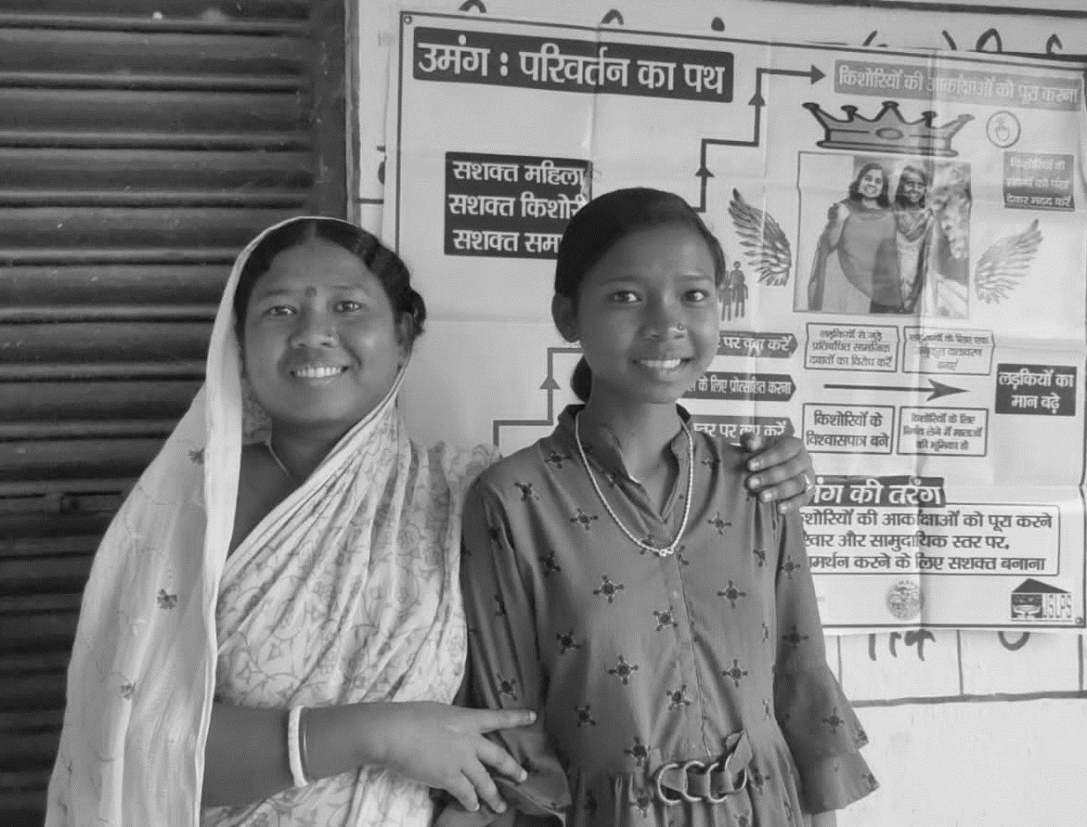

https://umang.pcidigitals.in
THANKS
Sushmita Mukherjee smukherjee@pciglobal.in
15

Slide 38

Speakers
LynnMarie Sardinha is a Technical Officer on Violence Against Women Data and Measurement at the World Health Organization, Geneva. She leads the work on the global, regional and national prevalence estimates on violence against women and girls and on strengthening the survey measurement on forms of violence and population groups where gaps remain. Previously LynnMarie has led several large-scale studies on violence against women and gender norms in low-and middle-income countries and on the health sector response to violence against women in India and the UK.

Slide 39

Intimate partner violence against adolescent girls:
Prevalence and country-level correlates
LynnMarie Sardinha, PhD
Department of Sexual and Reproductive Health and Research
sardinhal@who.int

Slide 40
Violence against women – particularly intimate partner violence and sexual violence – is a major public health problem and a violation of women's human rights
nearly
On average
1 in 3
736 million
women
and up to 852 million women who were aged 15 years or older in 2018,
have experienced physical
and/or sexual intimate partner violence or non-partner sexual violence in their lifetime.
Most of this violence is intimate partner violence
Notes:
Magnitude and consequences VAW - health

Slide 41
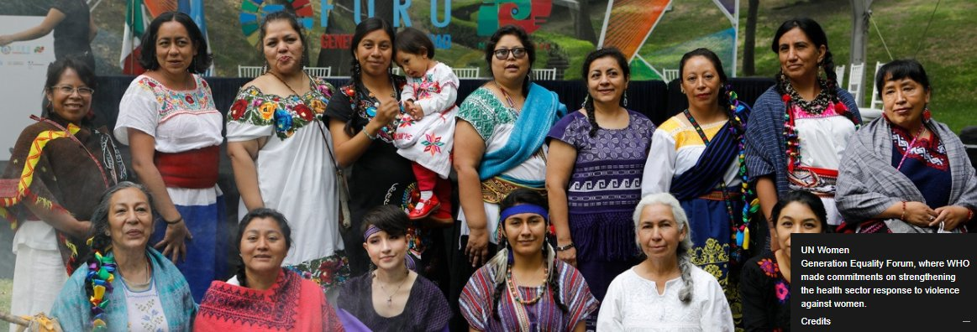


Indicators for SDG Target 5.2
Elimination of all forms of violence against women and girls in the public and private spheres, including trafficking and sexual and other types of exploitation
Indicator 5.2.1: Proportion of ever-partnered women and girls aged 15 years and older subjected to physical, sexual or psychological violence by a current or former intimate partner in the previous 12 months, by form of violence and by age
Indicator 5.2.2: Proportion of women and girls aged 15 years and older subjected to sexual violence by persons other than an intimate partner in the previous 12 months, by age and place

Slide 42
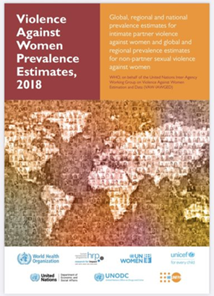
Study objectives
To present the regional and national lifetime and past-year prevalence estimates of physical or sexual violence by male intimate partners against adolescent girls (aged 15–19 years)
To examine the association of country-level economic, social, and political factors, including the prevalence of child marriage, with the lifetime and past year prevalence of intimate partner violence

Slide 43

Methods: Outcome and explanatory variables
Macro/country-level contextual variables
Educational and employment factors
  Primary; secondary; and tertiary education
  Female labour force participation
Economic factors
  World Bank income groups; GDP; GINI index
Legislative factors: Women’s economic rights
  Equal inheritance rights; equal property ownership rights for men and women
Legislative factors: Domestic violence laws
  Protection order; criminalization of martial rape
Harmful practice: Child Marriage
  Outcome variables
  Lifetime prevalence of physical and/or sexual intimate partner violence
  Past 12 months prevalence of physical and/or sexual intimate partner violence

Slide 44
Methods: Global Database on the Prevalence of Violence Against Women
Search strategy
  Comprehensive and systematic review electronic databases
  Searches of national and international meta-data repositories
  Microdata analyses from over 90 Demographic and Health Surveys
  (WHO mandated formal country consultations)
  Country-level data for the selected contextual variables drew on specialised topic-specific meta-databases and metadata repositories
Study inclusion criteria
Population-based studies representative at the national or sub-national level
Conducted between 2000 and 2024
Used acts-based measures of violence
Quality, completeness, and cross-national comparability of data
2018 (or closest year) country-level data on the associated factors

Slide 45

Data availability on prevalence of intimate partner violence and country-level explanatory factors
154 countries and areas have survey data on the lifetime prevalence of intimate partner violence
159 countries and areas have eligible survey data on the past 12 months prevalence of intimate partner violence
101 countries (lifetime prevalence) and 105 countries (past-year prevalence) for which country-level metadata were available

Slide 46

Summary of statistical analyses
  To achieve comparability across time, countries, and regions, national data were adjusted using robust statistical methods.
  Use of a Bayesian multilevel modelling framework with five nested levels: (i) individual studies, (ii) countries, (iii) regions, (iv) super regions and (v) the world.
  Multivariable linear regression methods were used to examine contextual social, economic, and political factors associated with intimate partner violence against adolescent girls
  Statistical software: SPSS (version 23), STATA (version 16), and R packages

Slide 47
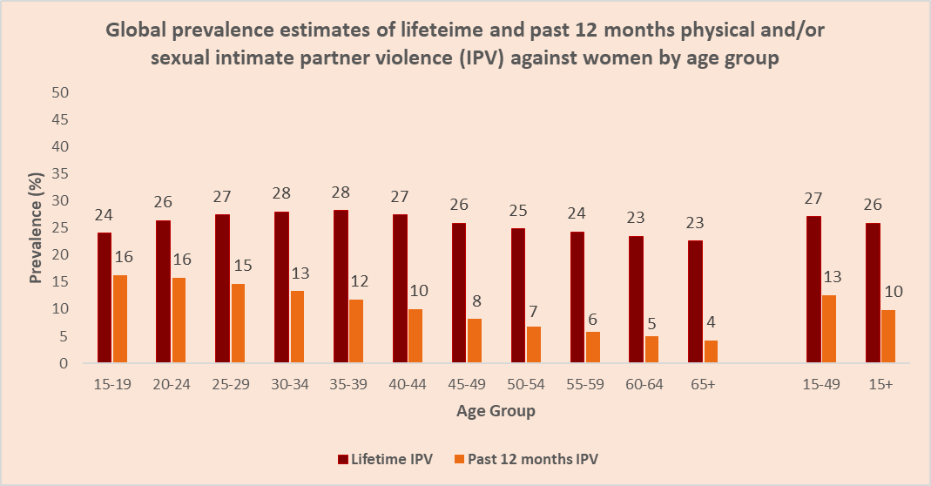

Slide 48

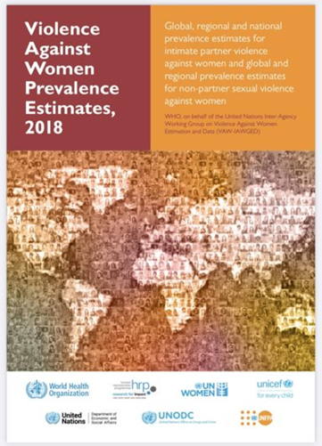
Global prevalence estimates of physical and/or sexual intimate partner: Violence starts early in the life of girls
Almost 1 in 4
16%
of young women
aged 15–24 experienced this violence within the past 12 months.
ever-married/partnered adolescent girls in the youngest age cohort (15–19 years old) is estimated to have already been subjected to physical and/or sexual violence from an intimate partner at least once in their lifetime (24%, UI 21–28%), and
Almost
19 million

Slide 49
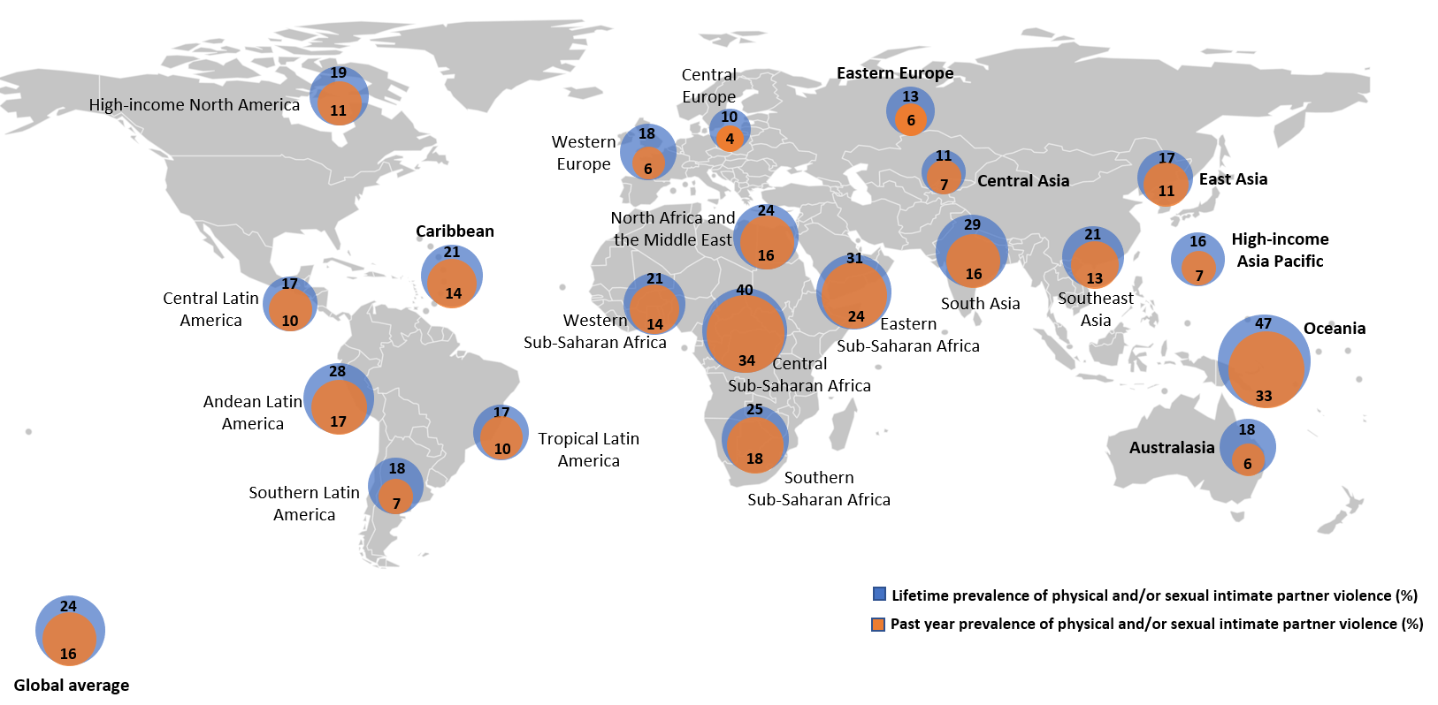
Regional prevalence estimates of intimate partner violence against adolescent girls aged 15-19

Slide 50
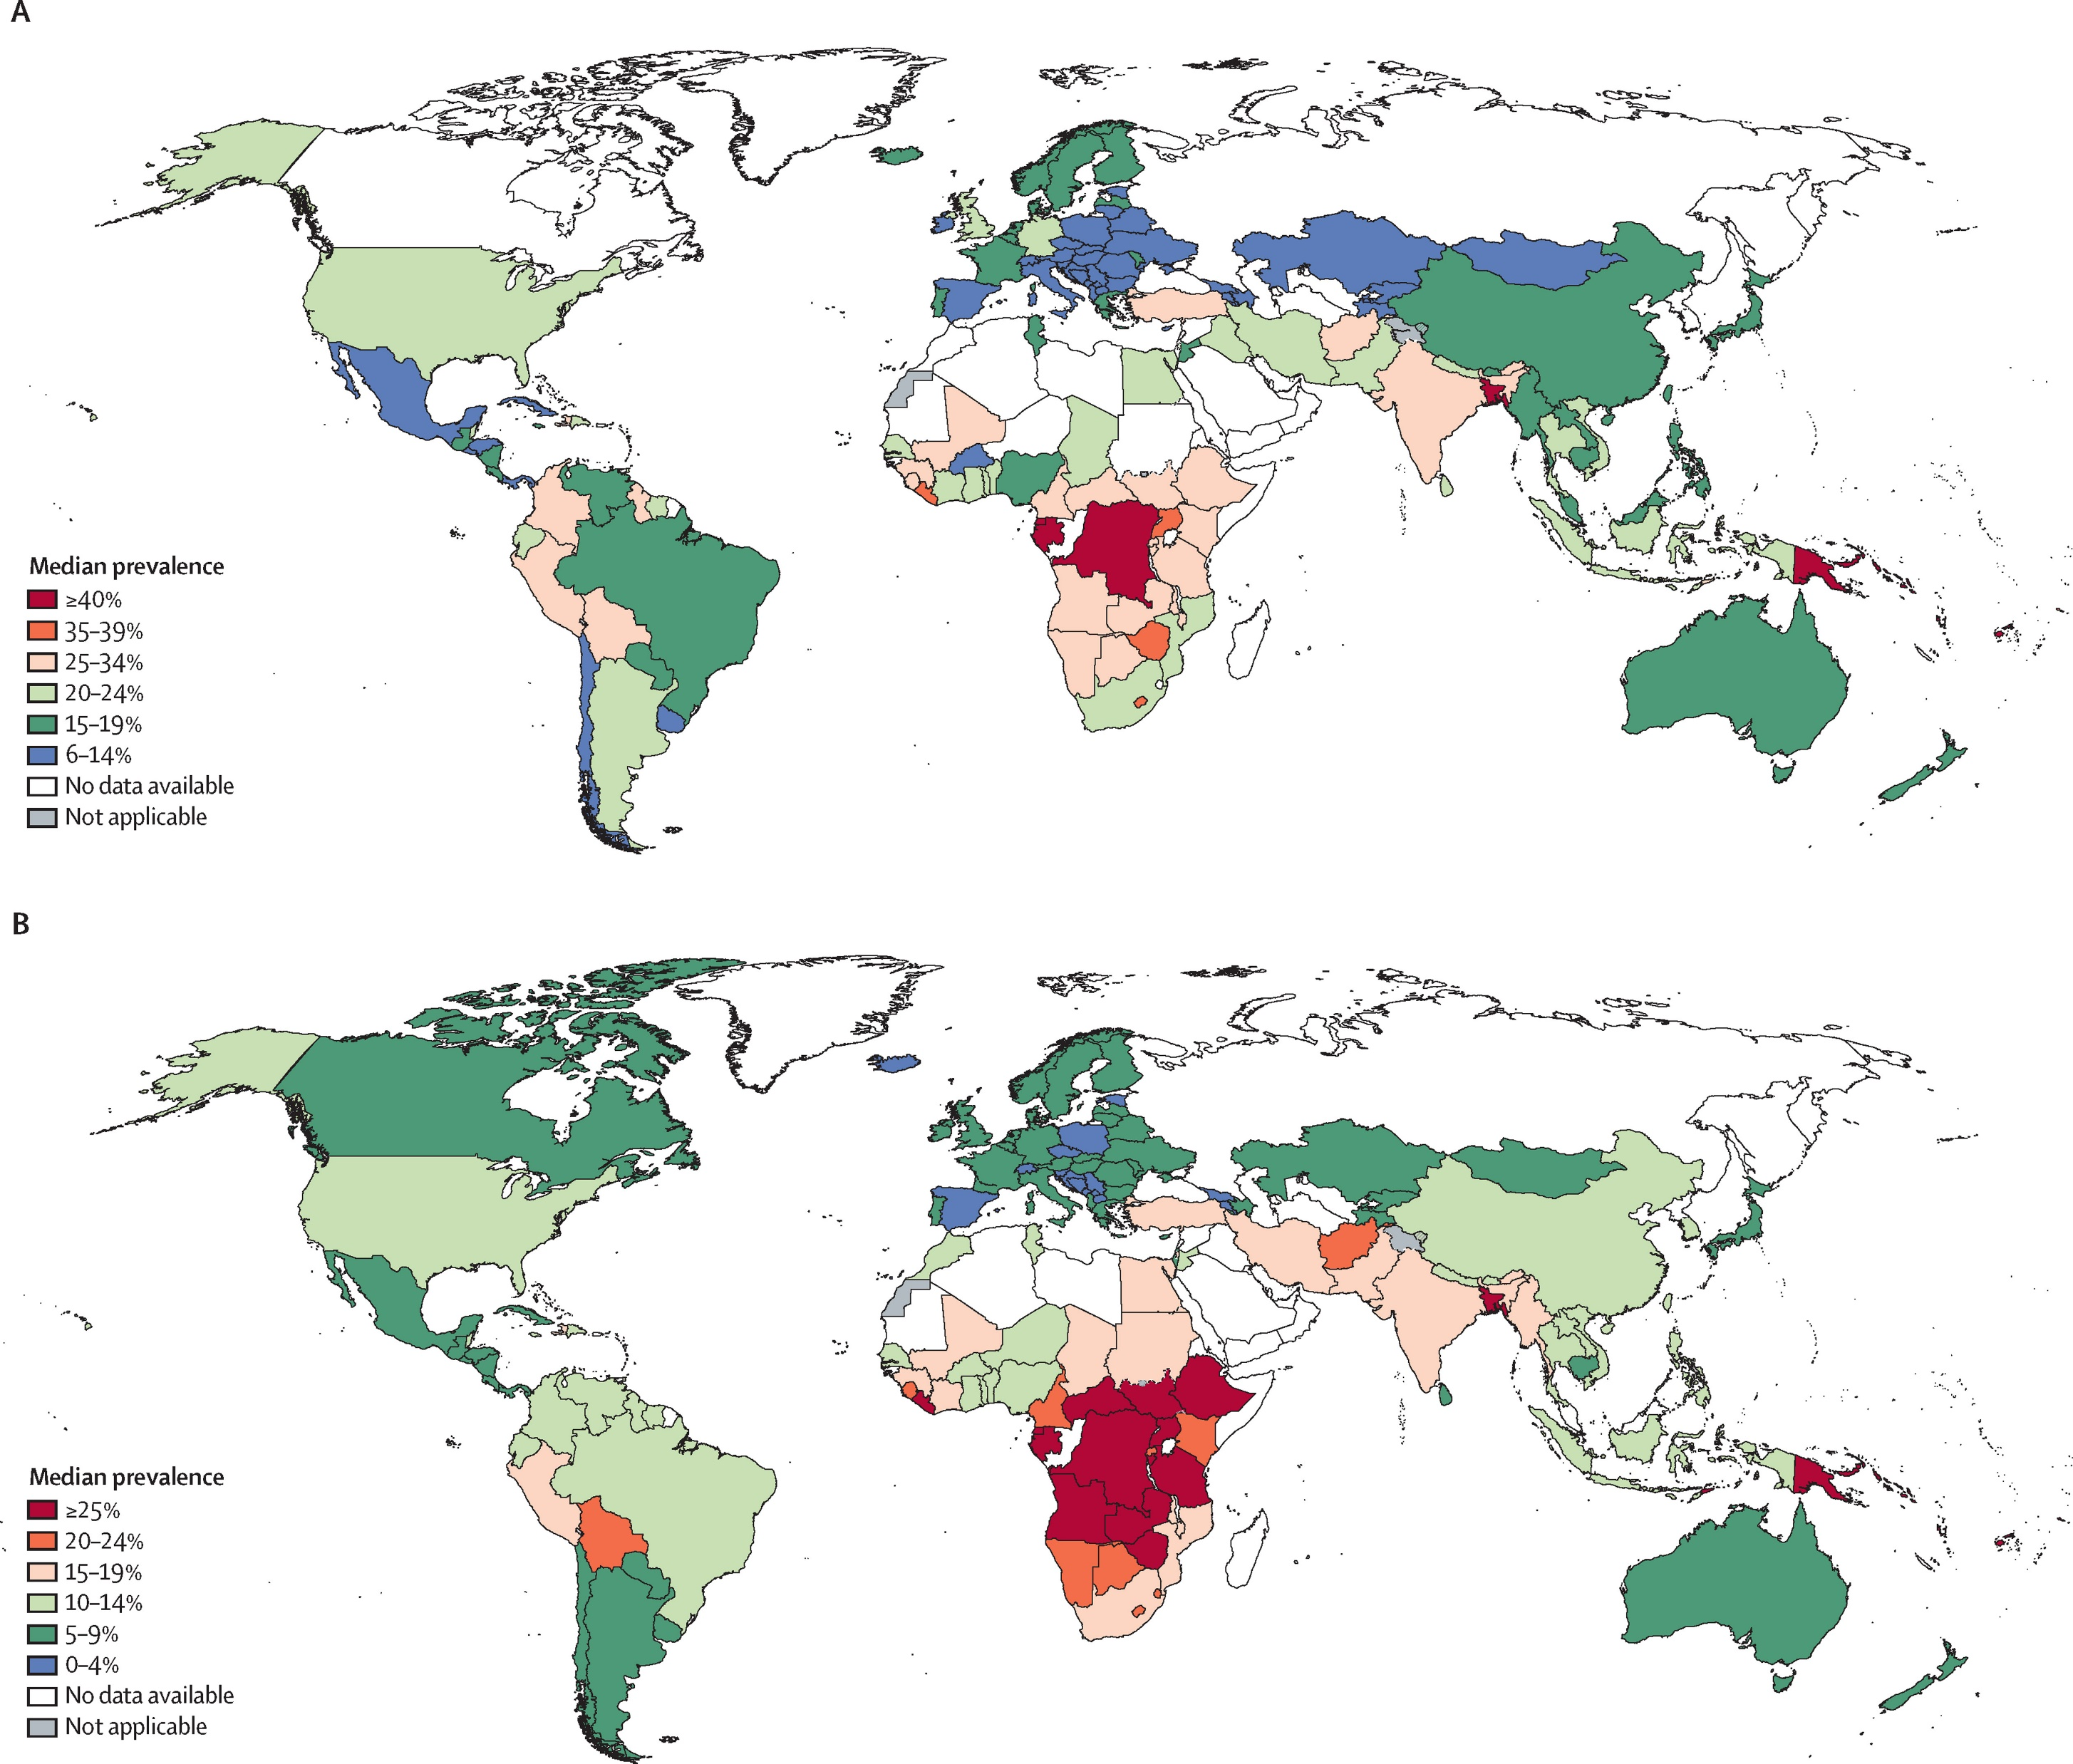


Lifetime and past 12 months prevalence of intimate partner violence against adolescent girls aged 15-19
Lifetime prevalence of intimate partner violence
Past 12 months prevalence of intimate partner violence

Slide 51

Country-level/contextual factors associated with intimate partner violence against adolescent girls
Adolescent girls in lower-income countries and regions (and regions affected by conflict) are disproportionately affected
A higher prevalence of child marriage was associated with a higher prevalence of both lifetime and past-year intimate partner violence against adolescent girls
Proportion of female enrolment in secondary education in a country had the strongest association with both lifetime and past year prevalence of intimate partner violence against adolescent girls
Equal property rights for women and men, was associated with lower lifetime and past-year prevalence of intimate partner violence against adolescent girls

Slide 52

Child marriage and increased risk of intimate partner violence against adolescent girls/intersections
Prevalence of child marriage decreasing but continues to be widespread
  Underpinned by the same inequitable gender norms that perpetuate violence against women and girls and other harmful practices
  Exacerbates power imbalances and increases economic and social dependency (school drop-out, pregnancy, motherhood and domestic responsibilities)
  Barrier to adolescent girls leaving abusive relationships and adolescent girls who leave violent relationships may be at risk of violence from persons other than partners

Slide 53

Violence against women and girls is preventable!
Requires action at multiple levels and across different sectors
Implement, invest in and strengthen inter-sectoral programmes and policies that:
combat and prevent child marriage and support girls who are married before age 18 years in safely leaving abusive relationships
expand educational opportunity that support girls’ secondary and higher education
protect and promote gender equality and economic rights including inheritance/property rights for women

Slide 54

Violence against women and girls is preventable!
Challenge discriminatory gender norms and attitudes at all levels of society including:
  acceptability of violence against women and girls
  norms that perpetuate the practice of child marriage (schools-based, community- based, community groups);
  comprehensive sexuality education
Support and scale-up prevention programs
Scale and invest in support service
Support autonomous women’s and community organizations
Strengthening data and measurement

Slide 55
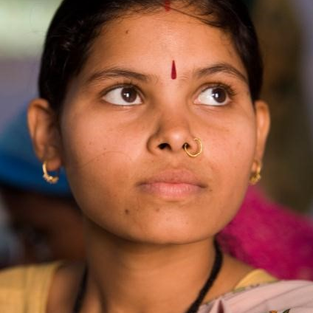
Recommendations for future research
Subnational analyses and identify modifiable drivers that can be targeted at local levels to reduce intimate partner violence among adolescent girls and child marriage
Robustly assess the effect of multilevel risk and protective factors, pathways, and causal mechanisms that can inform the development of more nuanced evidence-based prevention and response policy and programming to intimate partner violence and harmful practices like child marriage
Tracking trajectories and longitudinal research
Evaluation of community-level interventions and appropriate, context-based scale-up of what works

Slide 56

https://srhr.org/vaw-data

Slide 57
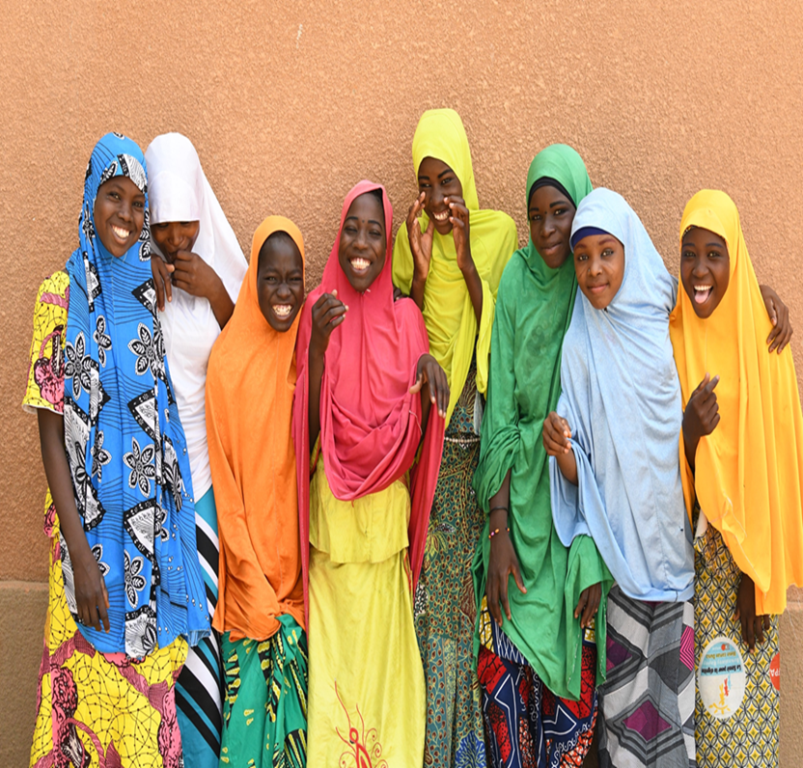
GRACIAS!
MERCI!
Thank you!
धन्यवाद!

Slide 58
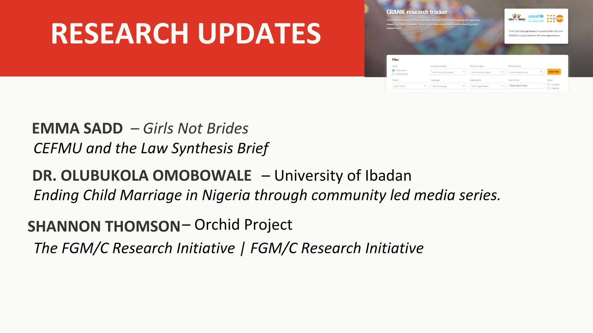
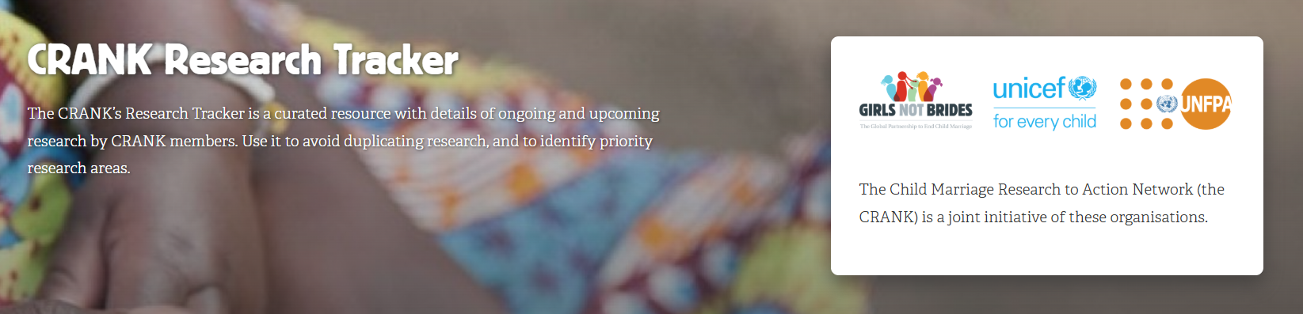
RESEARCH UPDATES
CRANK members: please share your research updates in the chat & submit your research to the CRANK Research Tracker
Ramya Subrahmanian, Accelerating evidence-based action to end child marriage, envisioning a way forward
LynneMarie Sardinha, WHO Guidelines: preventing child marriage & improving access to contraception for adolescents

Slide 59
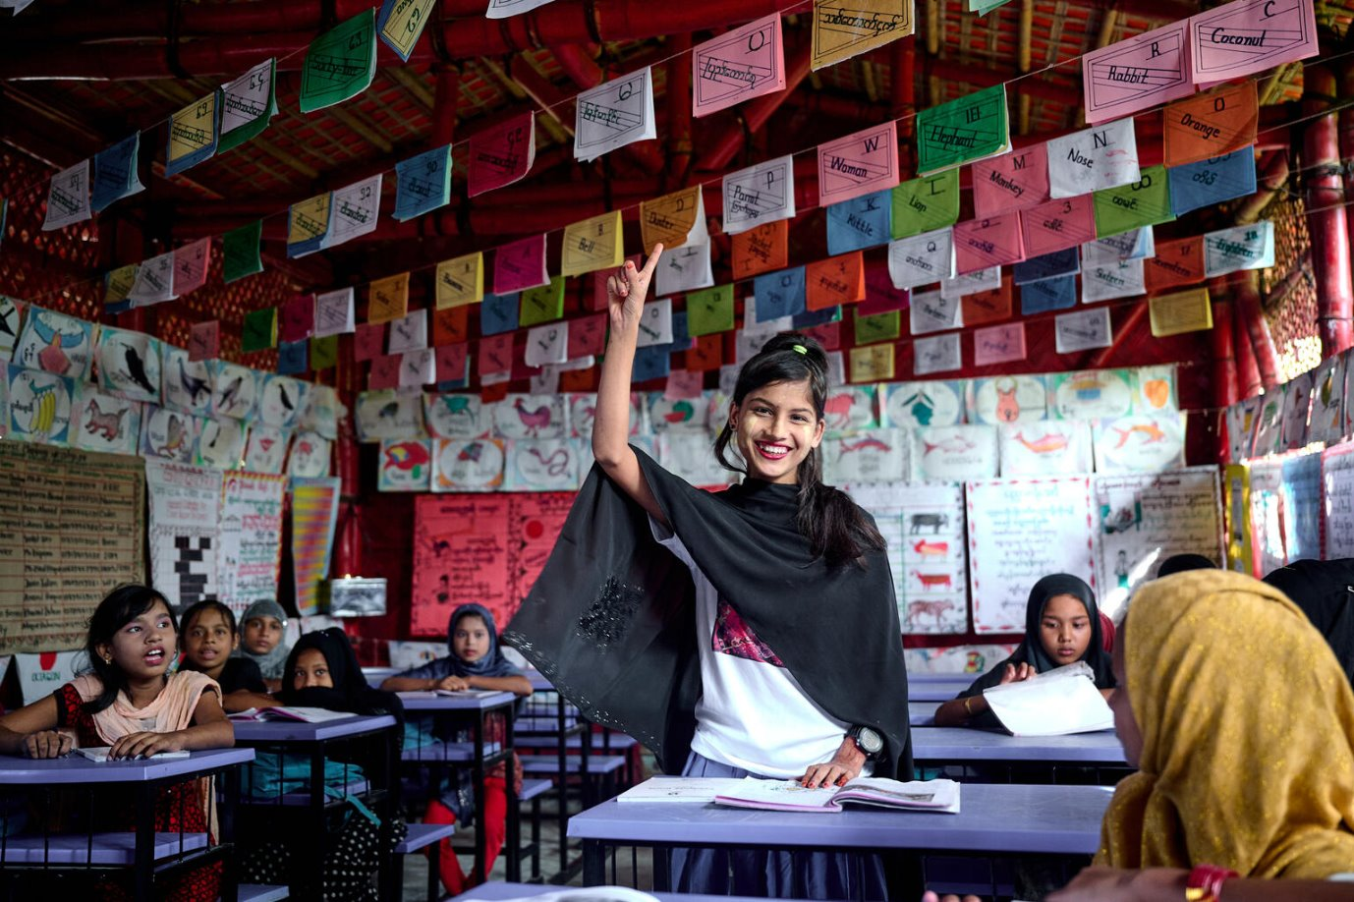

Accelerating Evidence-Based Action to End Child Marriage
ENVISIONING A PROCESS AND WAY FORWARD
SVRI Forum 2024
Cape Town, South Africa

Slide 60
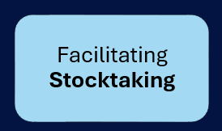
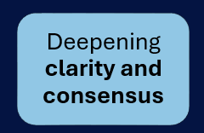
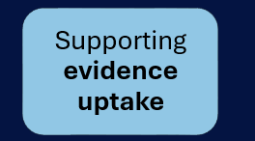
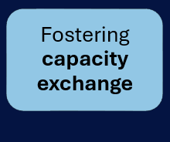
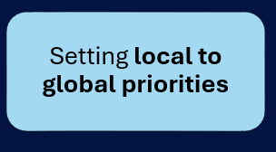
Evidence to Action: Objectives of a process
Notes:
Stock-taking: Assess progress in achieving 2019 child marriage research priorities – how well did we do?
Targeted evidence uptake: Continue to promote the sharing and application of evidence on what works, with a targeted focus on key decision-makers who have the power and influence to drive results at scale (e.g., policymakers, donors). Leverage local, national, regional, and global partnerships to strengthen the engagement of policymakers, practitioners, and civil society for the uptake of evidence. Additionally, it promotes the integration of child marriage evidence across sectors, including within our in child marriage evidence ecosystem.
Local-to-Global Priority-Setting: Promote an inclusive and participatory process for a global-south led evidence agenda-setting process to define research needs, priorities, and progress across a wide range of evidence users at the country, regional, and global levels
Capacity-exchange: Strengthen skills and awareness across child marriage field including amongst resea

Slide 61




Guiding principles
Ensure an inclusive & participatory process, deepen strategic, equitable and meaningful engagement across stakeholder groups
Foster equitable partnerships, with a focus on Global South leadership
Focus on accelerated action (prevention and response) with a focus on targeting geographies where there are the most gaps
Embrace pragmatism and strengthen synergies, including leveraging existing research and opportunities
Notes:
(including amongst groups that have been marginalized, including adolescent girls, pregnant and married adolescents, divorced and widowed girls, girls and women with disabilities and LGBTQIA+ people)

Slide 62
Strategy
1
Take stock of available evidence, identify gaps and map upcoming research
2
Identify priorities for evidence that will have catalytic and multiplier effects in ending child marriage through stakeholder outreach
3
Strengthen regional and country-level engagement for translating evidence into strategy and action
Notes:
1. Inventory and synthesis of research agendas, and existing research of relevant groups and institutions ​
​
Series of expert group meetings on each specified theme to identify gaps and priorities across areas of child marriage and FGM research, also integrating the use of several-stage Delphi technique
2. Broad consultations with regional and country-level SDG 5.3 stakeholders including research institutions​
​
Clear, transparent, objectively measurable priority ranking exercise​
3. Cross stakeholder in person meetings to review state of evidence, take stock of child marriage progress and gaps based on available data and evidence, and identify priorities for acceleration and hence evidence that will support.

Slide 63




Proposed Process
KICKSTARTING CONSULTATIONS
Oct 2024 – SVRI Consultation
Feedback and inputs
IDENTIFY PRIORITIES
Global survey
Stock taking exercises
REGIONAL AND NATIONAL-LEVEL ENGAGEMENT
Crowdsourcing
Region-specific evidence generation and uptake agendas
RENEWED PRIORITIES AND AGENDA FOR EVIDENCE TO ACTION
Global convening
Launch of evidence agenda

Slide 64
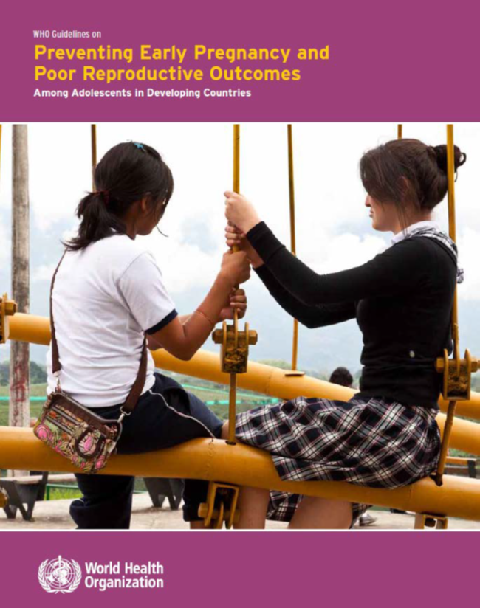
LAUNCH of WHO Guidelines on preventing child marriage and caring for married adolescents and improving access to contraception among adolescents in January 2025

